Slide 1


des.sc.gov/WaterSC

Slide 2
The Charge for WaterSC Executive Order No. 2024-22
Balance the State’s economic, environmental, and social needs;
Ensure the reliability, resiliency, sustainability, and sufficiency of the State’s water resources for all existing and future uses, while simultaneously protecting the environment; and
Support and facilitate additional collaboration with ongoing efforts and existing initiatives.

Slide 3
WaterSC Guiding Principles
"Water is a shared resource with shared responsibility"
A collaborative approach to develop and implement a science-based actionable plan
A plan that balances economic, environmental and community needs
A plan that secures reliable and resilient water resources for the future
3

Slide 4
The WaterSC Working Group: Stakeholder Engagement Plan
Have a statewide resource-focused approach
Remain committed to the process
Serve as a voice and connection for stakeholder sectors and categories
Provide transparency
Be collaborative and solution-focused
Resource
State
Sector

Slide 5
The Charge for WaterSC Executive Order No. 2024-22
Stakeholder Engagement Plan October 31, 2024
Quarterly updates to the Surface Water Study Committee
Advise on updated State Water Plan December 31, 2025

Slide 6
The WaterSC Working Group: Decision Making Process
Make decisions by consensus
All Members can “live with” a decision.
Built through interest-based negotiation to satisfy basic interests of all the Members.
If consensus is unlikely after good-faith negotiation, Chair will allow for majority vote
The opposing viewpoint will be documented
Who and/or what industries approved/opposed will also be documented
Notes:
From PPAC Framework (which was adopted for WaterSC in June Working Meeting)

Slide 7
Topic: Continued Support of Water Planning
Recommendation #1: The State of South Carolina should continue this working group beyond the State Water Plan updating process, and should continue to support ongoing state water planning.
Recommendation #2: SCDES should request and encourage the Legislature to continue funding for state water planning activities, including planning, administration, data collection and research and grants for implementation of water projects.
Recommendation #3: SCDES should also pursue additional funding sources or opportunities from both public and private sectors.

Slide 8
Topics: Interstate/Multi-state Water Management Strategies & Needs for Education and Outreach
Recommendation #4: Thes State of South Carolina should increase coordination with Georgia and North Carolina on inter-state water management strategies and shared water resources.
Recommendation #5: Develop and implement an intentional Education and Outreach Communication Plan on efficiency of water usage throughout the State.

Slide 9
Action Items
Invite SCDES Office of General Council to coordinate with others and share updates on the current state of water reuse in SC and possible strategies to inform further discussions at an upcoming WaterSC Working Session.
Recommend SCDES convene a sub-group of legal and technical experts to discuss differing opinions of the agency's authority/lack of authority to make decisions related to reasonable use. Small group will report back on progress and findings at an upcoming WaterSC Working Session.
Invite SCDNR State Climatologist, Dr. Hope Mizzell, to attend the September WaterSC Working Session to inform the work group's discussion on possible improvements and coordination between the SC Drought Management Act and the SC Surface Water Withdrawal Act.

Slide 10

Today's Agenda
Leading the Charge for WaterSC
Drought Response Discussion & Recommendations
Beneficial Water Reuse
Report from the Legal Working Group
State Water Plan Progress & Discussions
Review Recommendations & Next Steps
Lunch is provided for members of WaterSC

Slide 11
des.sc.gov/WaterSC

Slide 12
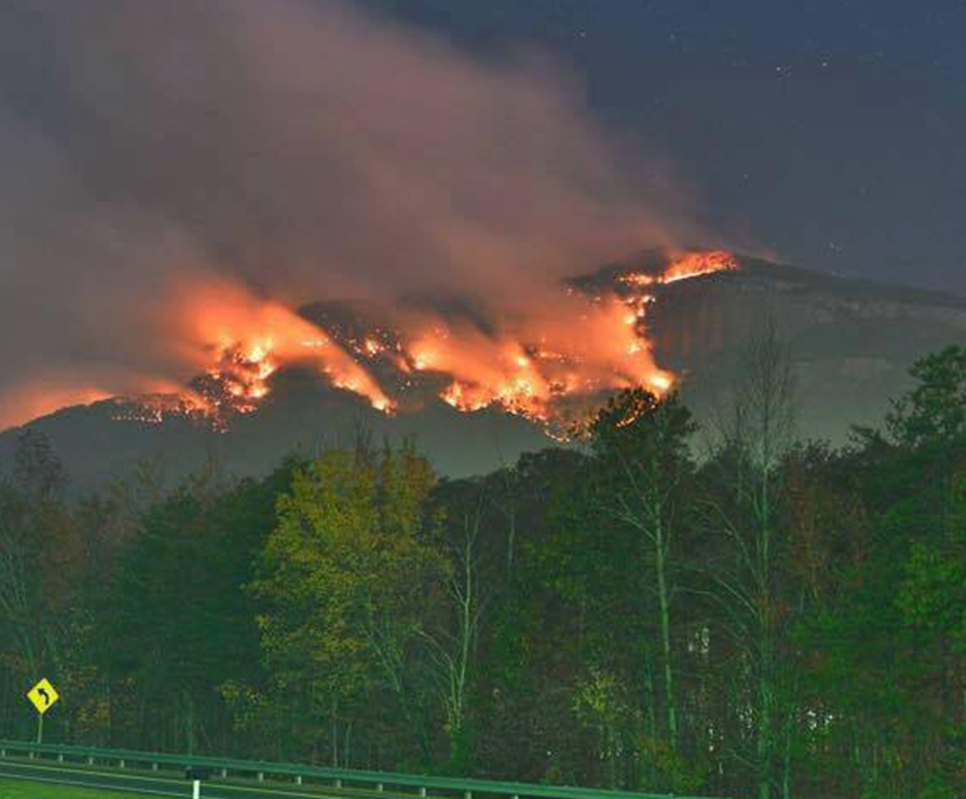
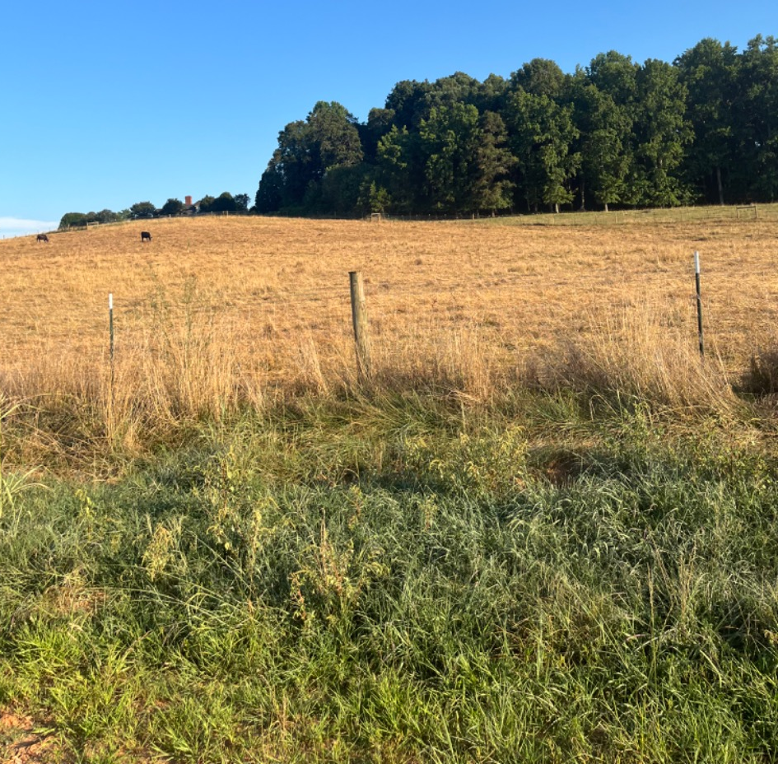
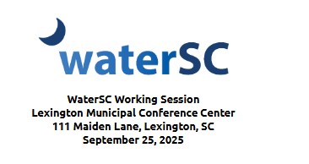
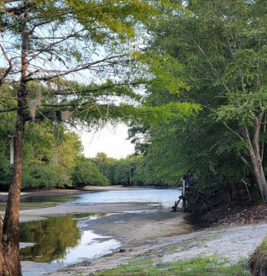
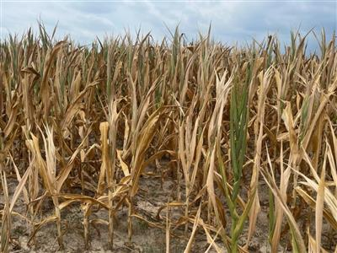

Drought Response Discussion and Recommendations
Hope Mizzell , Ph.D.
South Carolina State Climatologist
Department of Natural Resources

Slide 13
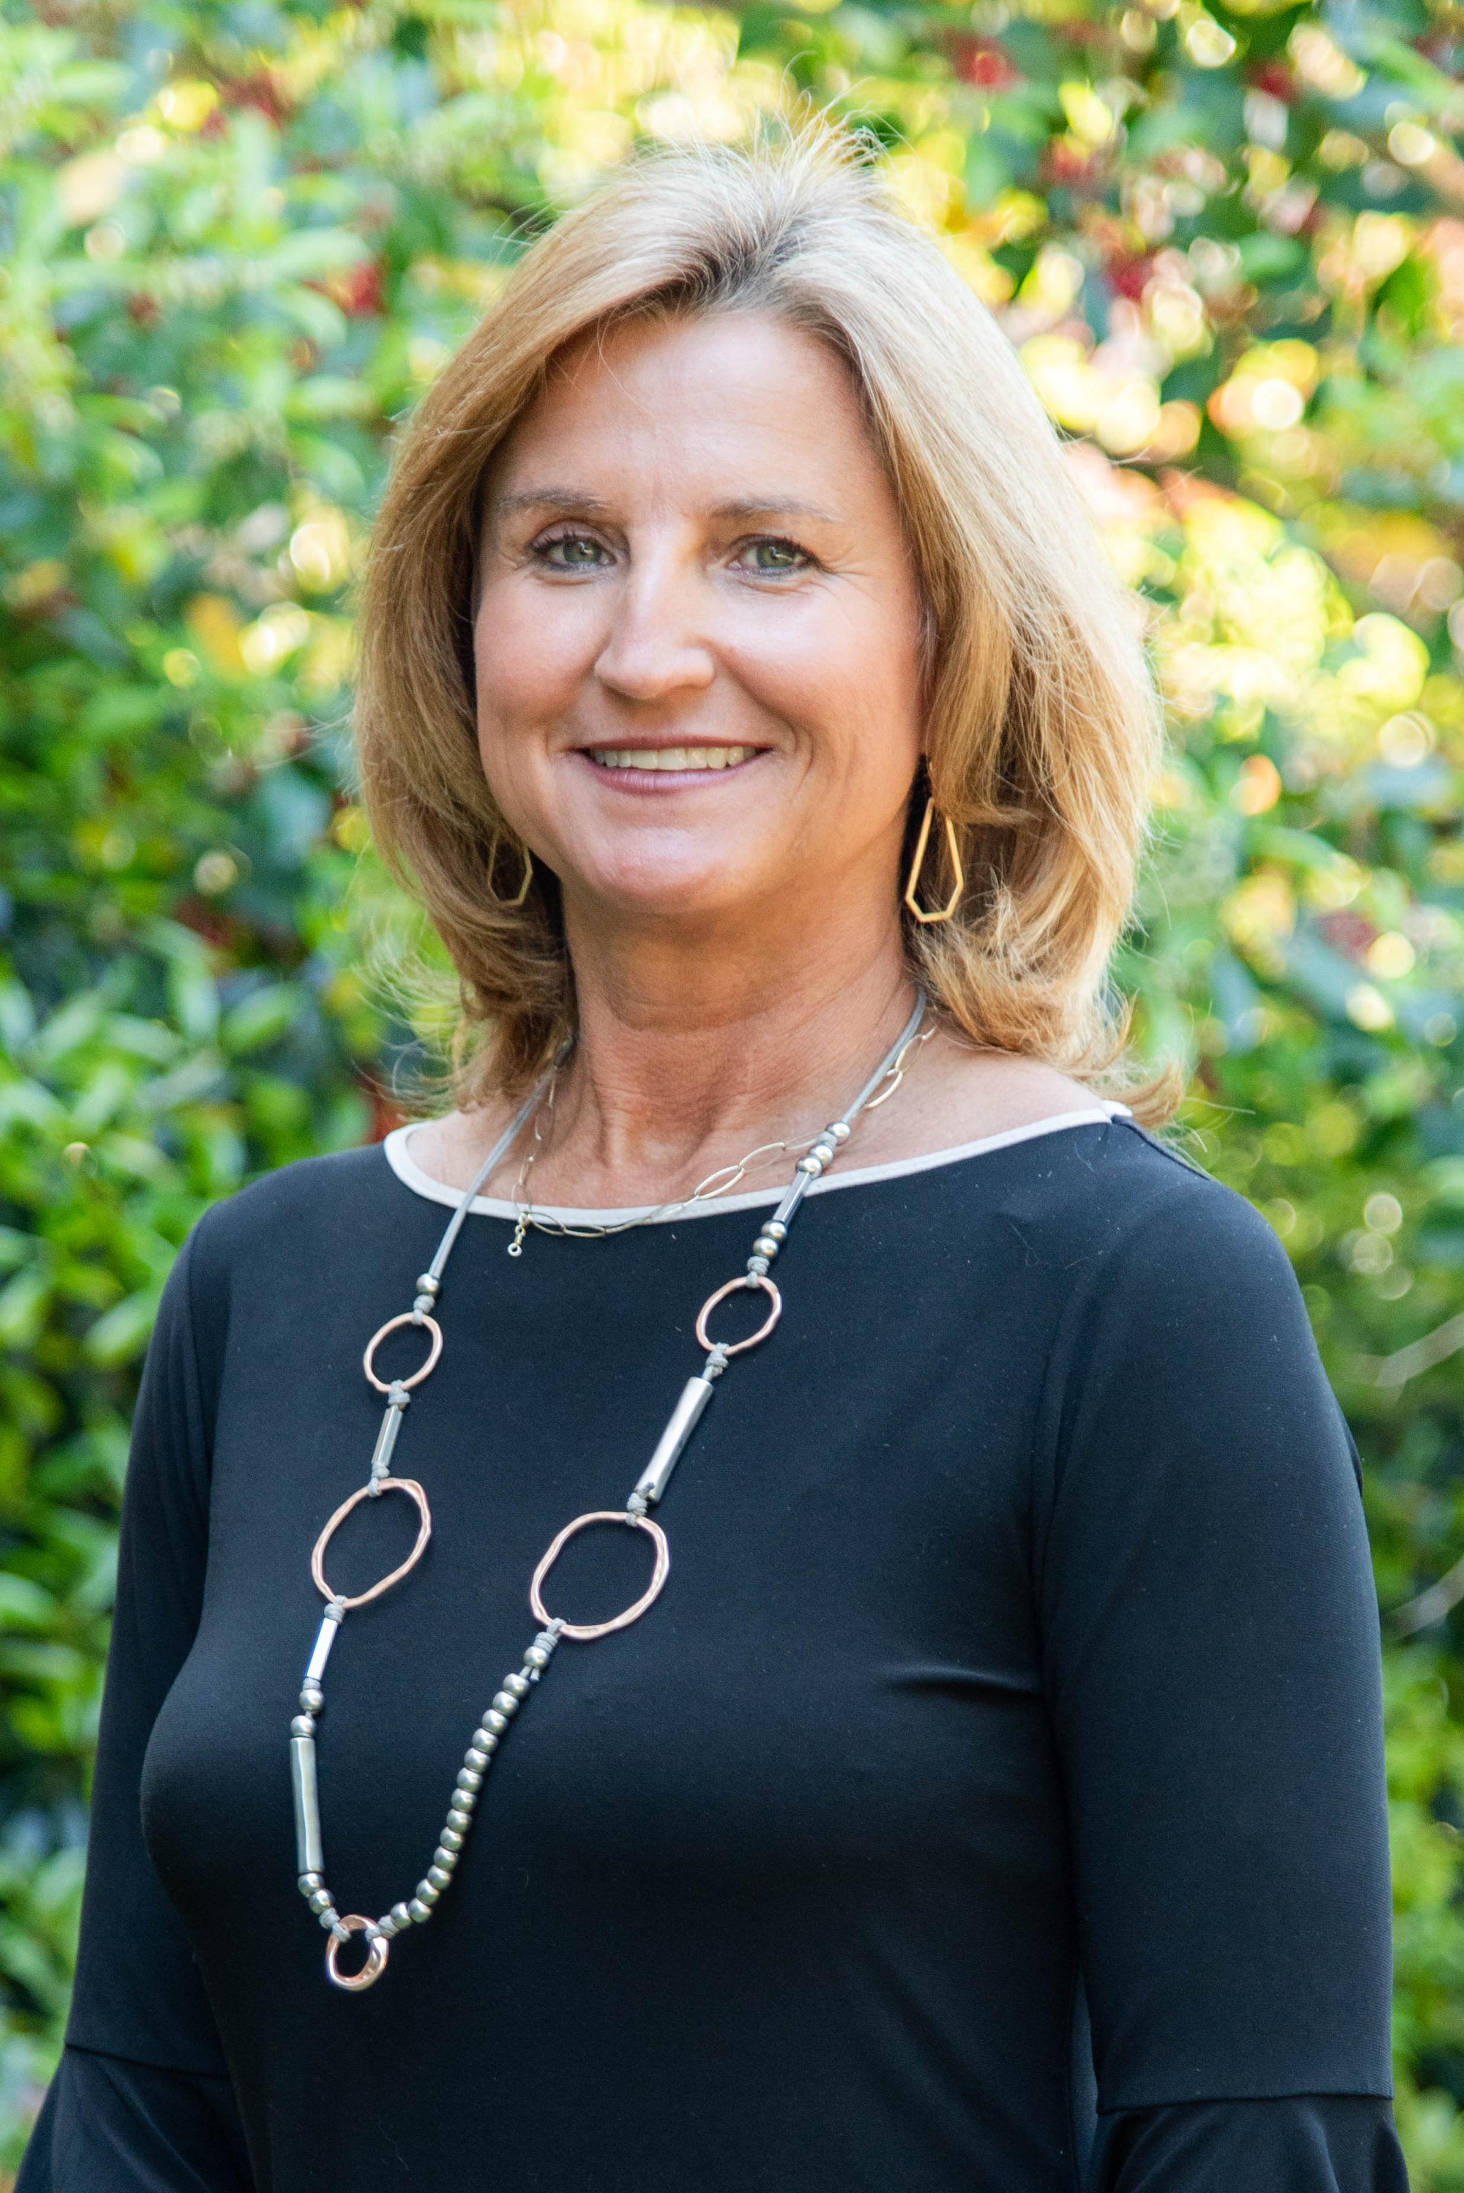


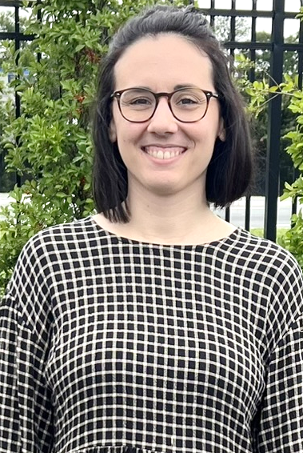


What Is The State Climatology Office?
Promote climate and weather awareness and knowledge by developing and delivering science-based climate services and tools.
Hope Mizzell
South Carolina State Climatologist
Melissa Griffin
Asst. State Climatologist
Jennifer Simmons
Water Resource Climatologist
Frank Strait
Severe Weather Liaison

Slide 14
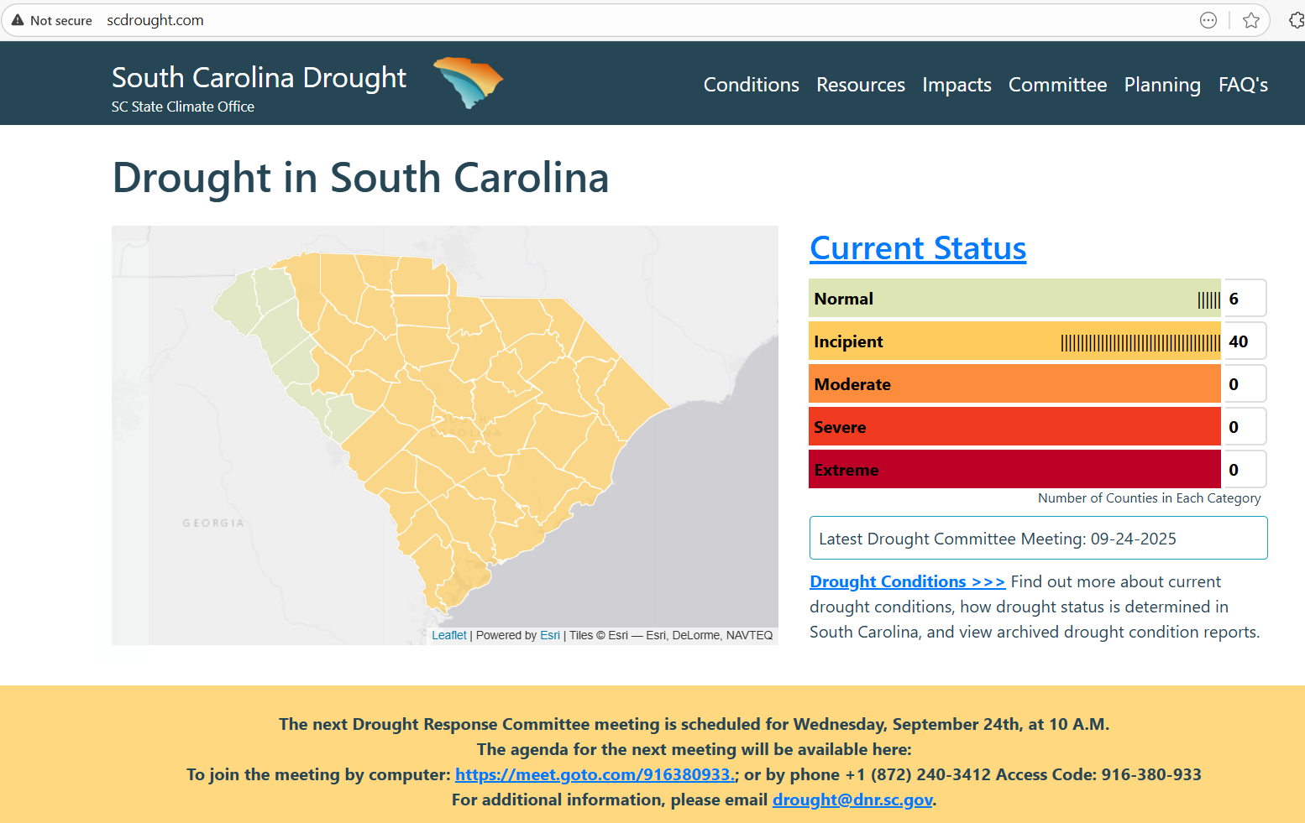


Drought Monitoring and Response
http://www.scdrought.com
Notes:
The SCO is also designated through legislation, the South Carolina Drought Response Act (South Carolina General Assembly Section 49-23-10 et seq., Code of Laws of South Carolina, 1976), to serve as the led agency for Drought Response. The DRC is the primary drought decision-making entity in the State. It is chaired and supported by the South Carolina Department of Natural Resources (SCDNR) and the state Climatology Office (SCO). Local members are organized according to four Drought Management Areas (DMAs). The DRC reports on conditions and impacts and evaluates drought indicators to determine drought status defined by the S.C. Drought Response Act to protect the State’s water resources.

Slide 15
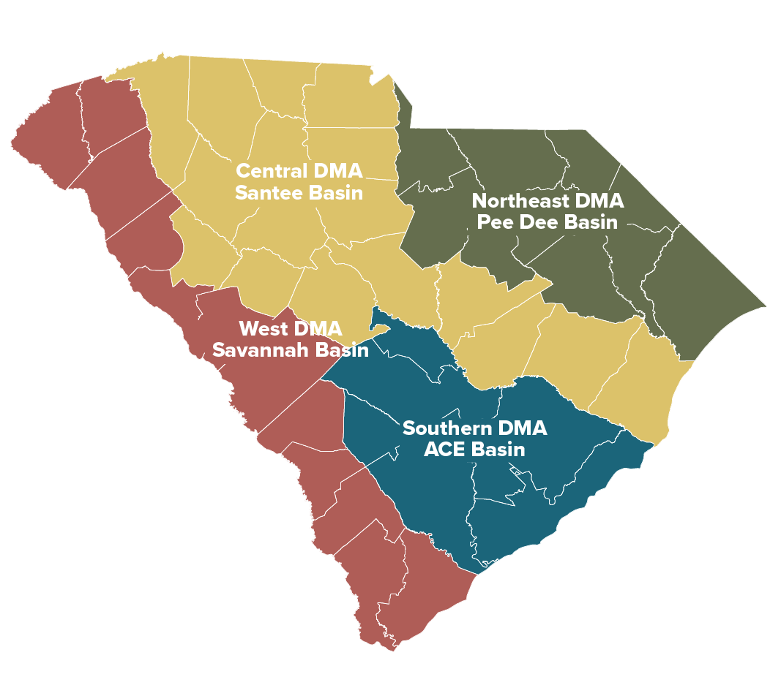
South Carolina Drought Response Program consists of legislation, regulations, and procedures that establish recommended and required response.
South Carolina Drought Response Act (enacted in 1985, amended in 2000) and Supporting Regulations.
The Drought Response Committee
Chaired and supported by SCDNR.
Evaluates drought indicators and determines county-level drought status as defined by the Drought Response Act
Consults with stakeholders about drought conditions and impacts
Determines when drought conditions warrant measures beyond the scope of local actions, including mandatory reductions, curtailment of non-essential water use, or activation of the South Carolina Emergency Response Plan
Drought Monitoring and Response
Notes:
The SCO is also designated through legislation, the South Carolina Drought Response Act (South Carolina General Assembly Section 49-23-10 et seq., Code of Laws of South Carolina, 1976), to serve as the led agency for Drought Response. The DRC is the primary drought decision-making entity in the State. It is chaired and supported by the South Carolina Department of Natural Resources (SCDNR) and the state Climatology Office (SCO). Local members are organized according to four Drought Management Areas (DMAs). The DRC reports on conditions and impacts and evaluates drought indicators to determine drought status defined by the S.C. Drought Response Act to protect the State’s water resources.

Slide 16
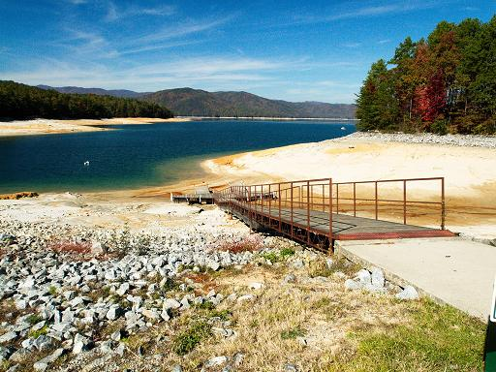
Drought Monitoring and Response in SC
Why: To carefully and closely monitor, conserve, and manage the State’s water resources in the best interest of all South Carolinians.
Who: Drought Response Committee and
Department of Natural Resources – State Climatology Office
Statewide members
Forestry Commission
Dept. of Agriculture
Emergency Management Division
Dept. of Environmental Services
Dept. of Natural Resources
Local members (12 per DMA)
Agricultural
Comm. of Public Works
Counties
Domestic Users
Industry
Municipalities
Power Generation Facilities
Private Water Supplier
Public Service District
Reg. Council of Governments
Soil and Water Conservation Districts
Special Purpose Districts

Slide 17
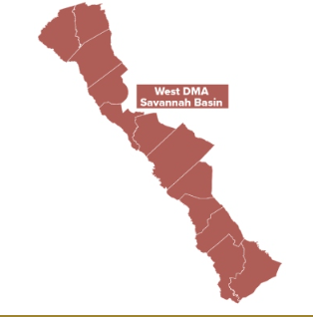
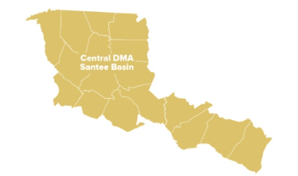
Local Drought Response Committee
West Savannah |  | Group | Central Santee
Reg Williams | Edgefield | Agriculture | John Irwin | Laurens
Cheryl Daniels | McCormick | Comm of Public Works | Ken Tuck | Spartanburg
Mark Warner | McCormick | Counties | Peggy Swearingen | Fairfield
Vacant |  | Domestic User | Christy Jones | Richland
David Evans | Pickens | Industry | Ed Holder | Greenville
Lynn McEwen | Barnwell | Municipalities | James Bagley | York
Preston Pierce | Oconee | Power Generation | Alan Stuart | York
Scott Willett | Anderson | Private Water Supplier | Brad Powers | Spartanburg
Chris Rasco | Anderson | Public Service District | Vacant
Rick Green | Edgefield | Reg. Council of Government | Gregory Sprouse | Richland
Yvonne Kling | Aiken | Soil and Water Conservation | John Rivers | Sumter
Brian Chemsak | Beaufort | Special Purpose District | Fred Castles | Chester
*11 River Basin Council members on the DRC.

Slide 18
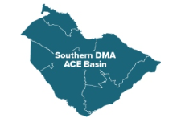
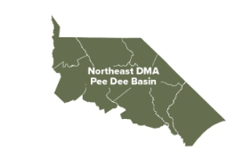
Local Drought Response Committee
Southern ACE |  | Group | Northeast Pee Dee
Landrum Weathers | Orangeburg | Agriculture | Caleb Miller | Dillon
Jason Thompson | Charleston | Comm of Public Works | Vacant
Vacant |  | Counties | Alan Watkins | Lee
Chris Wallace | Bamberg | Domestic User | Karolan Ohanesian | Horry
Vacant |  | Industry | Athena Strickland | Marlboro
Eric Odom | Orangeburg | Municipalities | Clint Elliot | Horry
Matthew McCants | Berkeley | Power Generation | Vacant
Vacant |  | Private Water Supplier | Vacant
Russell Cornette | Berkely | Public Service District | Elbert Warren | Darlington
Ronald Mitchum | Charleston | Reg. Council of Government | Lindsay Privette | Florence
Marion Rizer | Colleton | Soil and Water Conservation | Joe Ghent | Lancaster
Vacant |  | Special Purpose District | Nathan Ward | Kershaw

Slide 19





SC State Agency Drought Response Committee Members
Committee Member | State Agency
Ken Rentiers (Drought Committee Chair) | SC Department of Natural Resources
Darryl Jones | SC Forestry Commission
Joe Koon | SC Department of Environmental Services
Sam Quinney | SC Department of Agriculture
Jordan Van Delden | SC Emergency Management Division

Slide 20
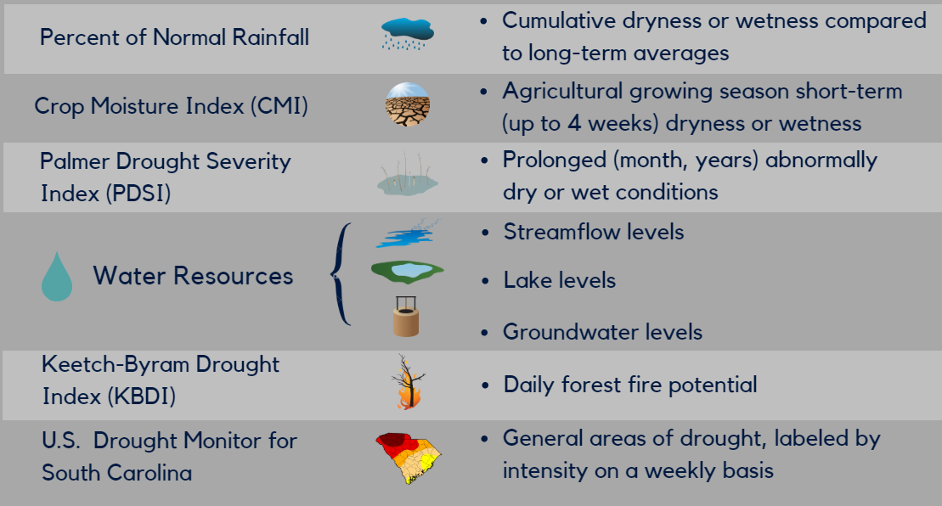
Drought Monitoring and Response in SC
How: The State uses multiple indicators and indices to monitor drought and determine drought severity levels.

Slide 21

SC Drought Response Act and Regulations
Incipient
Moderate
Severe
Extreme
Drier than normal
Soil moisture declines
Water demand increases
Water levels decrease
Crops and plants wither
Irrigation increases
Poor grazing
Water levels continue to drop
Number of wildfires increase
Significant impacts to agriculture
Widespread impacts to agriculture, forestry, water utilities, and water-dependent businesses
SCDNR and DRC monitor conditions, share information, and make recommendations to manage drought.
State and federal agencies, water utilities, and reservoir managers monitor conditions.
Water utilities review drought plans and ordinances.
Water utilities implement drought plans and ordinances.
DRC may recommend voluntary or mandatory water conservation.
State agencies increase monitoring and communications.
Citizens may see burn bans, boat ramp closings, and water use restrictions.
The Governor may:
request voluntary or mandatory water conservation.
assist with managing impacts, including requesting disaster declarations by the US Dept. of Agriculture and activating the National Guard to assist with wildfire suppression.
As drought conditions and
impacts become more severe,
response actions increase accordingly.
State Emergency Operations Plan
Water systems and citizens are without, or losing access to water.
Public safety, health, and welfare are threatened.
The State Emergency Response Team (SERT) is activated to lead state-level response to the drought emergency.

Slide 22
Components of South Carolina Drought Response Program
SC Dept. of
Natural Resources
SC Drought Response Committee
(state and local members)
Incipient
Chairs DRC
Consults with stakeholders
Provides support and coordinates response
Issues drought declarations
Moderate
Determines nonessential water use during severe and extreme drought
Review variance requests
Issues mandatory curtailment of nonessential water use during severe and extreme drought
Severe
Mediate disputes
Affected parties have right to appeal to Administrative Law Court which is immediate stay of declaration
Extreme
Administrative Law Judge hears appeals within 5 days

Slide 23
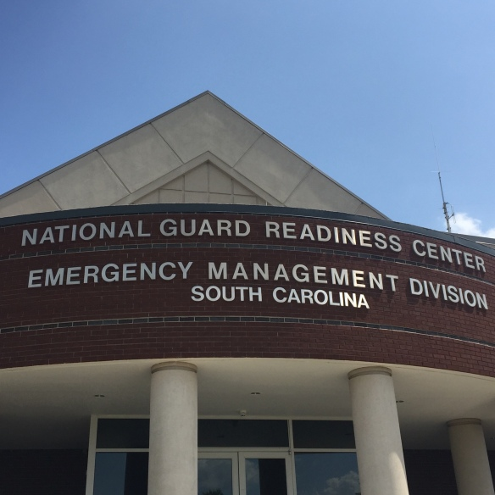
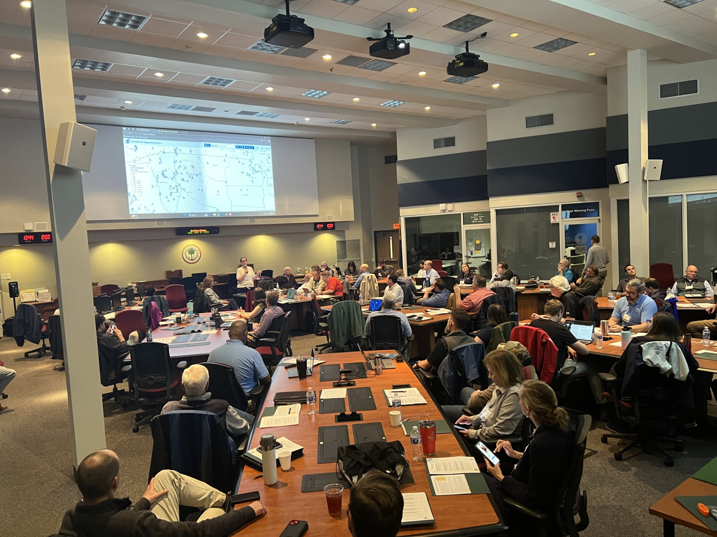
Components of South Carolina Drought Response Program
Health & Safety threatened, DRC presents recommended actions to Governor
Extreme
Governor may declare drought emergency and issue water curtailment regulations
Emergency Management Division ad State Emergency Response Team activated
Emergency Operations Plan

Slide 24
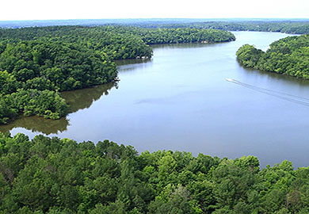



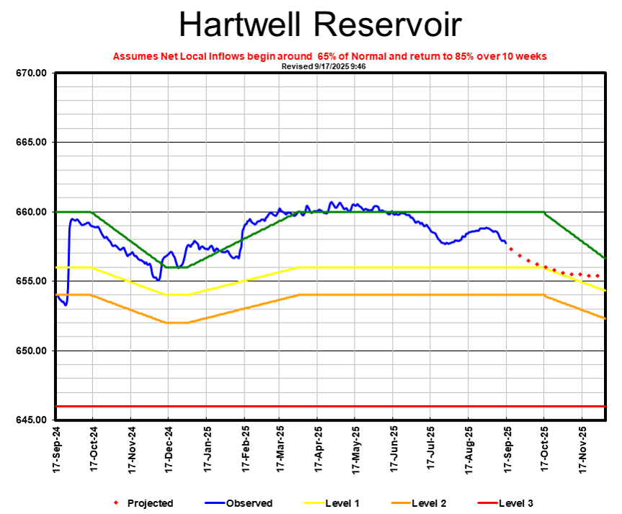



Components of South Carolina Drought Response Program
Incipient
Public Water Suppliers
Reservoir Managers
Moderate
Implement Drought Response Ordinances or Plans
Follow Dam Operations, Low Inflow Protocols and Reservoir Management Plans
Severe
Extreme

Slide 25
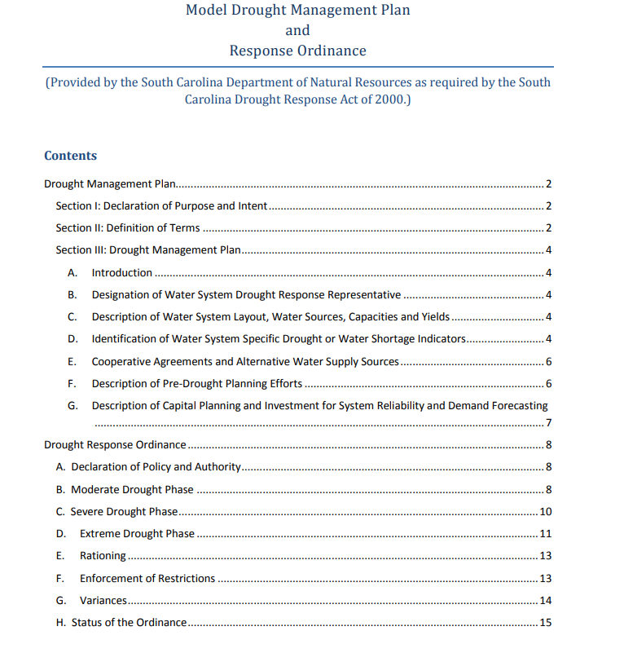

Local Level Drought Plans
While the Drought Response Act requires local water systems to have a drought plan, there is no legal requirement to update the plan.
Many plans in the state have not been updated since 2003…

Slide 26
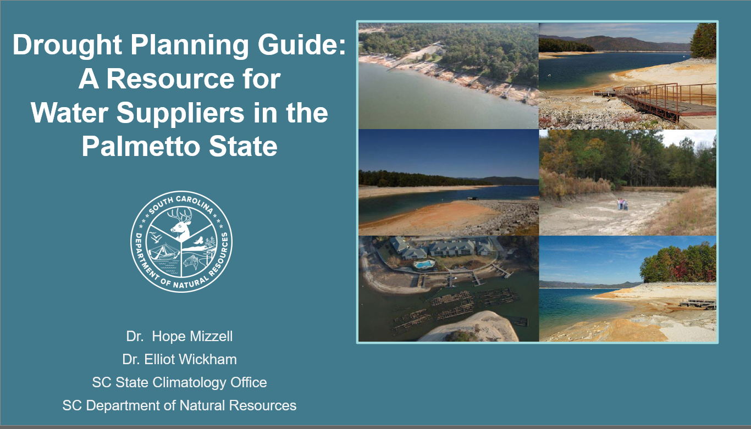


Slide 27
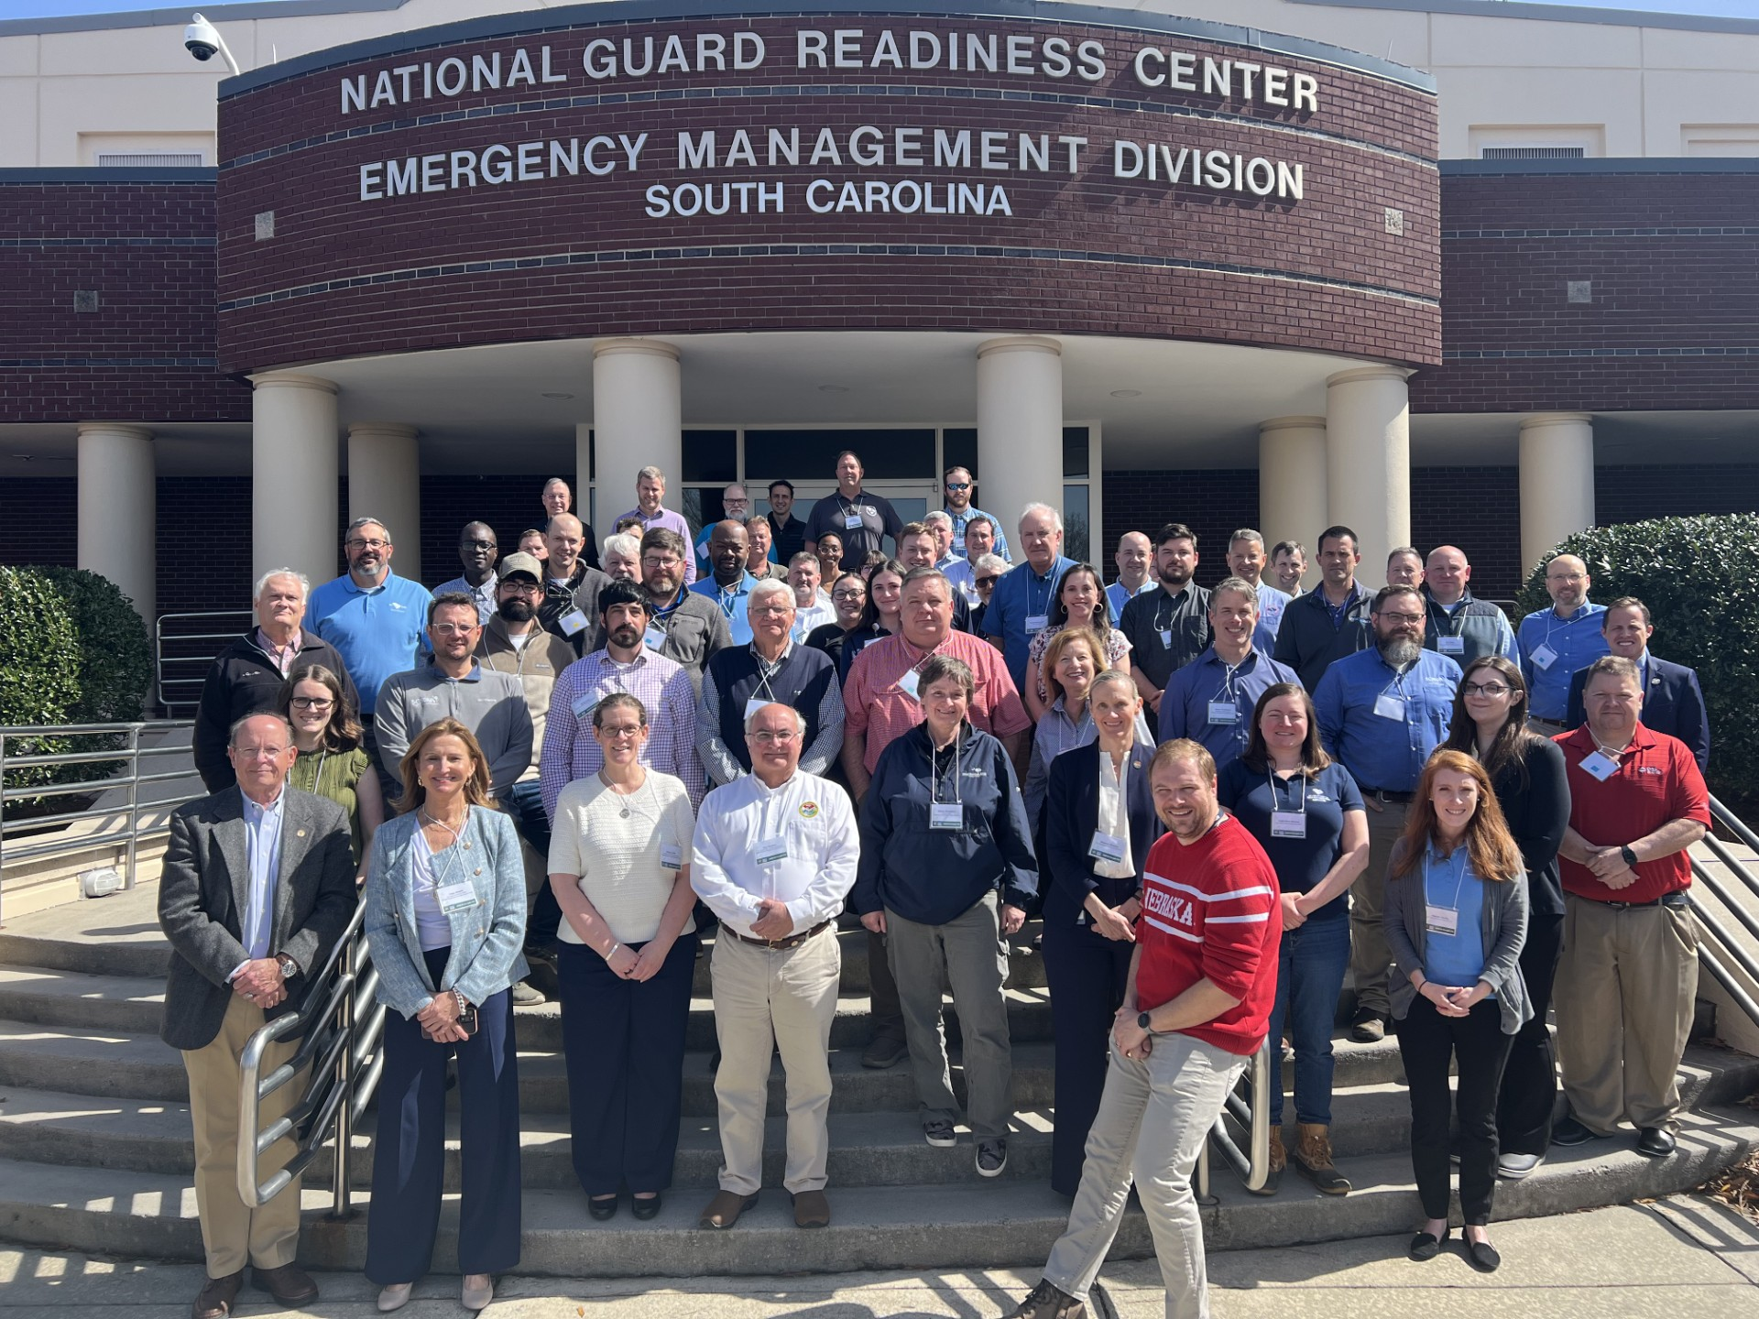


SC Drought and Water Shortage Tabletop Exercise
2017, 2019, 2025 – SC Emergency Operations Center

Slide 28


Tabletop Exercise Recommendations
Key Needs & Action Items
Water Resources Climatologist Position (2020)
Key Needs & Action Items | Ongoing and Uncompleted Tasks
Plans & Procedures: Better coordinated and timely drought response
Fill Drought Response Committee vacancies (Appointed by the Governor) | 20 new appointments since 2020 9 vacancies
2025 SC Drought TTX

Slide 29
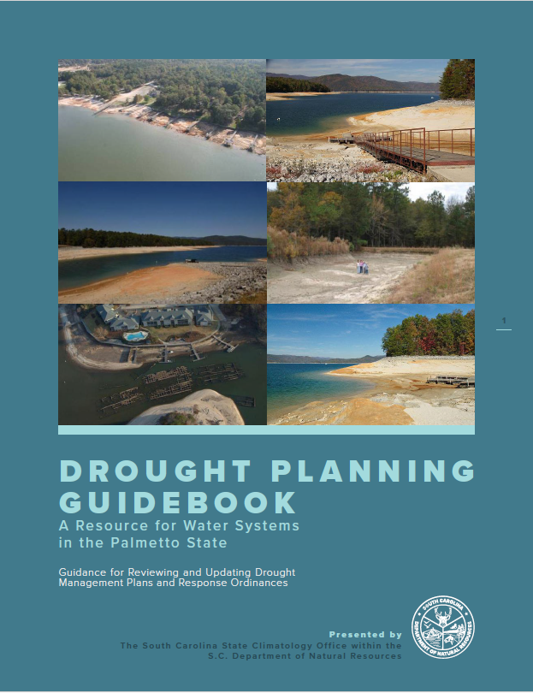
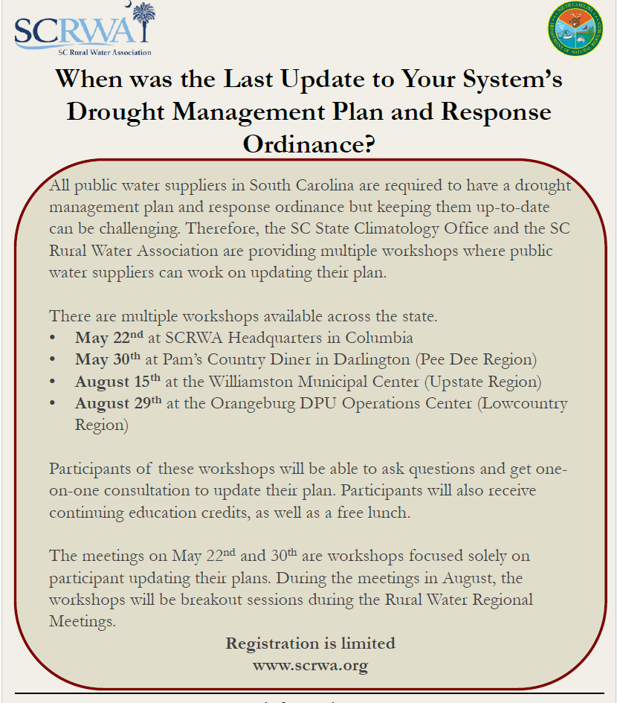
Tabletop Exercise Recommendations
Key Needs & Action Items | Ongoing and Uncompleted Tasks
Plans & Procedures: Better coordinated and timely drought response
Review and update state and local plans and ordinances. Most water systems have not updated their ordinances and plans since 2003 No requirement for industry to have a plan | Drought Planning Guidebook: A Resource for Water Systems in the Palmetto State Completed 2024 Through partnership with SC Rural Water Association, conducted 4 Training Workshops (48 water systems plus several engineering and consulting firms attended)
2025 SC Drought TTX

Slide 30
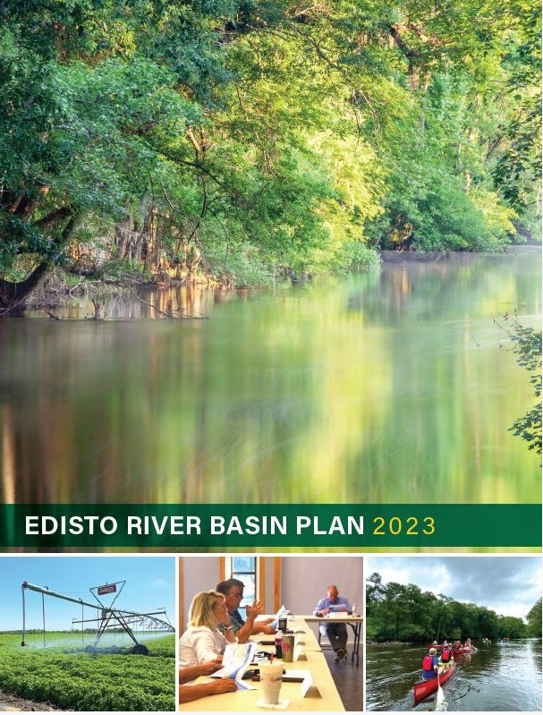
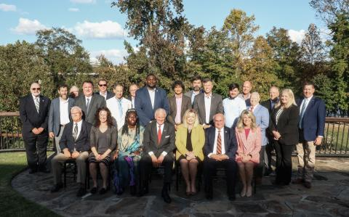
Key Needs & Action Items | Ongoing and Uncompleted Tasks
Plans & Procedures: Better coordinated and timely drought response
DRC has authority to curtail nonessential water use at severe and extreme drought - Concerns about implementation and appeals | Meet with the Administrative Law Court regarding water curtailment appeals
Coordination between SC Drought Response Committee, SC Planning Process Advisory Committee, River Basin Planning Committees, and WaterSC | 11 DRC members also serve as RBC members Try to fill DRC vacancies with RBC members

Slide 31
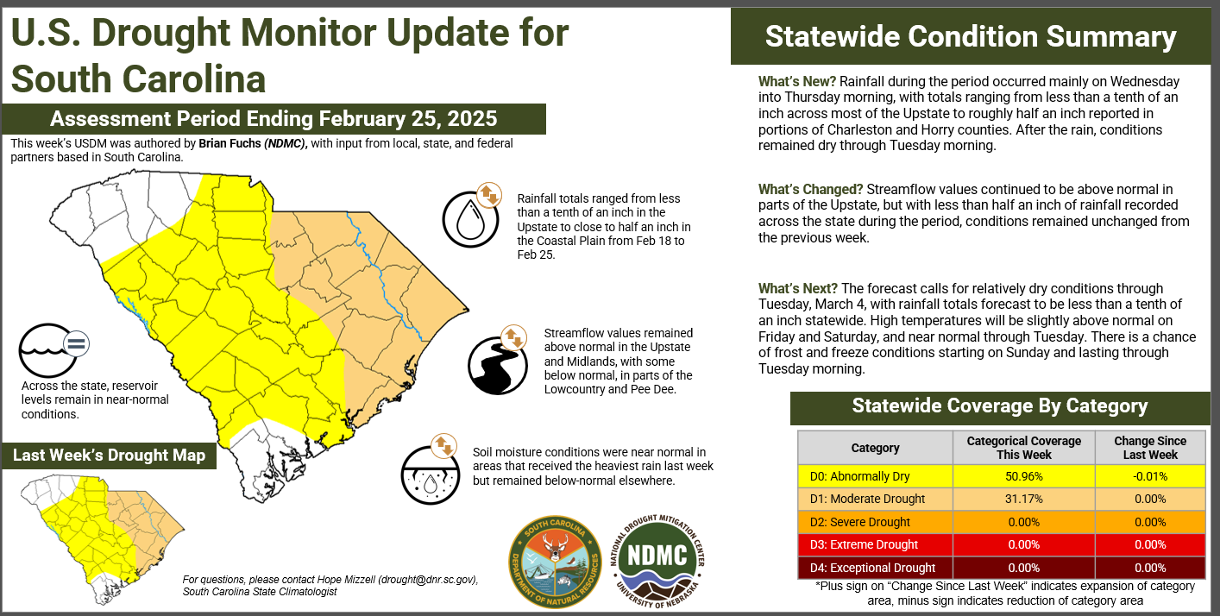
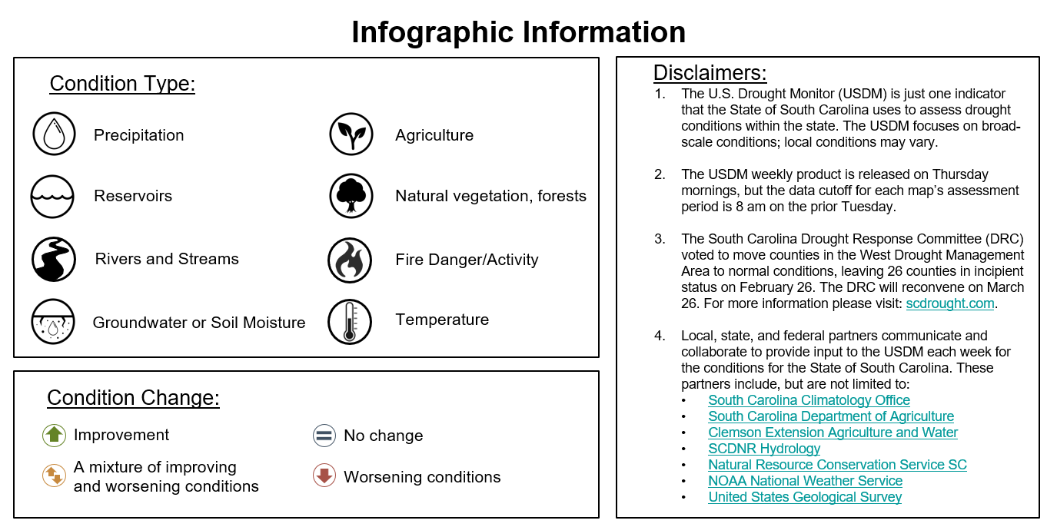
Key Needs & Action Items | Ongoing and Uncompleted Tasks
Education and Communication: Improved information sharing across agencies and with the public
Understand the connection and difference between the SC Drought Committee Declarations vs US Drought Monitor Declarations Agriculture Drought vs Hydrologic Drought | Weekly Infographic Outreach Presentations (example SC Farm Bureau Annual Meeting)
Promote information sharing, enhance awareness of regional and local issues, facilitate better working relationships between different agencies | scdrought.com website

Slide 32
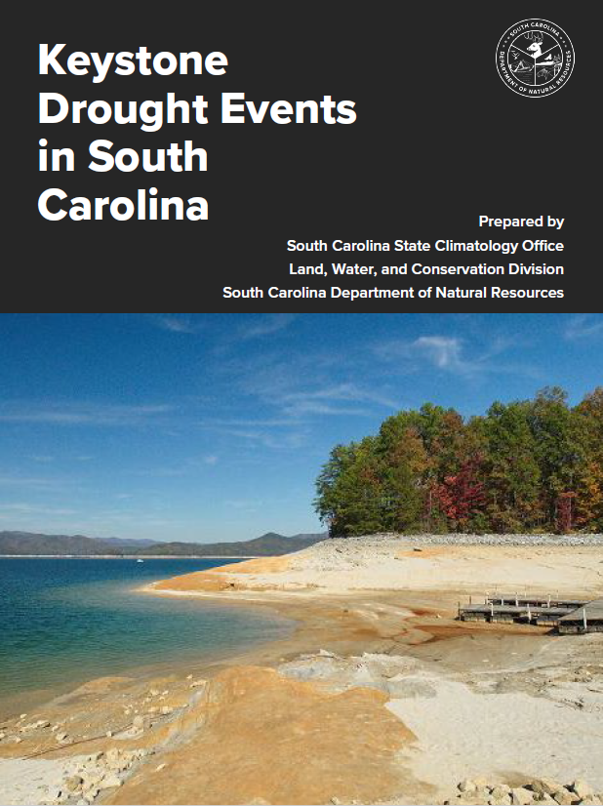

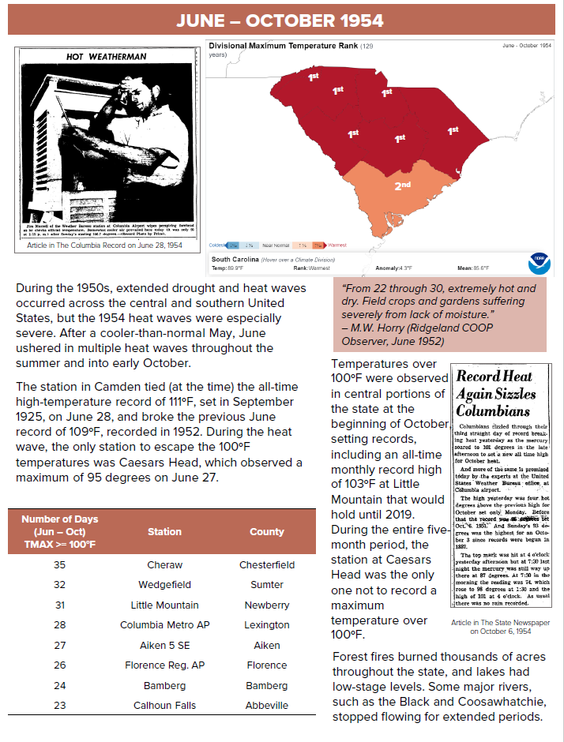
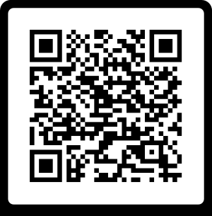
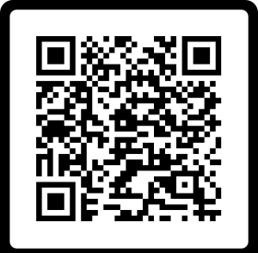

Key Needs & Action Items | Ongoing and Uncompleted Tasks
Education and Communication: Improved information sharing across agencies and with the public
Develop education and training modules | Proposed trainings for SC DRC Members
Conduct future exercises at regional and watershed level
Identify and develop information to enhance drought response and planning | Keystone Drought Events Keystone Heat Wave Events
Develop clear, consistent water conservation messaging for different stages of drought
Differentiate drought stages; more prominent speakers for higher levels.

Slide 33
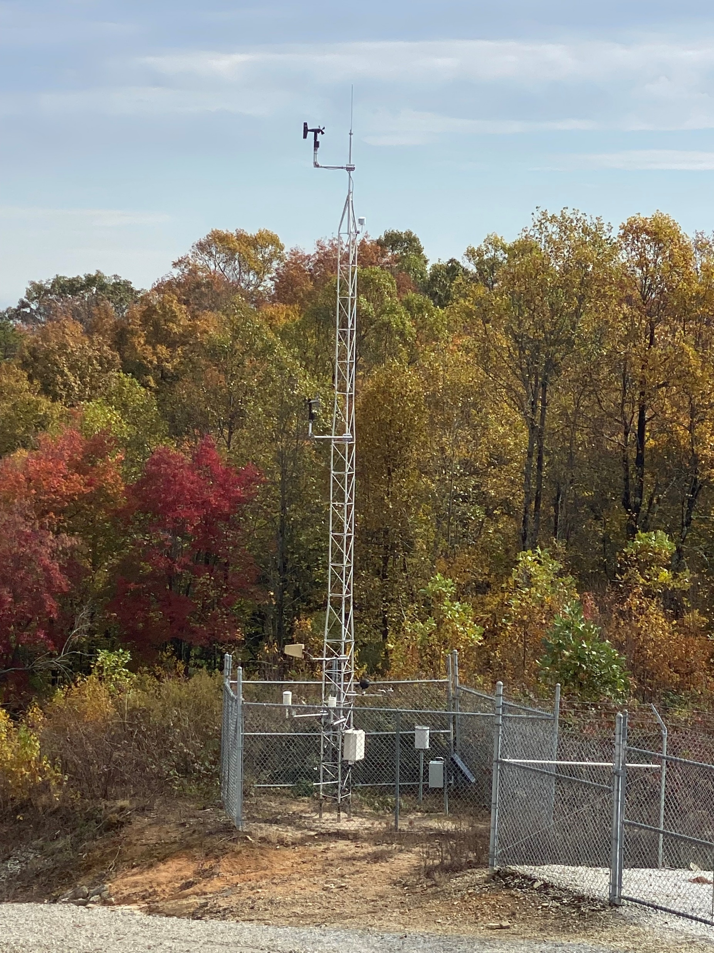
RBC recommendations to improve drought response and mitigation
Conducting 5-year updates to drought management plans and supporting smaller public water systems with technical and financial assistance for plan updates.
Consideration of drought surcharges to disincentivize high water use during drought.
Coordinated drought response messaging and consistency in response actions between water utilities.
Encouraging more frequent and widespread drought condition reporting .
Enhanced drought and climate monitoring via development of a statewide automated environmental monitoring network.
Discouraging decreasing block rate structures that incentivize high water use.

Slide 34
Contact Information
Hope Mizzell, South Carolina State Climatologist, MizzellH@dnr.sc.gov, 803-734-9568
Melissa Griffin, Asst. State Climatologist, GriffinM@dnr.sc.gov, 803-734-9091
Jennifer Simmons, Water Resources Climatologist
SimmonsJ@dnr.sc.gov, 803-734-8311
Frank Strait, Severe Weather Liaison, StraitF@dnr.sc.gov, 803-734-0339
dnr.sc.gov/sco

Slide 35
des.sc.gov/WaterSC

