Slide 1
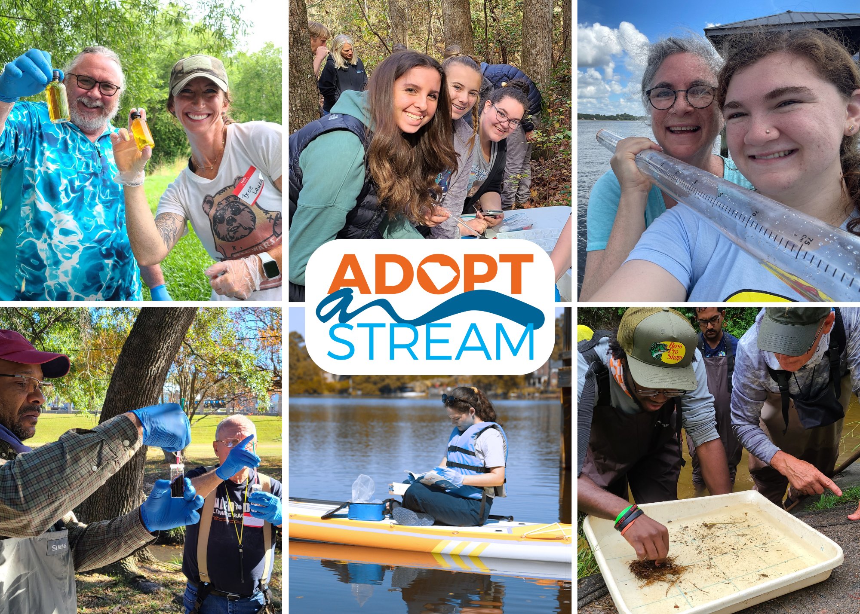
Welcome!
The presentation will begin shortly. Here are some tips for a great workshop experience.
Please have a way to take notes.
Ask questions at any point in the presentation
Current Steps for Becoming a Certified Volunteer:
  Complete today’s online training
  Complete group field training and pass test
  Adopt a site to monitor monthly
Notes:
**** Notes with [brackets] are reminders for trainers only and should NOT be read out loud. ****
[This slide is for virtual workshops only.]
[Log on to your virtual training 15 minutes before start time. Check audio and external links prior to use with your co-trainer. Post waiver to chat after people log in.]

Slide 2
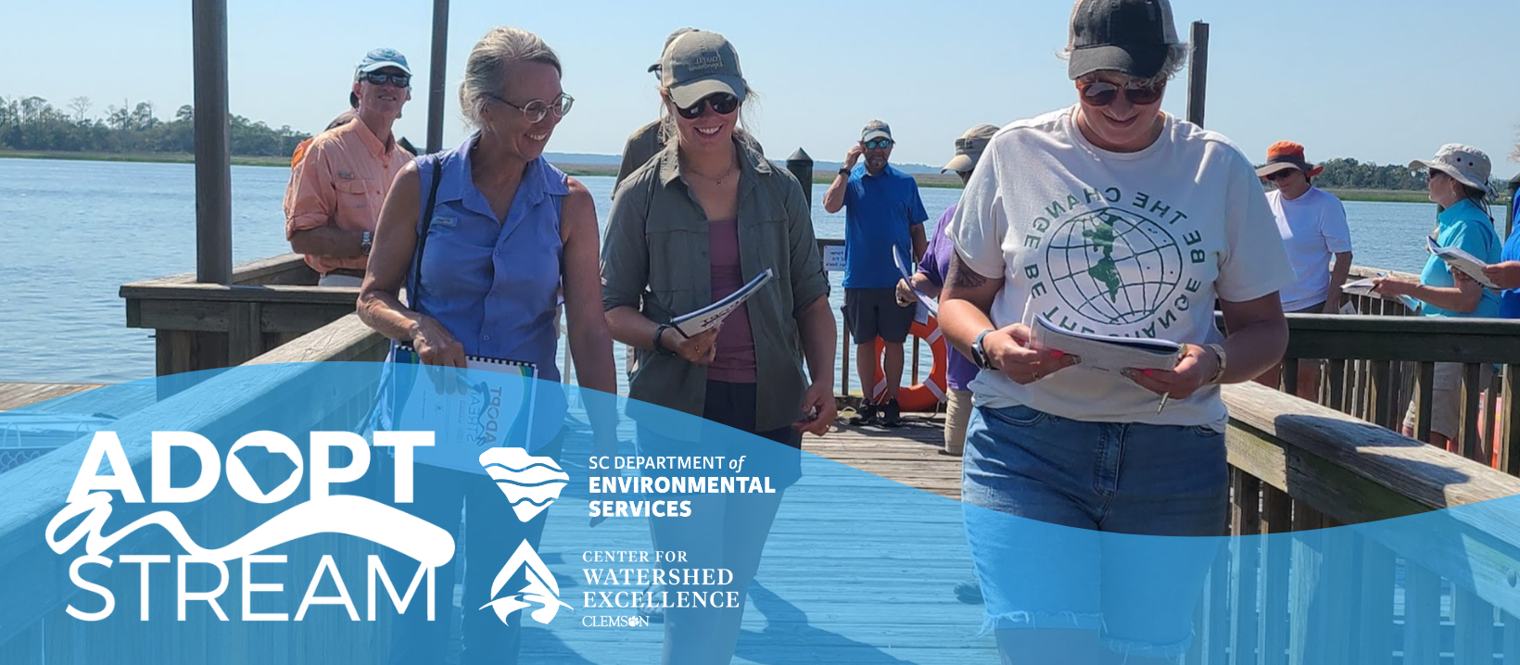
TIDAL SALTWATER MONITORING WORKSHOP
Updated 2/24
Notes:
**** Notes with brackets [xyz] are reminders for trainers only and should NOT be read out loud****
[Welcome volunteers. Introduce yourself.]
Hello and welcome to South Carolina Adopt-a-Stream’s Tidal Saltwater Monitoring workshop. Today marks the start of your certification to become an active volunteer water quality monitor. We will cover some basic water quality information, go over monitoring protocols, and show you resources to help you learn about the waterway you may adopt.
[Go over any logistics info: Where are bathrooms? When is the first break? Did everyone get signed in and have a way to take notes?]

Slide 3
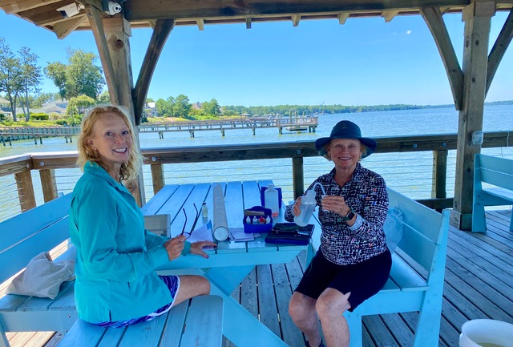
INTRODUCTIONS
Who are you?
Why are you here?
Where will you monitor?
Notes:
[Ask volunteers:
Who they are/what they do
Why they have come to the training
Where they will monitor (if known)]

Slide 4
CHAPTER 1
SC Adopt-a-Stream Introduction
Page 6
Notes:
Page 6.

Slide 5
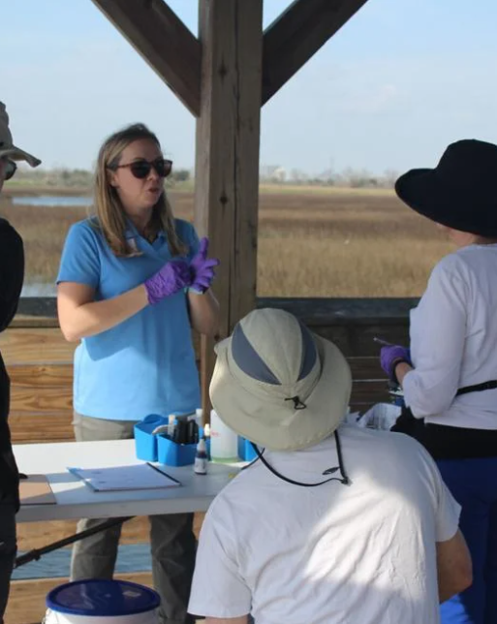
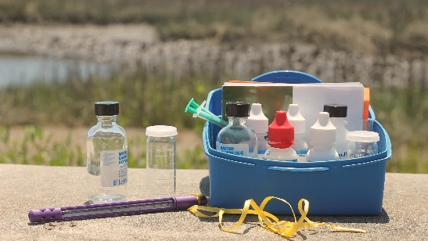

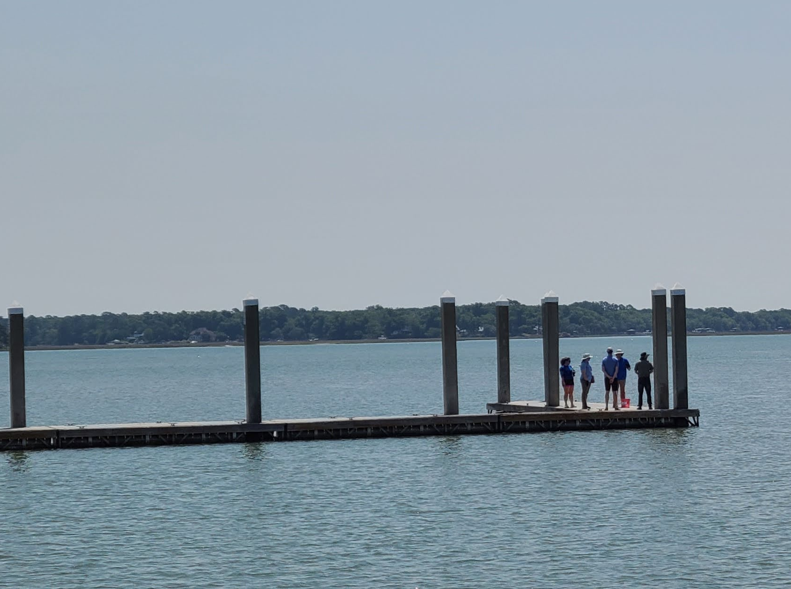


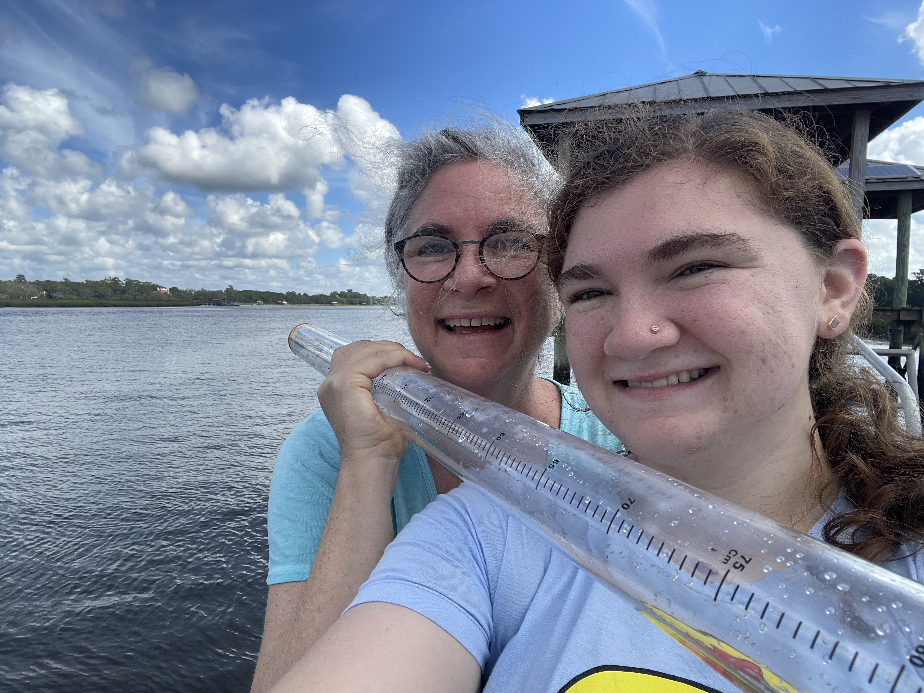
SC ADOPT-A-STREAM (SC AAS)
Notes:
South Carolina Adopt-a-Stream is a volunteer monitoring program where participants learn to monitor the health and water quality of their local waterways. We offer certification in four different protocols: freshwater, tidal saltwater, macroinvertebrate, and lake monitoring. ​
​
Volunteer water quality monitors help our state by collecting data on waterways that may not be regularly monitored otherwise. After this workshop, YOU will be a certified volunteer scientist. You have the chance to impact water quality in your community by providing VALUABLE data about freshwater streams that you care about. ​
​
The program is led in partnership by the SC Department of Environmental Services and Clemson’s Center for Watershed Excellence. Your Adopt-a-Stream Program Coordinators with SCDES keep the program running and growing and CU CWE oversees the public database.
​
As of January 2024, we have data on 500+ sites across South Carolina thanks to our wonderful volunteers.

Slide 6
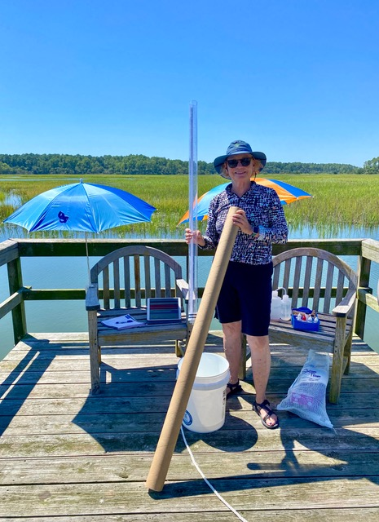
WHAT’S OUR MESSAGE?
  A: ACTIVE
  D: DATA
  O: OUTDOORS
  P: PRESERVATION
  T: TOGETHER
Notes:
Through this program, it is our GOAL to help citizen scientists increase their knowledge, provide more information about stream health statewide, encourage behavioral changes, and provide opportunities for watershed stewardship.
As volunteers, we take an ACTIVE approach to collecting DATA while enjoying the OUTDOORS to help PROTECT our waters TOGETHER.
Overall, educational participation and spreading awareness about this program leads to a positive impact in communities across South Carolina.

Slide 7
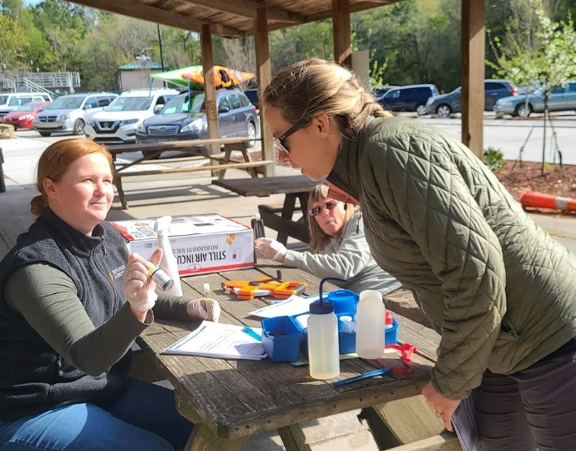
CONSISTENCY & INTEGRITY
Quality Assurance Project Plan (QAPP)
Pass certification test
Recertify annually
Follow protocol
Only certified volunteers enter data
Notes:
Although the data generated by our volunteers is NOT REGULATORY in nature, it is still extremely valuable and considered HIGH quality data thanks to our EPA-approved “Quality Assurance Project Plan,” or QAPP. This means we have a set way of collecting data and that we follow certain water sampling protocols to ensure we are collecting data in a way that is valuable for many different uses.
At the end of this workshop volunteers must pass a certification test that is valid for one year. Only certified volunteers have access to enter data into our public database. As long as volunteers follow our protocol EXACTLY, the data is high quality and available for anyone to use. Volunteers must be recertified annually using the virtual recertification or attending another in person workshop.
[Volunteers must pass a written evaluation and field demonstration with a score of at least 80% to become certified. This is a test to make sure you were taught everything, NOT a test on prior knowledge or experience. ]

Slide 8
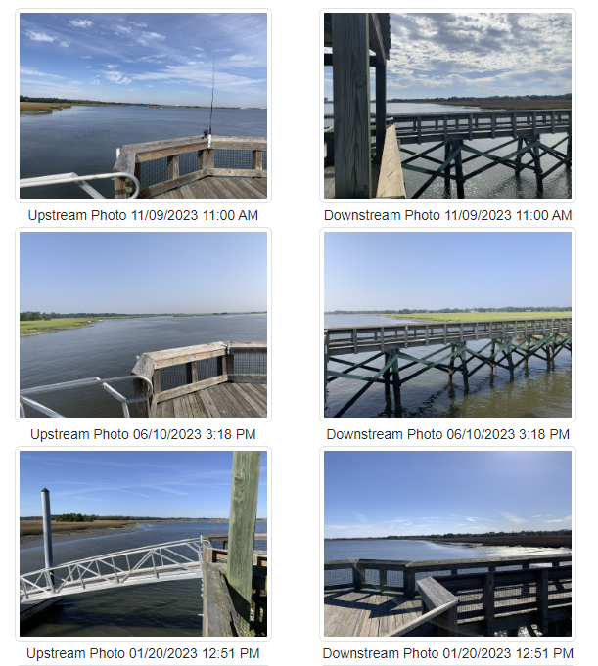
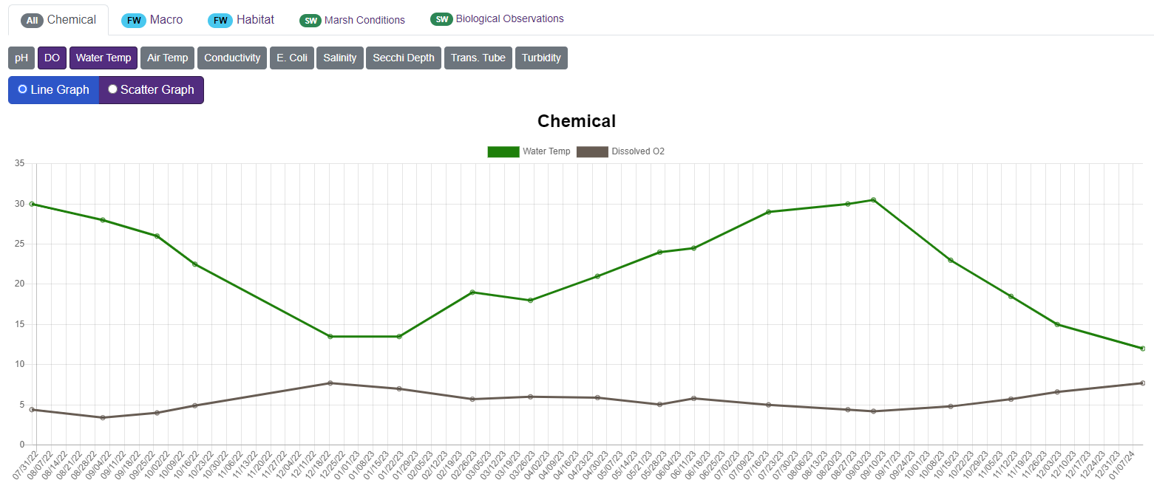

VOLUNTEER DATA USES
Educational, baseline, and screening purposes
NOT REGULATORY
Other uses
Notes:
Volunteer data can have a lot of uses. Data collected for this program is to be used for EDUCATION, to monitor for BASELINE conditions, and SCREENING for issues. It can spark investigation and action, but it is NOT to be used as regulatory data. Other data uses include research, advocacy, and watershed planning, among many others. Follow-up from collected data happens at the program coordinator level and you as the volunteer can also seek follow up from other groups!
[If you use AAS data in your job, use examples from how you use it.]

Slide 9
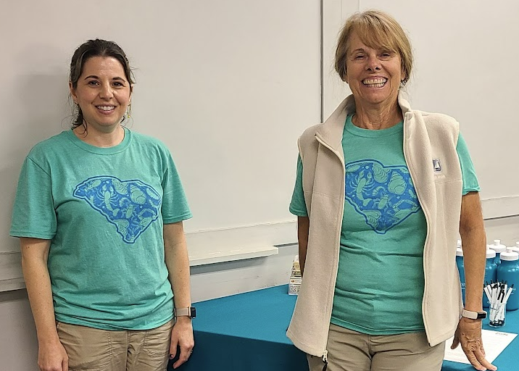
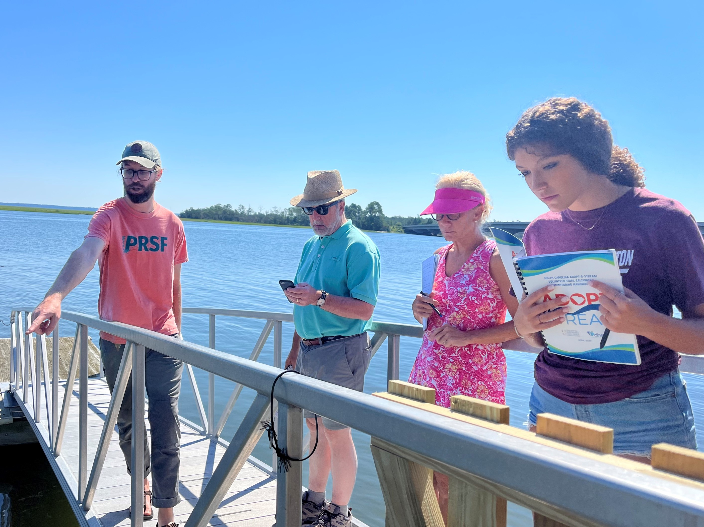
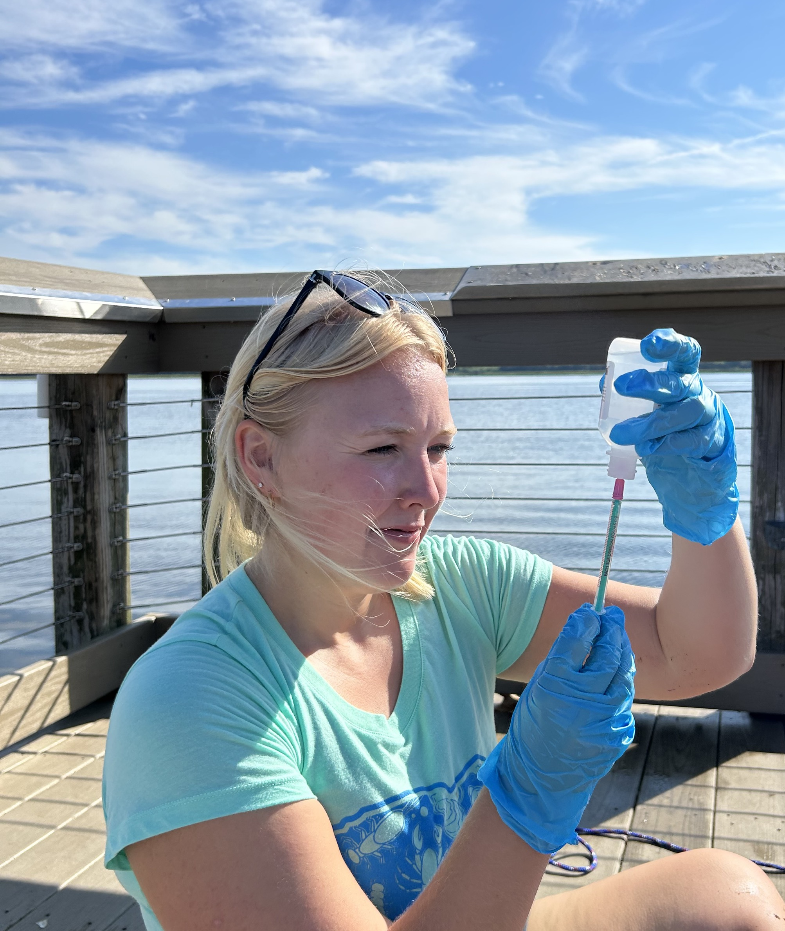
CODE OF ETHICS
Accurately document everything on datasheet
Stream Access Permission
Site Cleanup
Share Data ASAP
Notes:
SC AAS Volunteer Monitors and Trainers represent this program with integrity, by following the SC AAS monitoring protocol exactly, accurately documenting observations, and reporting data in the database as soon as possible.
Make sure you have permission to sample at your site. Get permission from private landowners using the Landowner Permission Form [found on AAS website].
We encourage you to always leave your site cleaner than you found it. Be extra careful not to leave trash, spill chemicals, or let items blow away in the wind. Most volunteers add a reusable trash bag to their kit.
While at your site, you may have people ask who you are or what you are doing. Be prepared to explain how volunteer monitoring makes a positive impact and that anyone can view the data you collect on our website.

Slide 10
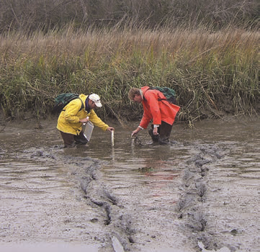
SAFETY
DON’T SAMPLE if conditions are too dangerous!
Sample together
NEVER sample during a storm
WEAR gloves, boots, life jacket
WASH hands and gear after
Notes:
The safety of volunteers is of the highest priority. We care more about you than your data!
Never sample if conditions are too dangerous! Always keep an eye out for wildlife and harmful plants.
Remember to sample with someone (whether they are certified or not). If you are sampling without a friend, let someone know where you’ll be and when you’re leaving/returning.
NEVER sample during a storm. Wait until a storm has stopped AND strong water flow has subsided.
Your site may be contaminated with bacteria or other pollutants. Always wear the proper personal protective equipment and wash hands after sampling. Rinse glassware and dry equipment before storing.

Slide 11
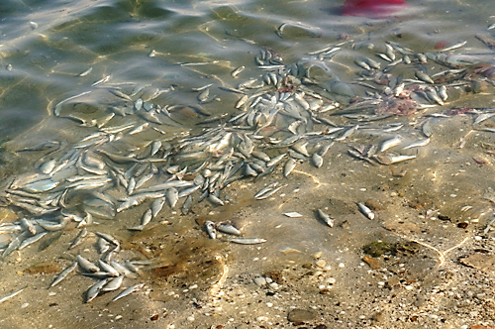
EMERGENCY HOTLINE
If there is evidence of ongoing chemical releases, oil spills, or fish kills, contact the SCDES toll-free 24-hour emergency response line at
1-888-481-0125
Learn more about reporting an environmental concern:
https://des.sc.gov/about-scdes/contact-us/report-environmental-concern
Notes:
If you do find evidence of ongoing chemical releases, oil spills, or fish kills, call the SCDES hotline at 1-888-481-0125. Save this number in your phone and highlight it on Page 3 of your handbook. This page is also a great place to write down your trainers’ names and contact information.
[Give time for volunteers to record this number.]

Slide 12
CHAPTER 2
Watersheds and Water Monitoring
Page 13
Notes:
Page 13.

Slide 13
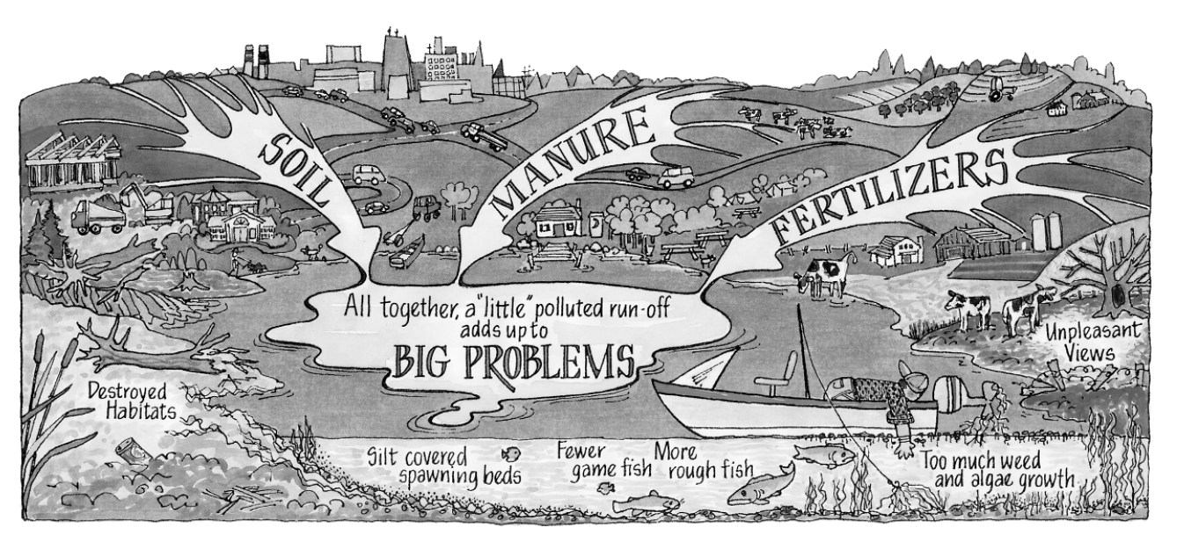
WHAT IS A WATERSHED?
WATERSHED
An area of land and water that drains to a central point
Notes:
To understand what is causing your site conditions to change or where pollution may be coming from, you must know what’s in your watershed. So… what is a watershed? It is an area of land and water that drains to a central point. Everyone lives in a WATERSHED.
Watersheds can vary in size. They can be as large as the Mississippi River watershed that spans from Canada to the Gulf of Mexico or as small as your back yard. Understanding your watershed can help you determine where you want to sample.

Slide 14
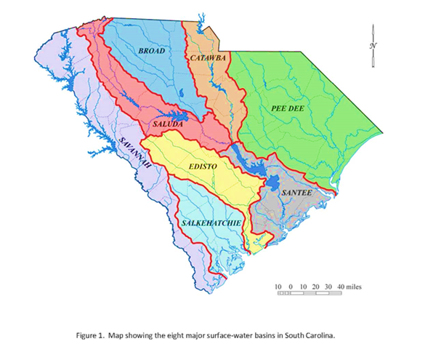
GETTING TO KNOW YOUR WATERSHED
Notes:
This map shows the 8 largest watersheds in South Carolina. These watersheds can be broken up into smaller watersheds at different scales with different names. The coastal basins include the Savannah, Pee Dee, Edisto, Santee and Salkehatchie.
[Help your volunteers find their watershed.]

Slide 15
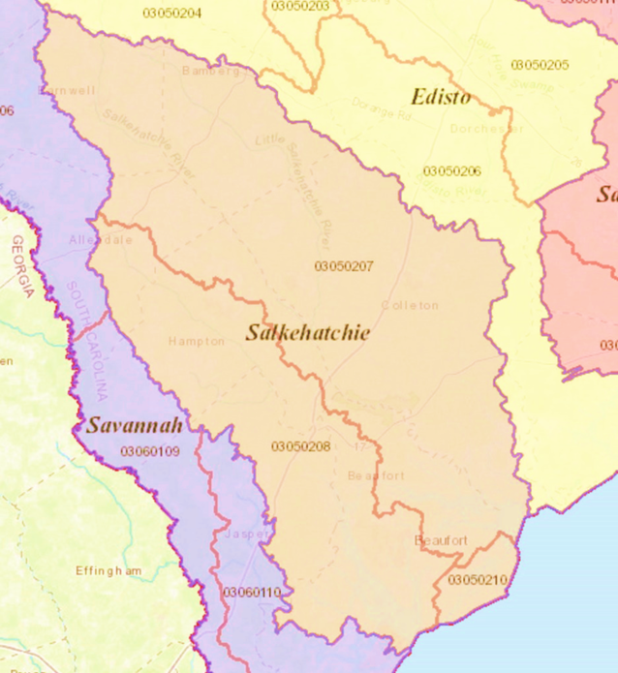
IDENTIFYING WATERSHEDS
Hydrologic Unit Codes (HUCs) identify watersheds
Smaller watersheds have larger HUC numbers
Notes:
Instead of using various names for the millions of watersheds, scientists use numbered codes to identify them. These codes are called hydrologic unit codes or HUCs.
The smaller the watershed, the larger the code. SC AAS uses 8-digit HUCs in the database. You will need this code to go with your watershed name when creating your site in the database. Use the SC Adopt-a-Stream Atlas to find your HUC or contact your trainer for help once you adopt a site.

Slide 16
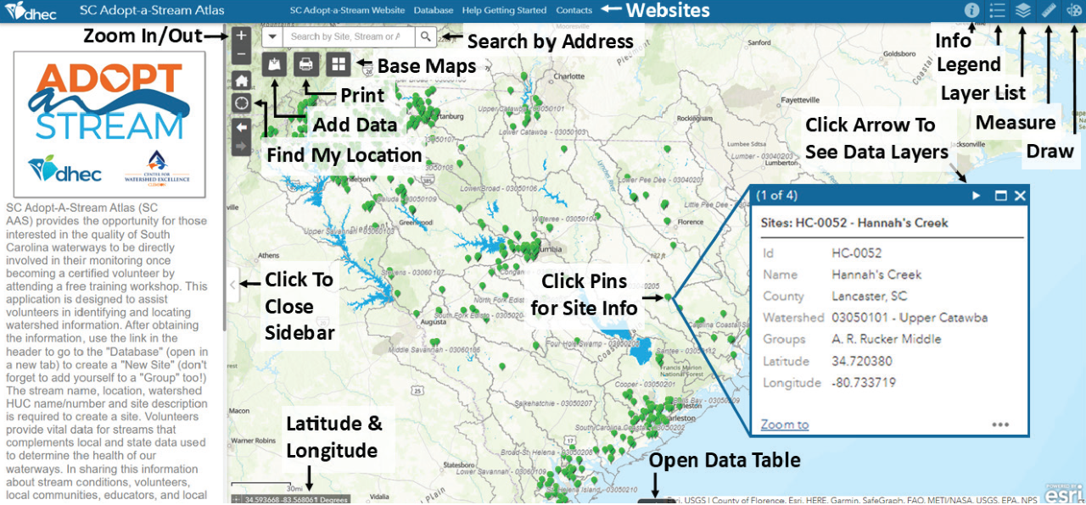
SC AAS ATLAS
https://gis.dhec.sc.gov/scaas/
Notes:
Use the SC AAS Atlas to help you find your watershed name and HUC or see where existing volunteer monitoring sites are. Please be aware that new sites do not immediately show up on this map.
[This tool is not in SW Handbook 1st Edition. Visit the SC AAS Atlas and show volunteers how to access info, like water classifications and HUC-8 codes. https://gis.dhec.sc.gov/scaas/.
You can find instructions for using the Atlas by clicking the “Info” icon in the upper right-hand corner of the webpage
• Change the background to a satellite view by selecting “Imagery” in the “Basemap Gallery”.
• Turn layers on and off using the “Layer List”.
• Hover over icons to identify the tools
• Click any pin on the map to view details for that location. A pop-up will display the Waterbody Name, Watershed Name, and Watershed Number (8-digit HUC). Latitude and Longitude will be displayed in the lower left-hand corner of the screen. ]

Slide 17
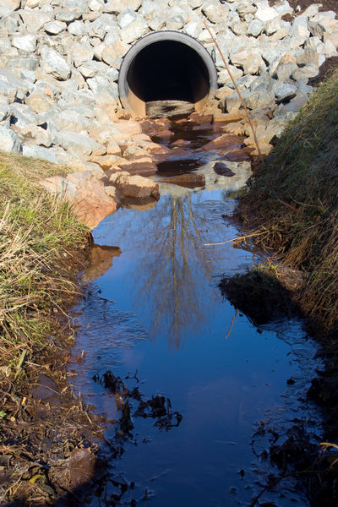
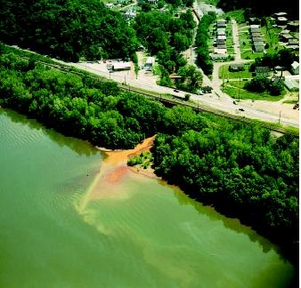
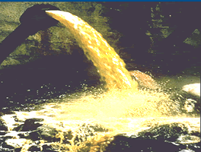
POINT SOURCE POLLUTION
Can point to the source of the pollution
Regulated by SCDES
Notes:
There are two main types of water pollution, point source and nonpoint source, that can negatively affect water quality in a watershed. Point source is where you can actually see or point to the source. Some examples of this include industrial discharges and municipal sewage treatment plants.
This type of pollution is regulated by SCDES. Industries, business, cities, and counties have to go through a lengthy permitting process to discharge into a waterbody. The amount and severity of point source pollution has drastically improved since the Clean Water Act was implemented 50+ years ago. This is NOT the number one threat to water quality issues…

Slide 18
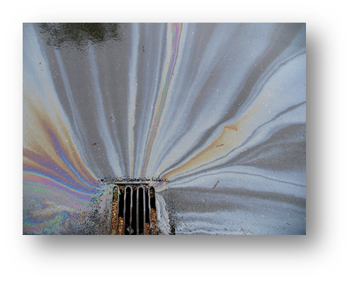
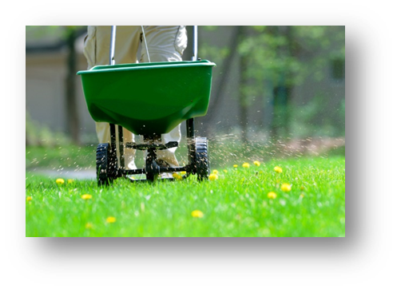
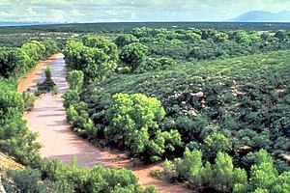
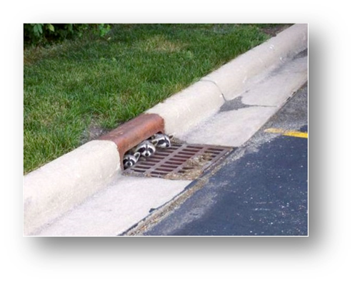
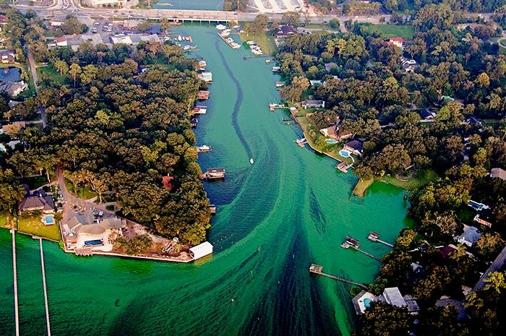
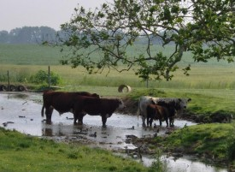
NONPOINT SOURCE POLLUTION
Source not easily identified
Runoff carries materials into streams
Notes:
Nonpoint source pollution is the #1 cause of water quality problems in South Carolina. Nonpoint source pollution is where an individual source cannot be identified. Examples of nonpoint source pollution include erosion, stormwater runoff that can carry pollutants like fertilizers, pesticides, and animal wastes, failing septic or municipal wastewater systems, illegal dumping, and more.
Many impaired streams have multiple sources of this type of pollution, which makes it hard to track and hard to fix. Having more sites adopted by volunteer monitors helps us to better understand these impaired streams.

Slide 19
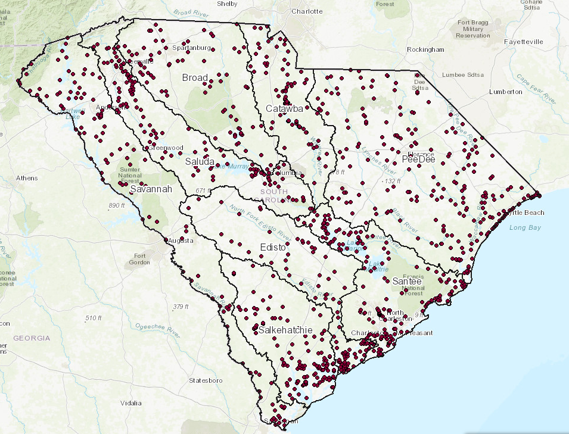
WATERSHED HEALTH
Temperature
Sediment
Shellfish Restrictions
(Sites that don’t meet state standards)
303(d) List of Impaired Waters
Notes:
Many “pollutants” in a stream are natural and only considered a pollutant when their presence is impairing a waterway’s ability to maintain life or threatens users. Therefore, monitoring helps identify possible pollution or ongoing changes. Some of the most common impairments include bacteria, sediment, and temperature. We will discuss how we monitor for these impairments in future slides. If you want to learn more about waters in SC that don't meet state standards or see shellfish restrictions, explore SCDES's 303(d) list of impaired waters.
[https://des.sc.gov/programs/bureau-water/south-carolina-303d-list-impaired-waters-tmdls]

Slide 20
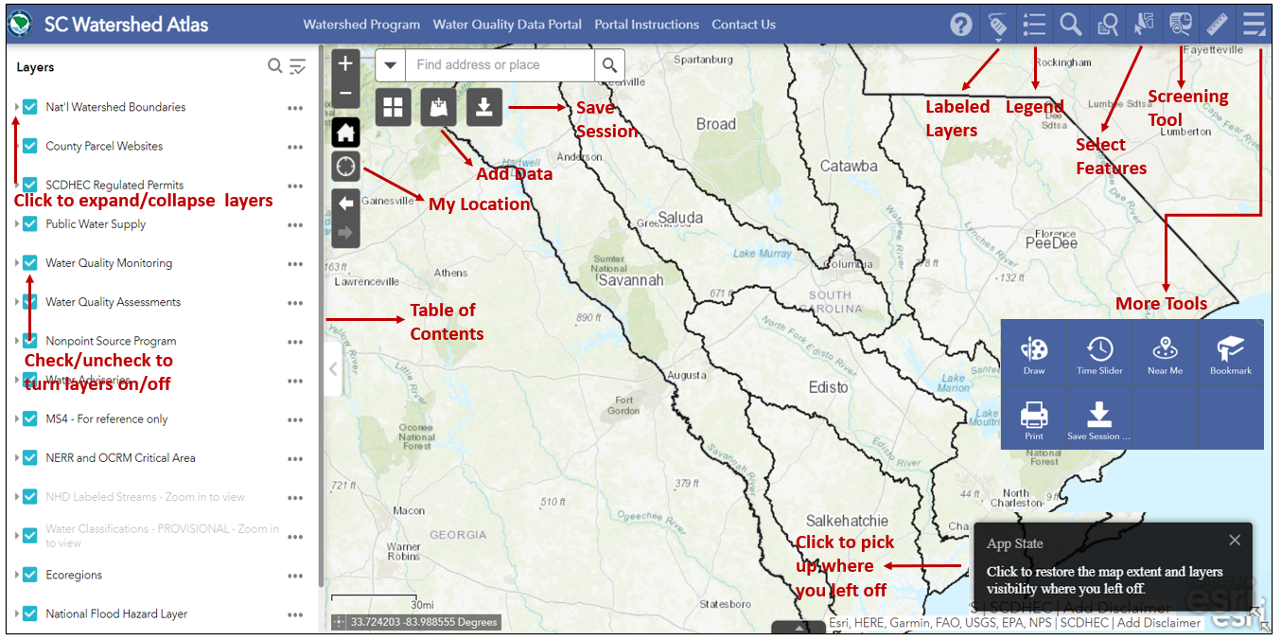
SC WATERSHED ATLAS
Search “SCDES Watershed Atlas”
Notes:
This online application (detailed on page 21-29), called the SC Watershed Atlas, can be used to find additional information about your watershed such as impaired sites, discharge permits, trout waters, state water quality monitoring sites, and more. It has 90+ different layers of data that can be turned on or off to make maps that can be printed or referenced for data sharing. Video tutorials of this tool can be found on our website’s Resources & Materials page.
[Reference links only....do not display tool or tutorial at workshop.
YouTube Tutorial https://youtu.be/oG5E6sXGnpk?si=A3FHM-oepvI2eUKG
Watershed Atlas - https://gis.dhec.sc.gov/watersheds/ ]

Slide 21
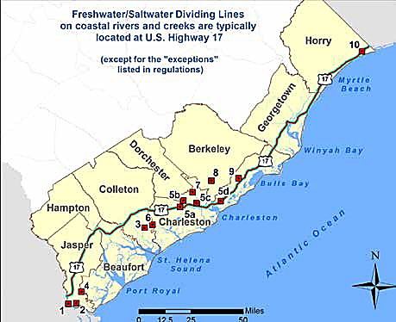
FRESHWATER/SALTWATER DIVIDE
( > 0.5 ppt – Salinity )
Notes:
Establishing a freshwater-saltwater divide can be difficult to define statewide, as there is a transition zone between the two water types. This zone will shift inland with rising tides and moon phase, and oceanward with heavy rain events. A very rough estimate of the freshwater/saltwater boundary is Highway 17 in South Carolina’s coastal counties.
The definitive factor of whether you are in a tidal saltwater or freshwater waterbody is the salinity reading. Any water with greater than 0.5 ppt salinity can be monitored using our tidal saltwater monitoring protocol. We will go over this process more later.
A very rough estimate of the freshwater/saltwater boundary is Highway 17 in South Carolina’s coastal counties. The red squares are the exceptions.

Slide 22
HEALTH OF TIDAL SALTWATER
Half of US population lives in coastal areas
Growth Rate
Monitoring can help track nonpoint source pollution
↑ Human Activity = ↓ Water Quality
Notes:
Half of our US population lives in coastal areas. South Carolina now has a steady growth rate, closely tied to new industries building in coastal SC.
Increases in human activity can negatively affect water quantity and quality because of point and nonpoint source pollution. AAS volunteers play an important role in tracking nonpoint source pollution and monitoring water quality.

Slide 23
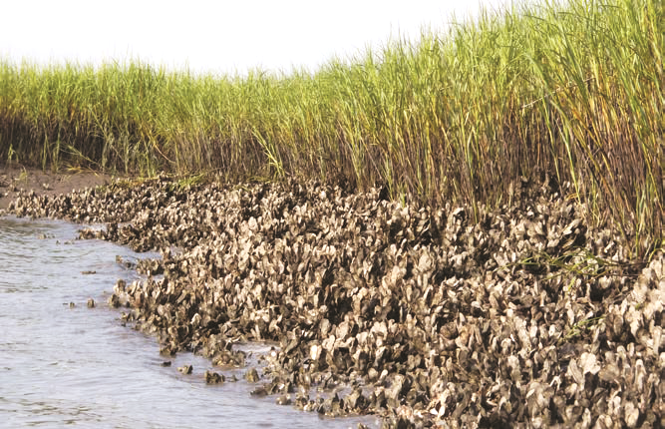
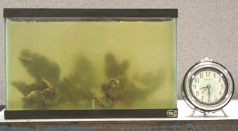
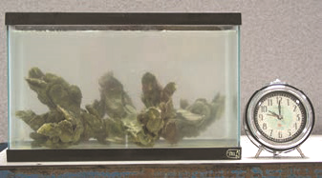
VALUABLE HABITAT
Productivity
344,500 acres of salt marshes in SC
Value of wetlands and marshes
Notes:
The salt marsh-tidal creek ecosystem is a highly productive coastal wetland that occurs between upland areas and estuaries, where fresh and saltwater mix. South Carolina has more than 300,000 acres of salt marshes. Coastal marshes, like freshwater wetlands, have an important role in absorbing flood waters, excess nutrients, and pollution.

Slide 24
MARSH-TIDAL ECOSYSTEM
Undergoes High and Low Tide
Tides Alter:
  Salinity
  Water Temperature
  Dissolved Oxygen
  Transparency
Rotten Egg Smell
Notes:
The surface of the salt marsh is underwater at high tide and dry at low tide. A finger-like network of tidal creeks winds through the marsh, allowing for the movement of tidal water onto the marsh surface and back into the estuary.
As the waters rise and recede, the tide can change the water salinity, temperature, dissolved oxygen levels, and transparency. Saltwater marshes are ever-changing ecosystems!
At low tide, the area may have a sulfur or rotten-egg smell which is completely normal. This smell should NOT be recorded in the database.

Slide 25
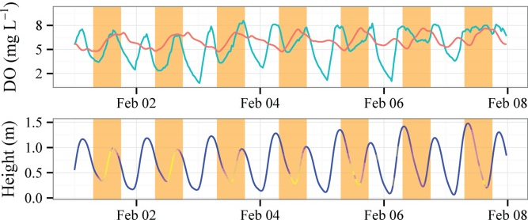
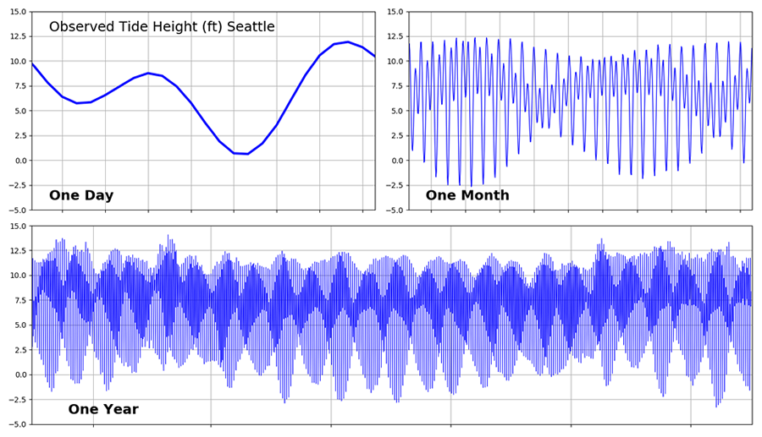
TIDES CONSTANTLY CHANGE
https://des.sc.gov/programs/office-ocean-coastal-resource-management/2024-tide-tables
Notes:
Daily tide cycles are ever changing and will alter the parameters that we moniton. Most seashores have 4 tides every day (2 high and 2 low). Changes in tides can be drastic or unnoticeable depending on your site location.
SCDES offers yearly tide change tables in collaboration with NOAA data. You can download or print a copy for your reference.
[Optional: 2024 Tide Chart here: https://des.sc.gov/programs/office-ocean-coastal-resource-management/2024-tide-tables ]

Slide 26
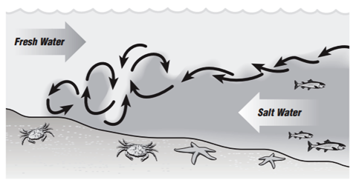
STRATIFICATION
Saltwater is denser than freshwater
Depth can lead to different values of:
  Water Temperature, Salinity, Dissolved Oxygen
Sample 1 foot below the water surface
Seasons, tides and rain events mix the water
Notes:
Freshwater and saltwater have different physical properties. Saltwater is more dense than freshwater, which can lead to periods of time where the freshwater sits on top of the saltwater. This period varies based on the tide cycle and the shape of the waterway that is monitored. This layering is called stratification.
When water is stratified, sampling at different depths can lead to variable results of temperature, salinity and dissolved oxygen. It is best to sample 1 foot below the water surface for a more evenly mixed sample.
Changing seasons, tides, significant rain events, and wind can lead to a mixing of freshwater and saltwater. In a well mixed estuary, the salinity doesn’t change with depth.

Slide 27
CHAPTER 3
Habitat Assessment & Observations
Page 30
Notes:
Page 30.

Slide 28
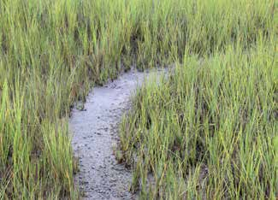
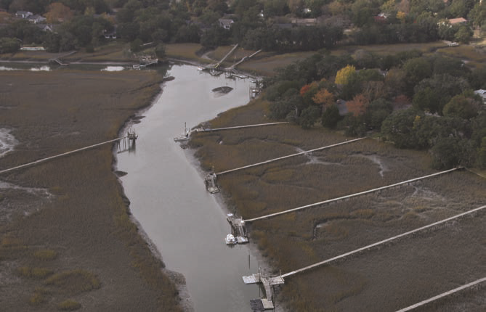
SITE SELECTION
Tidal Saltwater
Easy Access
Dock, Pier, Landing, Boat
DON’T enter the marsh!
Notes:
Volunteers can choose to adopt a site of their choice, can ask a trainer where to monitor, or can adopt a historical site that a previous volunteer is no longer monitoring.
If you are unsure about whether your site is tidal saltwater or freshwater, you can use the SC Watershed Atlas to check its classification, or check the salinity with your refractometer. As a reminder, a tidal saltwater site has a salinity of over 0.5 ppt.
Ensure that the site is easy access. This could mean sampling from a dock, pier, landing, or even a boat. DO NOT enter the marsh!

Slide 29
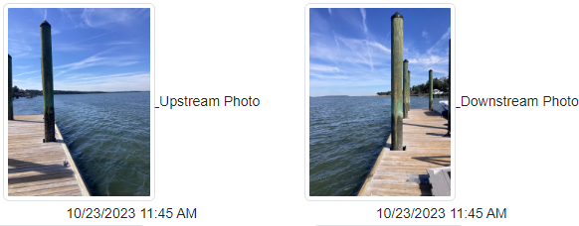
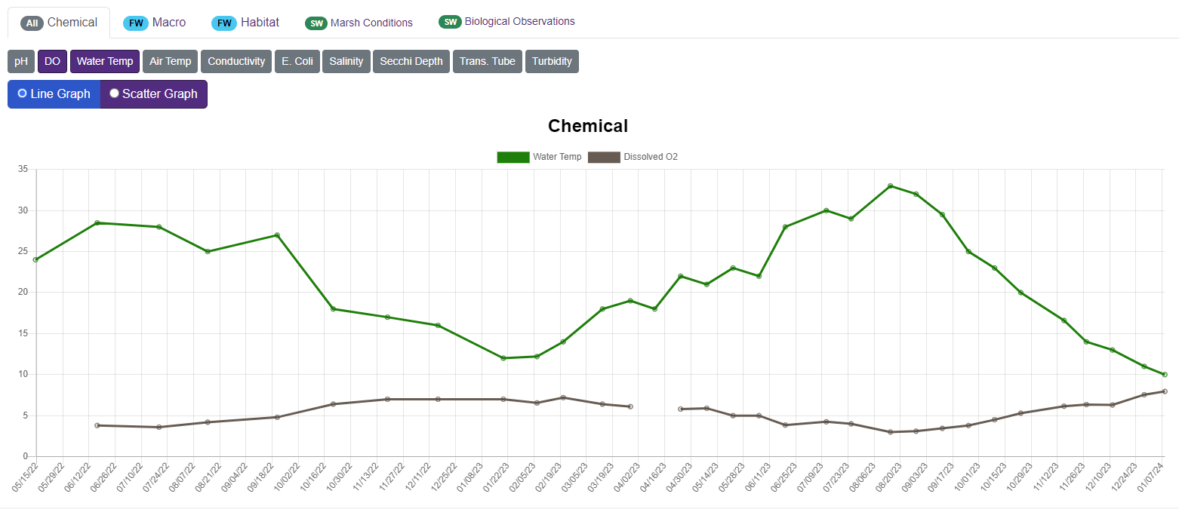
MONITORING COMMITMENT
Same location
Same time of day
Monthly
Notes:
For Adopt-a-Stream monitoring, volunteers always sample at the same location and roughly the same time of day during daylight hours. Keep in mind that measurements of certain parameters can vary at different times of the day and in different parts of the stream. Remember to visit the site monthly to collect and submit monitoring data.
[For example, you do not have to sample at exactly 10:53 AM but if you normally sample around 11:00 AM, don't go out at 5:00 PM.]

Slide 30
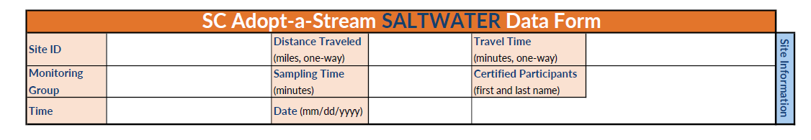
DATA FORMS
Data Forms found at www.scadoptastream.org
Choose your own group name or join an existing one
Database generates Site ID
**New version as of January 2024**
Notes:
When monitoring, you’ll need to fill out the datasheet entirely or enter data directly in the SC AAS Database from your mobile device. Datasheets can be found and printed from our website, or there is a back-up copy in the back of your handbook [note: as of 1/24 the handbook includes an outdated version].
[Do not go into database process here. Explain groups in more detail when showing database later in PowerPoint.]

Slide 31
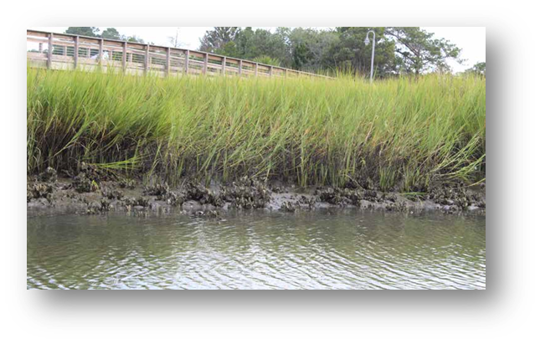
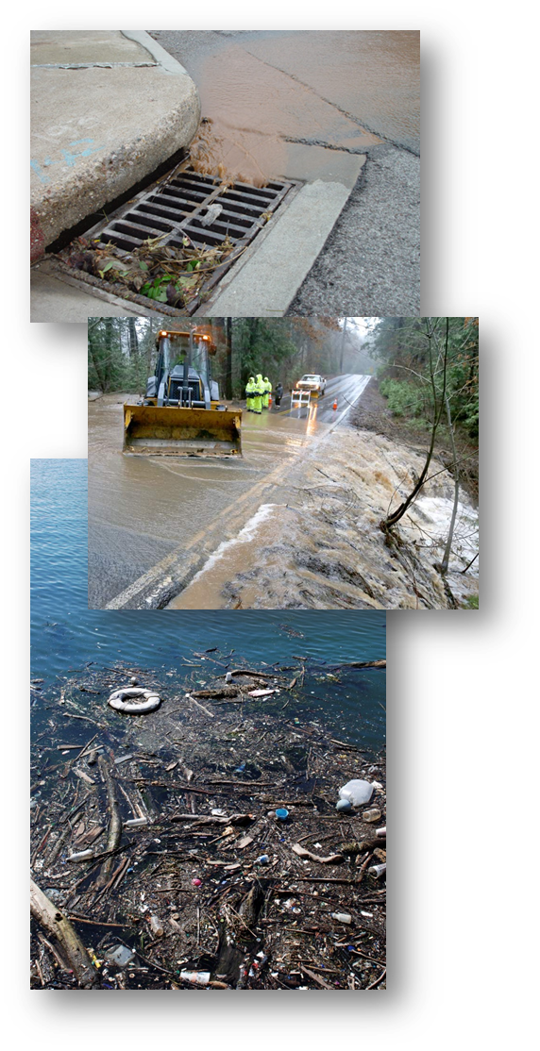
WEATHER
Present Conditions
Amount of Rain
  www.cocorahs.org/
**DO NOT sample during or after rain events**​
Notes:
Report the weather conditions at the time of your sampling event. Do NOT sample during or just after rain events. Rain runoff (and the pollution it carries) can cause spikes in your data that will lead to skewed baseline information. How long you wait to sample will depend on your watershed size. Wait at least 24 hours or until high flow has subsided before sampling. You can simply move your sampling event by a few days to avoid rain events instead of skipping that month's data collection.
Rain should be recorded as an amount in the last 24 hours and is a REQUIRED part of data entry. You can find recent rainfall data on most weather websites; however, CoCoRaHS is the recommended resource because it gives local amounts instead of regional ones. It’s also another fun citizen science program that you can volunteer to collect data for. Explore more at https://www.cocorahs.org/

Slide 32
RECORDING SITE OBSERVATIONS
Tide Level
  Low
  Mid
  High
Do not disturb the habitat – monitor from the bank, dock, or boat.
Notes:
Check your local high and low tide schedule to determine which stage your site is at. [Trainer recommend best website/app to use locally]
You never want to walk in a saltwater marsh habitat. This can disturb it! Make sure you are monitoring from a boardwalk, dock, boat, or stable bank.

Slide 33
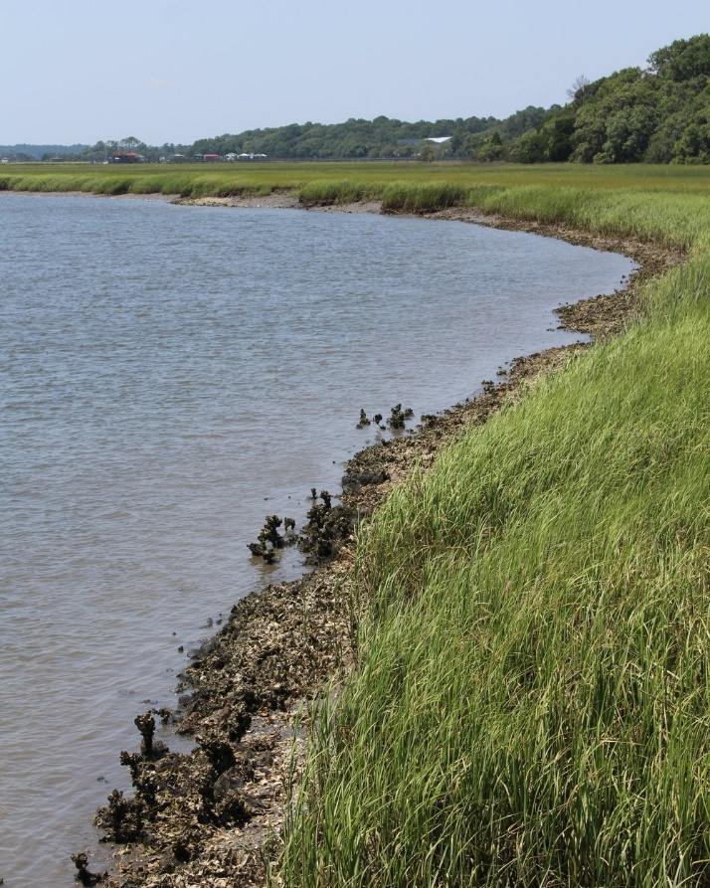
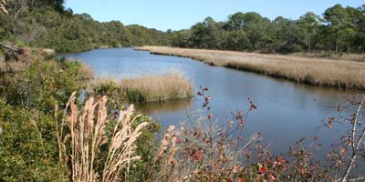
RECORDING SITE OBSERVATIONS
Water Conditions
  Calm
  Ripples
  Waves
  White Caps
Notes:
Typical salt marsh water conditions will appear calm, with the surface looking smooth or flat. With some wind or tide pull you may see ripples appear on the surface. White caps will probably only appear during poor weather conditions, in which you should not be monitoring!

Slide 34
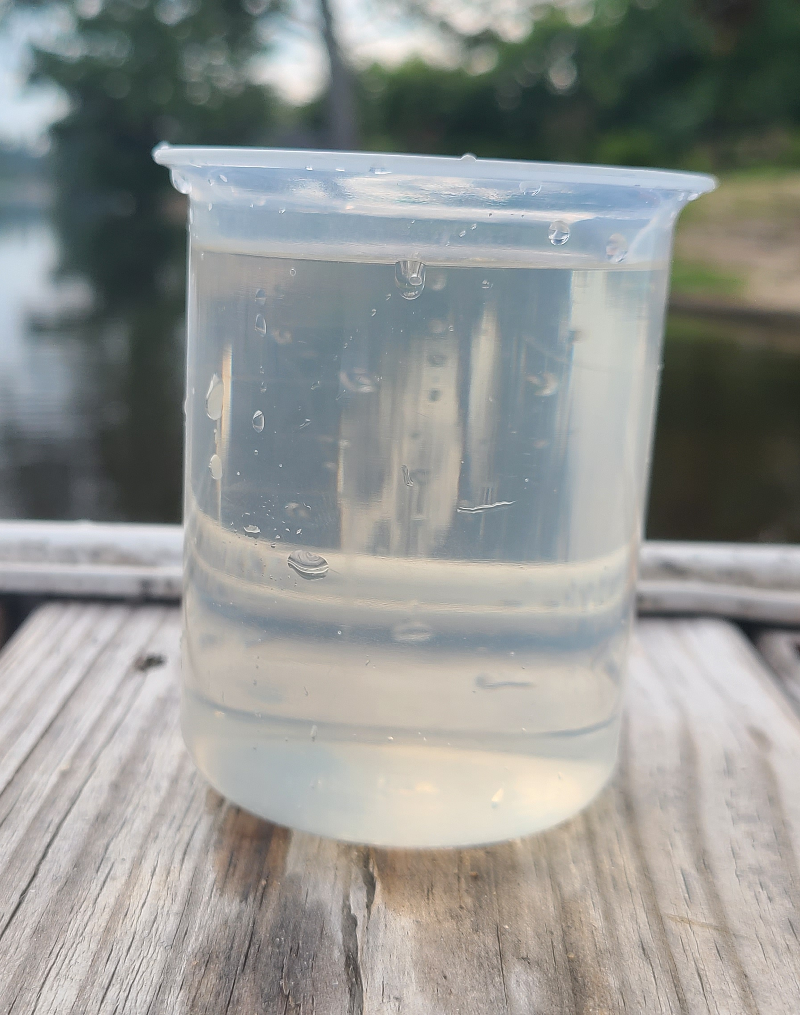
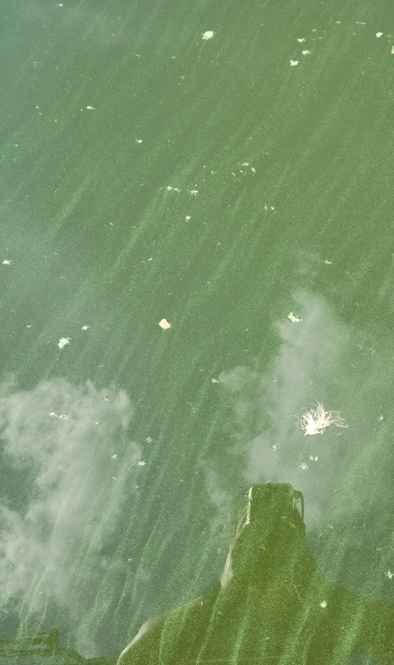
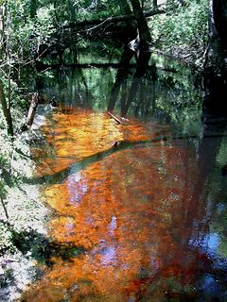


RECORDING SITE OBSERVATIONS
Water Color
No Color/Clear
Green
Tannic
Brown/Muddy
Milky/White
Notes:
Color can provide you immediate clues to a water conditions. Water color should be observed from a clear container. DO NOT look down at the water to decide its color. You may be observing the color of the stream bottom instead of the water itself.
Although clear water may or may not be of high quality, other colors may indicate certain conditions:
No Color—Normally a good thing, but clear water does not necessarily mean pollution-free water (if your stream water looks normal mark this in the database)
Brown/Muddy—Brown water is usually due to heavy sediment loads. Some of our South Carolina rivers more regularly run brown due to their soil types
Green—Green water is usually the result of excessive algae growth.
Tannic—Darkly stained water is usually caused by natural processes of leaves breaking down. Pigments leached from decaying leaves can cause the water to appear brownish-red, like a glass of sweet tea.
Milky/White—A milky appearance may be caused by salts in the water. It can also be a sign of illegal disposal by contractors or dischargers.
[Emphasize the points in bold.]

Slide 35



RECORDING SITE OBSERVATIONS
Water Color - Other
Blue
Black
Red/Orange
Notes:
If you observe a water color other than those listed on your data form, take pictures of your site and record "Other". Alert the State Team and/or call the emergency number (listed on page 3 of your handbook).
Both the Black and Blue images were taken by volunteers when they were monitoring their sites. AAS volunteers have been able to find and report pollution events, helping make a difference in water quality.
Red/Orange— This is an image of a harmful algal bloom (or HAB). If you see something like this, call the emergency number and contact the State Team.

Slide 36



RECORDING SITE OBSERVATIONS
Water Surface
Oily Sheen
Foam
Algae
Notes:
Record the conditions of the water surface on your data form.
Oily sheen—Oily sheens can be caused by petroleum or chemical pollution, or they may be natural by-products of decomposition. To tell the difference between petroleum spills and natural oil sheens, poke the sheen with a stick. If the sheen swirls back together immediately, it may be petroleum. If the sheen breaks apart and does not flow back together, it is likely from bacteria or plant or animal decomposition.
Surface foam— Surface foam is common and can be naturally occurring. Vegetation can produce surface-acting agents, or “surfactants,” which can cause surface foam. Human-induced surface foam may be an unnatural color (red, pink, blue, yellow, or orange) and have a fragrant smell. This foam is most likely generated by household detergents and may be a sign of a failing septic drain field or illegal discharge. You can also perform the stick test with foam: if it breaks apart, it is natural; if it swirls back together, it is likely a man-made surfactant.
Algae— Excessive algae growth can occur when human activities introduce excess nutrients to the aquatic ecosystem. It can grow on the surface or form thick mats. Some algae and cyanobacteria can also produce toxins that are harmful, look or smell bad, and are potentially dangerous for people and pets.

Slide 37

RECORDING SITE OBSERVATIONS
Water Odor
Notes:
Water odor, like color, can provide immediate clues about potential problems in a stream.
Make sure you record water odor before you begin chemical testing so that you do not become acclimated to the scent. It is important to differentiate whether the odor is coming from the water or the air.
Gasoline— Any petroleum or chemical smells may indicate serious pollution problems from a direct source, such as a factory, parking lot, or storm sewer runoff.
Sewage— These smells can be common in the air but should not be what our water smells like.
Fishy— This smell may be a sign of dead and decomposing fish in the stream.
Chlorine—This smell may be a sign of pollution and will smell like a swimming pool.
In the SC AAS Database, entering "Other” for color or odor will trigger an email alert to the SC AAS Coordinators, SCDES, and any local officials or organizations who have agreed to receive such alerts. If you notice a strange odor walk upstream and downstream of the site to see if you can identify the source. Take photos of anything unusual.

Slide 38

RECORDING SITE OBSERVATIONS
Water Clarity
  Clear
  Cloudy
  Opaque
Notes:
Water clarity can also give us insight into how much sediment is present in the water. Transparency will be precisely measured later in the monitoring process — water clarity is a more general observation.
Use the water in the container to check for clarity. Give it a good stir. Is it perfectly clear? Is there murkiness, or is it hard to see through?

Slide 39


OTHER DATA FORM OBSERVATIONS
Dumping
Hazards
Security
Outfall Flow
Notes:
Other observations include…. dumping, hazards, or security concerns. Pay special attention if pipes are flowing during dry spells. This could be an illegal discharge or pollution event.
Using the “illegal dumping” button in the database triggers an alert to Palmetto Pride directly. Illegal dumping is defined as “disposing of more than fifteen pounds of any collection of solid waste, litter, or other materials including discarded, deceased animals or deceased animal parts which create a hazard to the public health and welfare, but NOT (defined) as a careless, scattered littering of smaller items.” Please take photos of any dump sites you encounter.

Slide 40

PHOTOS = PRICELESS
Take 3 photos:
  Upstream (inland)
  Downstream (toward ocean)
  Water height
Pick a location to stand every time
  Make sure your view includes a fixed object (ex. piling)
Other photos: Wildlife, pollution, smiling volunteers
Send more to scaas@des.sc.gov!
Notes:
Photos are VERY important to collect and upload. There is room to upload 4 per sampling event (upstream, downstream, water height, and an additional photo). Please be consistent about getting the same view each time. It is helpful to have a stationary landmark in your photos. You don’t want to use a buoy or anything that would float up and down with the tides. If you use an iPhone, change the photo file type to a .jpeg to get it to upload to the database.
NOTE: If the situation allows and their volunteer and property owner are willing, a staff gauge can be installed at the site to quantitatively record surface water height. If you want more information about installing a gauge, talk to your trainer or read more about it on Page 33.

Slide 41


HABITAT ASSESSMENT
Wetland Condition/Appearance
Notes:
Evaluate the color of the marsh grass. Is it green, brown, mostly muddy, or a color that it shouldn’t be in that season? A marsh should appear bright green in the warm months when new growth is appearing. Marshes are often brown in the fall and winter.
Is your wetland area increasing, decreasing, or the same as the last time you sampled?

Slide 42

HABITAT ASSESSMENT
Phragmites (Common Reed)
  Invasive
Notes:
It is also important to check for the presence of invasive Phragmites. Recently discovered in South Carolina, the common reed, or Phragmites australis subsp. australis, establishes itself in disturbed soils and in areas of high nutrient inputs, such as alongside agricultural fields, residential neighborhoods, and construction sites.
Volunteers should indicate if they find Phragmites on their data sheets and report it to the SCDES Aquatic Nuisance Species Program. This will help resource managers implement controls and track the spread of the highly aggressive non-native plant. Caution: there is a native version of this plant that is considered a “look-alike.”

Slide 43

HABITAT ASSESSMENT
Located within 100 feet of the waterway?
  Industrial
  Commercial
  Residential
  Agriculture
  Dock
  Groins/jetties
Observed impacts on marsh
  Dredging
  Erosion
  Algae
  Large vegetative debris
Notes:
Human activities can impact and change habitats, so make note of what land is being used for around the site. Look for signs of active erosion/bank loss, as well as mud in the marsh that accumulates as mud flats or fresh deposition of wet mud.
Keep an eye out for sediment plumes (obvious turbidity in the water column that is atypical of the site). Does it appear that dredging active has deepened or widened the channel?
Are any submerged grasses and plants visible along the bottom and sides of the waterway? Are any jetties/groins (manmade structures for access and water management) visible?

Slide 44










BIOLOGICAL SURVEY
https://www.saltmarshguide.org/
Notes:
The last thing to note on the Habitat Assessment section of the datasheet is the biological survey. DNR’s Guide to the Salt Marshes and Tidal Creeks of the Southeastern United States can help you identify plants and animals that you may be unfamiliar with. You can also take a photo and send it to your trainer to help you identify it.
[Link: https://www.saltmarshguide.org/]

Slide 45
CHAPTER 4
Physical and Chemical
Monitoring Protocol
Page 37
Notes:
Page 37.

Slide 46


WATER QUALITY MONITORING
6 Parameters:
  Air Temperature
  Water Temperature
  Transparency
  Salinity
  pH
  Dissolved Oxygen
Notes:
The 5 parameters that you will be sampling MONTHLY are: air temperature, water temperature, oxygen, pH, salinity, and transparency. We’ll practice measuring these parameters in the field later.

Slide 47

WHY MEASURE TEMPERATURE?
Source: Streamkeeper’s Field Guide
Notes:
Water temperature is one factor in determining which species may or may not be present in the system. A week or two of relatively high temperatures may make a stream unsuitable for sensitive aquatic organisms, even though temperatures are within tolerable levels throughout the rest of the year.
Not only do different species have different requirements, but optimum habitat temperatures may change for each stage of life. Fish larvae and eggs usually have narrower temperature requirements than adult fish. Temperature is also very closely linked with how much oxygen a stream can hold.

Slide 48

TEMPERATURE TRENDS
Temperature and Oxygen are opposite!
Cooler winter waters (lower temperature) will have higher oxygen levels
Affects feeding, reproduction, metabolism
Notes:
The higher the water temperature, the less oxygen water can hold. This is why you may see stories about fish kills in the heat of summer and why temperature and oxygen-sensitive fish species, like trout, can only thrive in cold streams. Temperature greatly affects feeding, reproduction, and the metabolism of aquatic animals making it an important parameter to measure.
[Data pulled from AAS site 239]

Slide 49


MEASURING TEMPERATURE
Measure:
In the shade
Take air temperature FIRST
Measured in degrees Celsius (˚C)
Notes:
To measure temperature, we use an armored case thermometer.
ALWAYS take air temperature before water temperature. Make sure the thermometer is hanging or suspended in the shade. Do NOT wrap your hand around the bottom of the thermometer while reading the result, as this increases the temperature.
Let the thermometer stabilize before recording air temperature. In other words, give it a few minutes to adjust.
Measure water temperature second by submerging the thermometer in the stream for at least 60 seconds. Try to read the thermometer in the water or immediately after removing it from the stream.
Record temperatures in degrees Celsius. There is a temperature conversion chart on page 39 that lists Celsius and Fahrenheit side by side for easy comparison.

Slide 50


WHAT IS TRANSPARENCY?
  Clarity or light penetration of water
  Affected by color &
  suspended materials
  Measured in cm
Notes:
Transparency, or the “clarity” of the water, is the measure of light penetration into a waterbody. It is affected by color and suspended materials in the water. This measurement can help monitor erosion or land use changes in your watershed.
The tools available for Adopt-a-Stream sampling measure transparency, however there is no state standard for transparency, only turbidity.

Slide 51

WHAT IS TURBIDITY?
  "Cloudiness" or measure of suspended particles of water
  NOT the same as Transparency
  Measured in NTUs
Let’s find it!
State Standard:
Not to exceed 25 NTUS
Notes:
Turbidity is a measure of the "cloudiness" of water. Transparency and turbidity are not the same and are measured in different units. They are inversely related: in other words, the higher the turbidity is, the less transparent the water is. Increasing turbidity can be an indication of increased runoff from land. It is an important consideration for drinking water as finished water has turbidity limits.
The database will convert transparency tube values to turbidity for you in order to relate your measurement to state standards.
[Optional video on measuring transparency: https://www.youtube.com/watch?v=56KxMeLKfG4]

Slide 52

TRANSPARENCY TUBE
  Collect a new sample using a bucket/sampling pole
  Measure in shade
    Remove hats and sunglasses
  > 120 cm
  Remix if water sample has settled
When quadrants are barely visible.
Notes:
To measure, submerge the tube to fill it with water, being careful not to stir up sediment, OR pour a fresh water sample from a bucket or sampling pole. Move the filled tube to the shade and remove anything that could alter your field of view like sunglasses or hats. Look straight down into the tube, slowly letting water out until you can begin to differentiate the black and white of the Secchi disk at the bottom of the tube. Read the scale on the outside of the tube and record measurement in centimeters.
If your tube is full but you can see the Secchi disk from the top, mark that your transparency is greater than 120 cm in the database.
If you leave the water sample in the tube too long, remix it to suspend everything again.

Slide 53



SECCHI DISK
Disappearance depth and reappearance depth
Measure from the disk to the top of the water NOT to where you hold the rope
Disc hits bottom?
Measured in meters
Notes:
Transparency tubes can be used anywhere. On the other hand, Secchi disks can only be used when sampling from a dock, pier, or boat without a strong current, as you must be directly above the disk to take the measurement.
When using a Secchi disk, two measurements are taken. The first is the disappearance depth, which is the measurement from the disk to the top of the water, taken when the disk first starts to disappear from sight. The next is the reappearance depth, which is the measurement from the disk to the top of the water, taken when you can just start to see the disk again as it is pulled upwards. These two measurements are averaged in the database to yield one transparency value.
Ropes made by AAS Trainers will have 10 cm, 50 cm, and 100 cm markings. Record your measurement in meters.

Slide 54

WHAT IS SALINITY?
Measure of dissolved salts
  ppt (parts per thousand)
> 0.5 ppt = Saltwater
  Freshwater: 0 ppt
  Tidal Creeks: 5-10 ppt
  Ocean: 36 ppt
Salt excretion on leaf of Spartina
↑ Salinity = ↓ DO
Notes:
Salinity is the measure of dissolved salts in water, typically reported in parts per thousand (ppt). It is the major determining factor in plant and animal distribution and changes from a freshwater environment to saltwater.
Freshwater has a salinity of 0 parts per thousand (ppt). As you travel up-river, salt marshes and tidal creeks have a lower salinity of around 5-10 ppt. Closer to the ocean, salinities range from 20-35 ppt. For Adopt-a-Stream sampling, any waters with salinity of > 0.5 ppt are considered saltwater.
Salinity also influences the saturation level of DO. As salinity increases (for example, as a river moves towards the ocean), the amount of DO that the river can hold decreases.

Slide 55


MEASURE SALINITY
Measure:
  Calibrate refractometer
  Remove hats and sunglasses
  Measure in bright area
  Read scale through eyepiece
Notes:
A refractometer is a device which measures the content of a solution by the refraction of light. The refractometer must be calibrated with distilled water prior to every sampling event.
Place a few drops of distilled water on the angled prism and seal the clear plate on top of it. Ensure that the liquid spreads evenly without air bubbles or dry spots. Hold the instrument in a bright area (no hats or sunglasses) and look through the eyepiece. Adjust until the reading is zero. Wipe the prism clean and repeat the process with your sample. Read the scale on the right-hand side and record your results in ppt.
Note: If your screen is all blue, two conditions may be at play. There may be too small an amount of sample water on the prism. Or, you may be seeing results of freshwater dilution, perhaps from a large storm.
[Optional video: https://www.youtube.com/watch?v=kay3tsU-u4M&t=7s]

Slide 56

WHAT IS pH?
Acid/Base Scale
Ranges from 0-14
7 is Neutral (pure water)
Source: Safe Drinking Water Foundation
Notes:
pH is a measure of how acidic or basic water is and has a scale of 0 to 14. A pH of 7 is considered neutral (not acid or basic). Rainwater is slightly acidic and sea water is slightly basic. The pH of stream water is influenced by the concentration of acids in rain and the types of soils or bedrock in the watershed.
Low pH levels (acidic water) can have a harmful impact on the health of aquatic communities. Very acidic water or acid rain can allow toxic substances such as ammonia and heavy metals to leach from our soils and possibly negatively affect aquatic plants and animals. Extremely high or low pH values are quite rare in South Carolina.

Slide 57



SC STREAMS WITH LOWER pH
Slow-moving streams in forested swamps and wetlands
Rivers of the southeastern and coastal plain
Notes:
There are surface waters in South Carolina’s coastal plain where pH may be very low, which is the natural condition of these waterways. Vegetation in the stream decays, which adds tannins to the water. These tannins cause the water to become darkly stained (reddish brown to black) and acidic. An example of this is the Edisto River.

Slide 58


HOW TO MEASURE pH?
Measure:
Rinse sampling bottles twice before collecting sample
Two samples must be within +/-0.25
White paper helps
Let’s find it!
State Standard:
6.5-8.5
Notes:
The pH of water is measured using a tool called a color comparator. Simply fill a test tube up with sample water, add the color changing chemical, and compare the color of the test tube to the color-coded scale.
There are two important things about testing for pH:
The test tubes must be rinsed with stream water two times prior to taking your measurement.
You must do this test twice for duplicate precision. The two samples must be within 0.25 of each other to be valid according to our Adopt-a-Stream protocol.
In the majority of tidal saltwaters in South Carolina, pH levels should fall between 6.5 and 8.5 to meet South Carolina state standards
[Demonstrate how to check both scales. There are different shades of green on BOTH scales. Always remove sunglasses to take reading.]

Slide 59

WHY MEASURE DISSOLVED OXYGEN?
Notes:
Like land organisms, aquatic animals rely on oxygen in the water to live. Fish, invertebrates, plants, and aerobic bacteria all require oxygen for respiration. Just like pH and water temperature, there are levels of dissolved oxygen that determine which species may or may not be present in the system. Low oxygen is thought to keep out the larger predators. This makes creeks and marshes good nursery habitats for smaller organisms that can withstand lower oxygen levels.
Dissolved oxygen levels (or “DO” for short) naturally fluctuate through the day and seasonally. You may see a wide range of values during your monitoring trips. However, when levels fall below 4 mg/L, aquatic life becomes severely impacted or dies.

Slide 60



ALTERING DISSOLVED OXYGEN
Increased DO:
  Diffusion from atmosphere
  Turbulent mixing (waves)
  Product of photosynthesis
Decreased DO:
  Warm temperatures
  Decayed organic matter
  Slow moving, deep water
Notes:
DO to changes daily and seasonally within your stream because there are multiple ways it can be increased or decreased in water.
DO levels can increase through oxygen entering from the atmosphere, turbulent mixing from wind and water flow, and photosynthesis by living aquatic plants, algae, and phytoplankton.
DO levels can decrease due to warmer temperatures, decaying organic matter increasing oxygen-consuming bacteria, and slow-moving, deep water. That is why critically low oxygen levels often occur during the warmer summer months when dissolved oxygen capacity decreases and oxygen demand increases.

Slide 61

HOW TO MEASURE DO?
  Measure:
  Rinse sampling bottles twice before collecting sample
  Take two samples for duplicate precision (+/- 0.6 )
  Retest if not within duplicate precision
  Measured in ppm or mg/L (1 mg/L ≈ 1 ppm)
Let’s find it!
State Standard: Daily Average above 5 mg/L and not less than 4 mg/L
Notes:
[Demonstrate the different pieces of the kit. Go over terminology like reagents, syringe/titrator, sample bottle, etc.]
Remember to rinse both stream sample bottles twice before taking the sample. Like the pH sampling, you will do this test two times. Once you have completed the chemical reactions, your final measurements between the two sample MUST be within 0.6 mg/L of each other. Redo the test until you have both samples within duplicate precision of one another.
The most common mistakes happen when there are air bubbles accidently left in the sample bottles or the syringe. You’ll get to practice using this kit later in the field. Remember your handbook has instructions and tips from pages 42-49.
DO levels must have a daily average not less than 5 mg/L and must be never be less than 4 mg/L to meet standards. Your saltwater site may also experience frequent DO levels below state standards in the heat of the summer. [Optional Video: https://www.youtube.com/watch?v=Nmu7r32gE-g&t=3s ]

Slide 62


CHEMICAL KIT MAINTENANCE
Always check expiration dates!
  Check the date on EACH chemical
  Replace when expired or contaminated
    Contact Trainer or Kit Loan Location
Store in a cool, dark place
Sampling waste:
    Flush down drain with excess water
    EXCEPT if you have a septic system
Notes:
Remember to maintain the pH and DO chemical kits by doing the following:
Always check the expiration dates of chemicals before you sample! Each chemical has it's own expiration date. If reagents are expired or contaminated, please contact your kit loan location or a trainer to let them know so they can be replaced.
Store a kit in a cool, dark place when not in use. This especially means to never leave the kit in a hot car or cold garage.
Sampling waste can be poured down your sink at home with extra water or flushed down the toilet UNLESS you are on a SEPTIC system. (DO NOT POUR expired chemicals down the drain).

Slide 63
CHAPTER 5
Phytoplankton
Monitoring Protocol
Page 53
Notes:
Page 53.

Slide 64

PHYTOPLANKTON
Phytoplankton Monitoring Network (PMN) :
  Plant-like micro algae
  Harmful algal blooms (HABSs) -toxins
  NOAA Database
  Climate Change
EMAIL: pmn@noaa.gov
Notes:
Phytoplankton, also known as microalgae, are like terrestrial plants in that they contain chlorophyll and require sunlight to live and grow. In a balanced ecosystem, phytoplankton provide food for a wide range of sea creatures.
Phytoplankton feed on nutrients such as nitrates, phosphates, and sulfur. When too many nutrients are available, some phytoplankton may grow out of control and form harmful algal blooms (HABs). These blooms can potentially produce extremely toxic compounds that have harmful effects on fish, shellfish, mammals, birds, and even people. Algae and cyanobacteria are a natural part of the waterway, but some can be harmful, and these are the organisms that are actively monitored.
The Phytoplankton Monitoring Network (PMN) is a national volunteer organization that monitors for potential HABs and promotes a better understanding of them.

Slide 65

PHYTOPLANKTON
Phytoplankton Monitoring Network (PMN) :
EMAIL: pmn@noaa.gov
Notes:
The minimum requirements for PMN volunteers are microscope access, biweekly sampling of a site, at least one year of participation, and completion of the training sessions.
This program is separate from SC Adopt-a-Stream but can be a great tool for monitoring biological communities at your adopted site.

Slide 66

PHYTOPLANKTON
Phytoplankton Monitoring Network (PMN) :
  Free Mobile Phyto App-ID Phytoplankton
EMAIL: pmn@noaa.gov
Notes:
There is a free app called that helps you learn to identify phytoplankton and their proper pronunciation. It includes the most common saltwater phytoplankton.

Slide 67
CHAPTER 6
Using the
Adopt-a-Stream Database
Page 56
Notes:
Page 56.

Slide 68

SC AAS DATABASE
Step 1: Find login link in email
Your Username to login will be the email used to register for this workshop.
Notes:
The link to the database can be found on our main website www.scadoptastream.org. Bookmark this page for easy access. [You can show the volunteers the database or go through these slides.]
This is the first screen you’ll see whether you are a certified volunteer or not. Anyone can VIEW sampling events, groups, or sites, but not volunteer information. Sampling Events and Sites pages have export buttons, or data can be copied and pasted directly from the screen.
All volunteers who complete this workshop will be added to the database as certified users. Once we add you as a volunteer, you will be sent an email from “SC Adopt-a-Stream” with a subject line “SC AAS Volunteer Sign-up” (check your spam folder if you don’t see it or contact our staff for a direct link). This login link will have you create a user profile.
Once your user profile has been created, you’ll be able to log in using the top right button. Your username will appear in the top right corner when you are logged in.

Slide 69

Navigate to the Groups page
Search for an existing Group or create a new one
Step 2: Create or Join a Group
You can be in a group by yourself or add additional volunteers later on.
Step 3: Add NEW Site/Adopt Existing
You’ll need to be able to find your site on a map or have the Latitude/Longitude.
Notes:
All new volunteers must create a group first, then add their site BEFORE entering data for the first time. After their group and site is linked to their name, volunteers will use the “Add Sampling Event” button on the Sampling Events page.

Slide 70


Step 4: Click “Add Sampling Event”
Then follow the tabs on your data form to match the tabs in the database.
Notes:
When you have completed a sampling event and are ready to enter data go to the sampling events tab and click the add sampling event button. The tabs in the database are the same as the tabs on your data form!

Slide 71

SUBMIT DATA
As soon as possible after monitoring
Submit data online OR on mobile device
Share your data with partners, local governments, and your local communities
Notes:
Data should always be submitted to the database as soon as possible. You can do this from your phone directly or from a computer. We encourage you to share this data with your community and continue to monitor once a month throughout the year. Datasheets can be found in the back of the handbook, on our website, and should be in the kits that you borrow.

Slide 72

LET’S LOCATE A KIT!
Notes:
Volunteers can always borrow kits from their local trainer or can look up to see if there is a kit loan location near where they live. You can do this by going to the SC Adopt-a-Stream website and navigating to the kit loan map. If there is no kit near you, try borrowing one from your trainer or contacting a program coordinator for help.
​
[Demonstrate kit loan map, Hub map, and/or explain where the local kits are.]

Slide 73

STAY CONNECTED
Facebook
facebook.com/scadoptastream
Instagram
@scadoptastream
Notes:
There are many ways to stay connected. After you register in the database you will be added to the monthly SC Adopt-a-Stream e-newsletter. We also recommend you follow us on Facebook and Instagram so you can keep up with the latest Adopt-a-Stream happenings! SC Adopt-a-Stream is an ever-growing and evolving program. We can’t wait to see which streams you adopt next!

Slide 74



CONTACTS
If you have any questions, please don’t hesitate to ask!
Your SC Adopt-a-Stream Coordinator Contacts:
Sierra Hylton
Columbia Office
sierra.hylton@des.sc.gov
(803) 898-4168
Lexi Toole
Columbia Office
alexandra.thomason@des.sc.gov
(803) 898-9564
Erin Rosebrock
Charleston Office
erin.rosebrock@des.sc.gov
(843) 953-0149
Reach the whole State Team: scaas@des.sc.gov
Notes:
If you have any questions, please don’t hesitate to ask! You can reach out to your trainer or program coordinators anytime. You are invited to join me during my monthly sampling event or can invite me out to join you the first time you sample your stream. Thank you and welcome to South Carolina Adopt-a-Stream!
Sierra Hylton: Sierra.Hylton@des.sc.gov (Columbia)
Lexi Toole: Alexandra.Thomason@des.sc.gov (Columbia)
Erin Rosebrock: Erin.Rosebrock@des.sc.gov (Charleston)

Slide 75

Now to the field!
What to Bring?
Handbook
Notes
Datasheet
Pencil
Water Shoes
Water Bottle
Notes:
[If travelling to the stream, give volunteers directions.]
[Modify this slide with field directions, map, and any special instructions]

