Slide 1
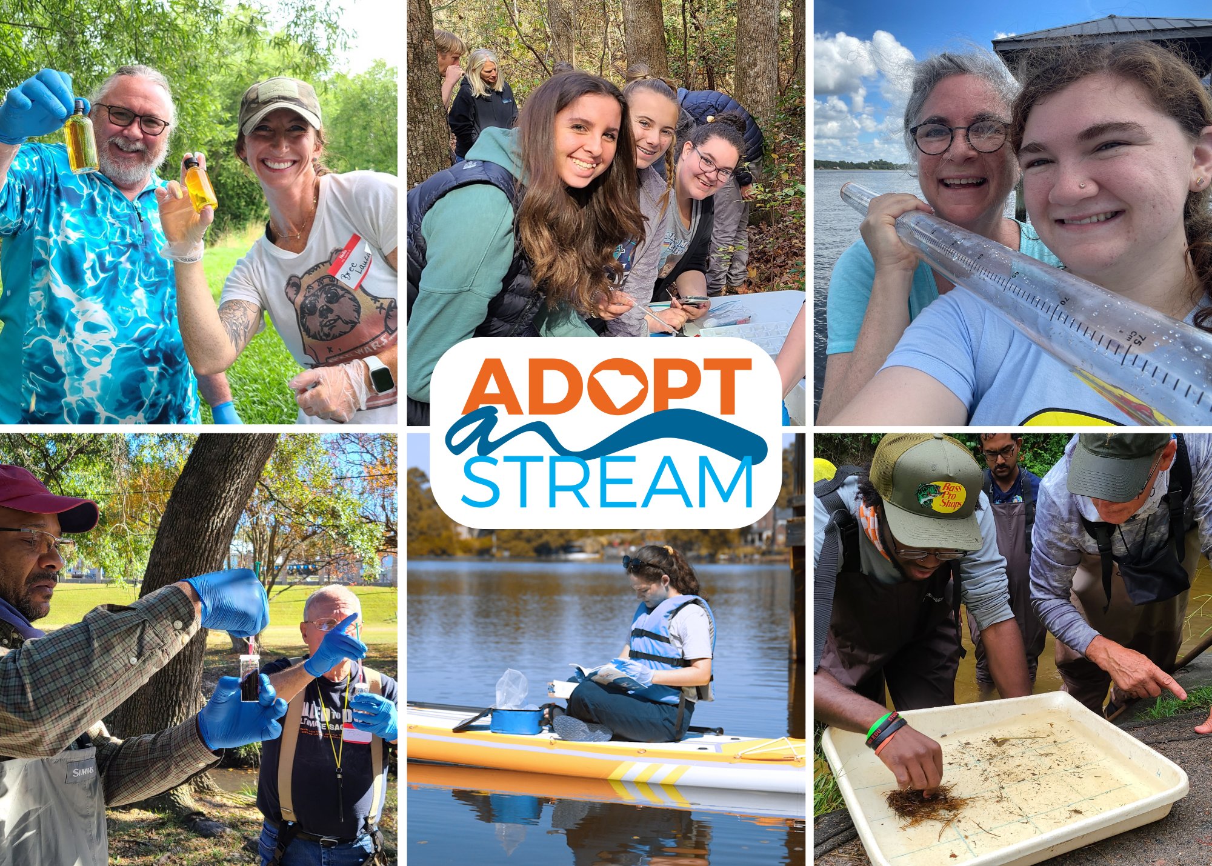
WELCOME!
The presentation will begin shortly. Here are some tips for a great workshop experience.
Please have a way to take notes.
Ask questions at any point in the presentation
Steps to become a certified volunteer:
  Complete today’s online training
  Complete group field training and pass test
  Adopt a site to monitor monthly
Notes:
**** Notes with [brackets] are reminders for trainers only and should NOT be read out loud. ****
[This slide is for virtual workshops only.]
[Log on to your virtual training 15 minutes before start time. Check audio and external links prior to use with your co-trainer.]

Slide 2
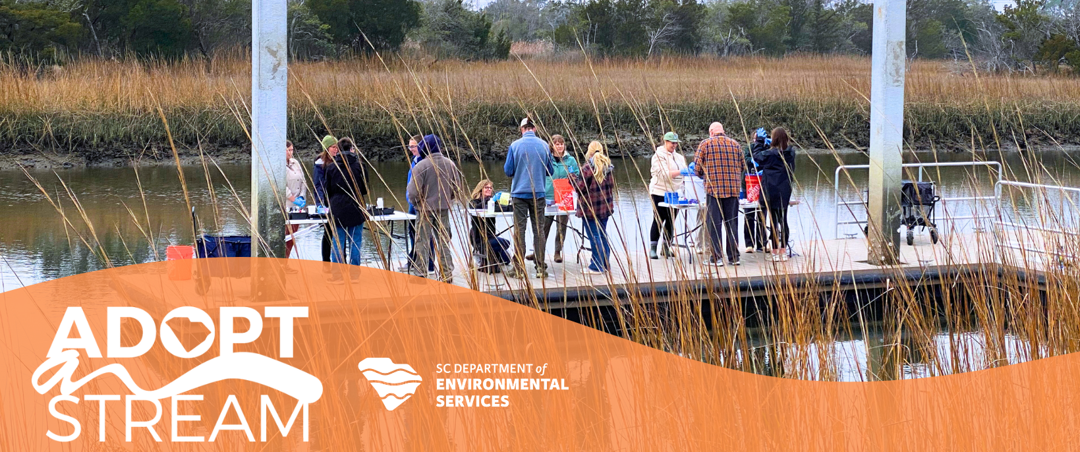
TIDAL SALTWATER MONITORING WORKSHOP
Updated 2/24
Notes:
**** Notes with brackets [xyz] are reminders for trainers only and should NOT be read out loud****
[Welcome volunteers. Introduce yourself.]
Hello and welcome to South Carolina Adopt-a-Stream’s Tidal Saltwater Monitoring workshop. Today marks the start of your certification to become an active volunteer water quality monitor. We will cover some basic water quality information, go over monitoring protocols, and show you resources to help you learn about the waterway you may adopt.
[Go over any logistics info: Where are bathrooms? When is the first break? Did everyone get signed in and have a way to take notes?]

Slide 3
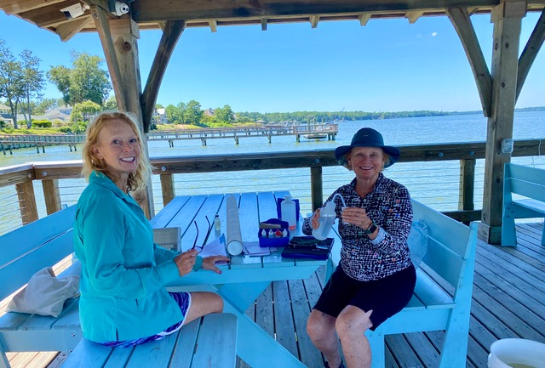
INTRODUCTIONS
Who are you?
Why are you here?
Where will you monitor?
Notes:
[Ask volunteers:
Who they are/what they do
Why they have come to the training
Where they will monitor (if known)]

Slide 4
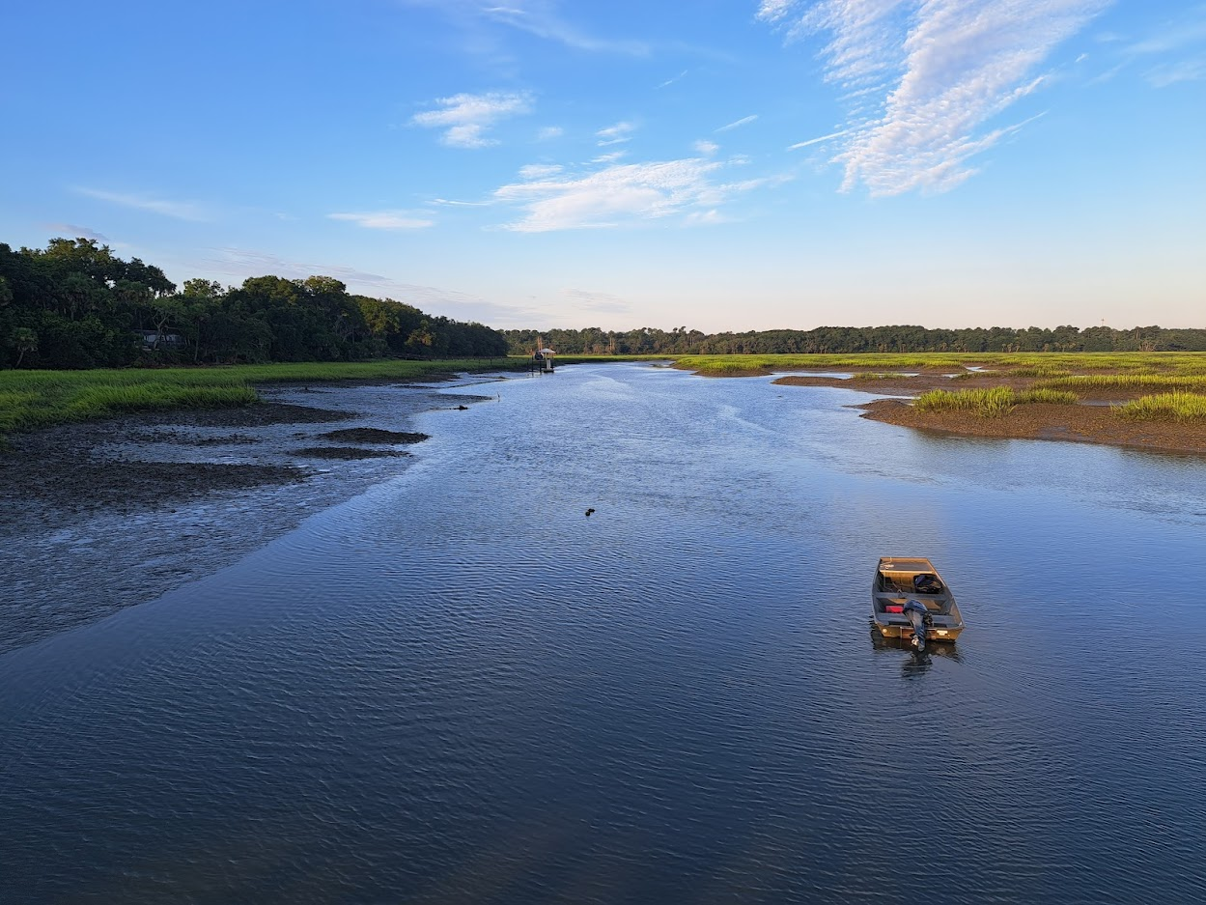
South Carolina Salt Marsh-
Tidal Creek Ecosystems
Page 6
Notes:
Page 6.

Slide 5
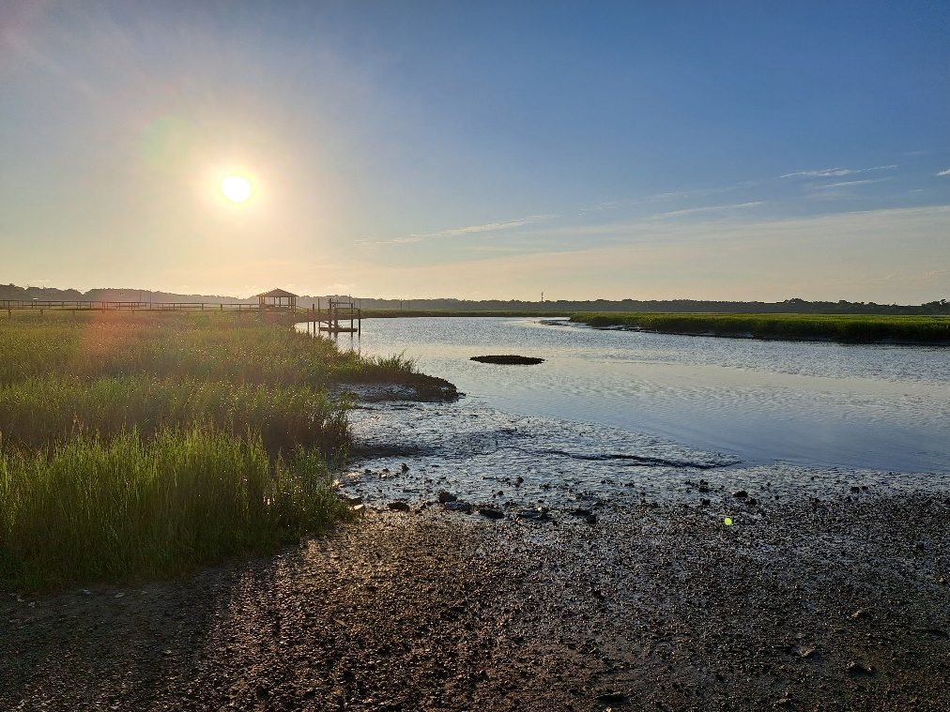

SALT MARSH-TIDAL CREEK ECOSYSTEM
Coastal wetland
  Wetland: transition zone between dry land and water
  Fresh and salt water mix
Surface of the salt marsh is underwater
at high tide and dry
at low tide
p.6
Notes:
The salt marsh-tidal creek ecosystem is a highly productive coastal wetland where fresh and salt water mix. Wetland is a term for the transition zone between dry land and water that is covered by water seasonally or permanently. A finger-like network of tidal creeks wind through the salt marsh, allowing tidal water to move onto the marsh surface and back into the estuary. The salt marsh and the tidal creek habitat impact the ecosystem as whole and influence water quality in the waterway.

Slide 6
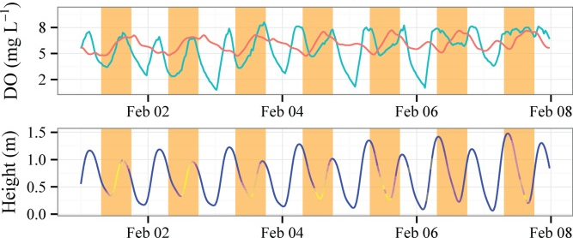
TIDAL INFLUENCE
Semi-diurnal tides
  Two high tides
  Two low tides
Tides alter water quality
Plants and animals are adapted to changes
p.7
Notes:
The salt marsh-tidal creek ecosystem has semi-diurnal tides, meaning it experiences two high tides and two low tides each day. Tides are important in controlling the water quality of these ecosystems, and plants and animals found here are adapted to the changes that occur hourly, daily, seasonally, and annually.
[The graph shows the relationship between DO and tide height]
Page 7

Slide 7



SALINITY
Indicates whether a waterway is a tidal saltwater or freshwater ecosystem
Measured in parts per thousand (ppt)
Pure fresh water: 0.0 ppt
Ocean water: 36.0 ppt
SC AAS tidal saltwater site: > 0.5 ppt
p.7
Notes:
Salinity indicates whether a waterway is a tidal saltwater or freshwater ecosystem. If your waterbody has a salinity greater than 0.5 parts per thousand (ppt), it is considered a saltwater habitat for SC AAS monitoring purposes. Ocean water has a salinity of 36.0 ppt and pure fresh water has a salinity of 0.0 ppt.

Slide 8
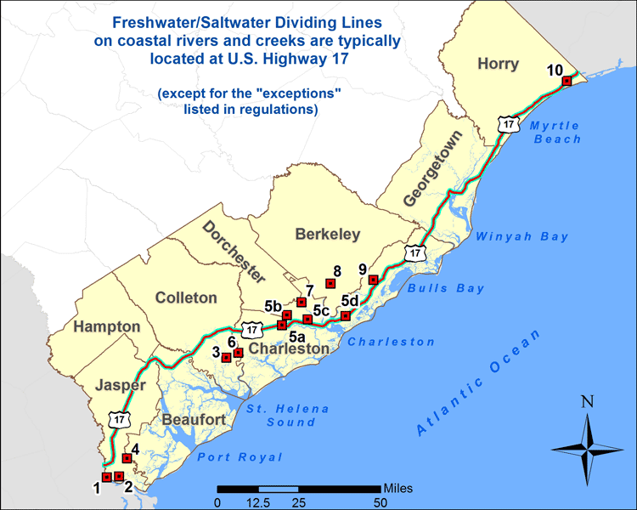
FRESHWATER/SALTWATER DIVIDE
p.8
Notes:
Establishing a freshwater-saltwater divide can be difficult as there is a transition zone between the two water types. This zone will shift inland with rising tides and oceanward with heavy rain events. A very rough estimate of the freshwater/saltwater boundary is Highway 17 in South Carolina’s coastal counties. Known exceptions are indicated by the red squares.

Slide 9
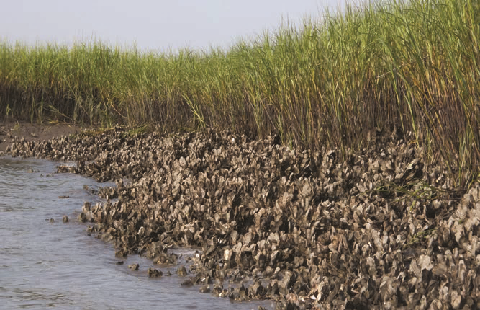
VALUABLE HABITAT
Protecting wetlands protects water quality
Ecosystem services
  Filtering pollutants
  Providing nursery habitat and feeding grounds
  Reducing flooding and erosion
  Supporting fisheries
p.8-9
Notes:
Salt marshes and tidal creeks provide us with a wealth of benefits, referred to as ecosystem services. Oyster reefs and creek bank vegetation filter out pollutants and help reduce wave energy and current velocity. Tidal creeks are important nursery areas and feeding grounds for many species. The marsh protects upland areas and private property from flooding and erosion. The ecosystem also supports fisheries and our state’s economy. Protecting these valuable wetlands protects water quality.

Slide 10
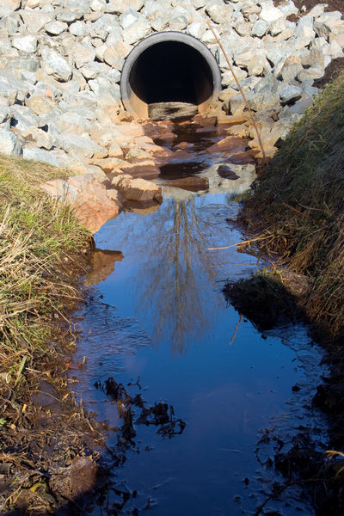
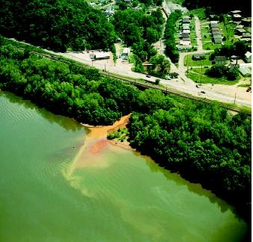
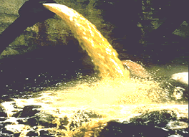
POINT SOURCE POLLUTION
Can point to the source of the pollution
Regulated by SCDES
p.10
Notes:
Our salt marsh-tidal creek ecosystems are threatened by pollutants that enter the water. There are two main types of water pollution, point source and nonpoint source, that can negatively affect water quality. Point source pollution is where you can see or point to the source of pollution. Examples include industrial discharges and municipal sewage treatment plants.
This type of pollution is regulated by the South Carolina Department of Environmental Services (SCDES). Industries, business, cities, and counties must go through a lengthy permitting process to discharge into a waterbody. The amount and severity of point source pollution has drastically improved since the Clean Water Act was implemented more than 50 years ago.

Slide 11
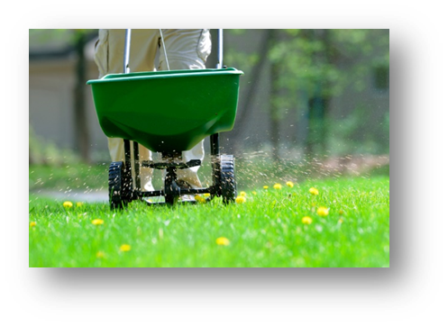
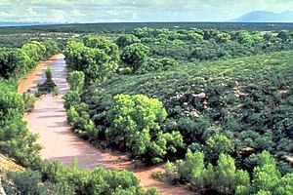
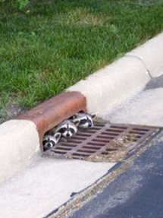
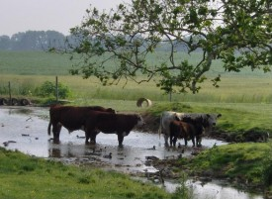
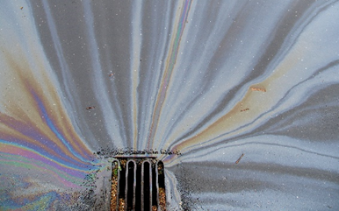
NONPOINT SOURCE POLLUTION
Source not easily identified
Runoff carries materials into streams
p.11
Notes:
Nonpoint source pollution is the #1 cause of water quality problems in South Carolina. Nonpoint source pollution means an individual pollution source cannot be easily identified. Water running into the creek following rain events, called runoff, often carries nonpoint source pollution with it. Examples of nonpoint source pollution include runoff from erosion and loose sediment, excess application of fertilizers and pesticides, oil from cars, car washing detergents, and human and animal wastes.
Many impaired waterways have multiple sources of this type of pollution, which makes it difficult to address and difficult to fix. Having more sites adopted by volunteer monitors helps us to better understand these impaired waters.

Slide 12
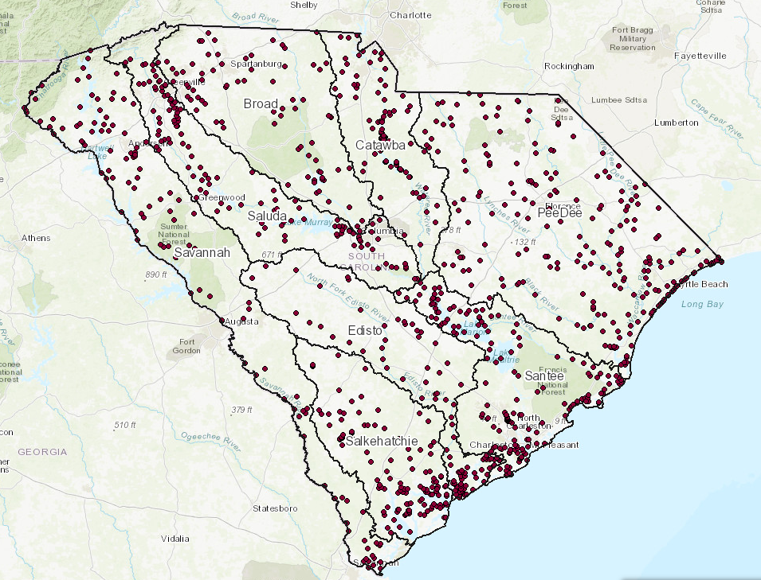
POLLUTANTS
Nutrients
Sediments
Temperature
Bacteria
(Sites that don’t meet state standards)
303(d) List of Impaired Waters
p.12-13
Notes:
Many “pollutants” in a stream are natural and only considered a pollutant when their presence is impairing a waterway’s ability to maintain life or threatening users. Some common pollutants affecting salt marsh-tidal creek ecosystems are nutrients, sediments, temperature, and bacteria.
If you want to learn more about waters in SC that don't meet state water quality standards or see shellfish restrictions, explore SCDES's 303(d) list of impaired waters.
[https://des.sc.gov/programs/bureau-water/south-carolina-303d-list-impaired-waters-tmdls]

Slide 13
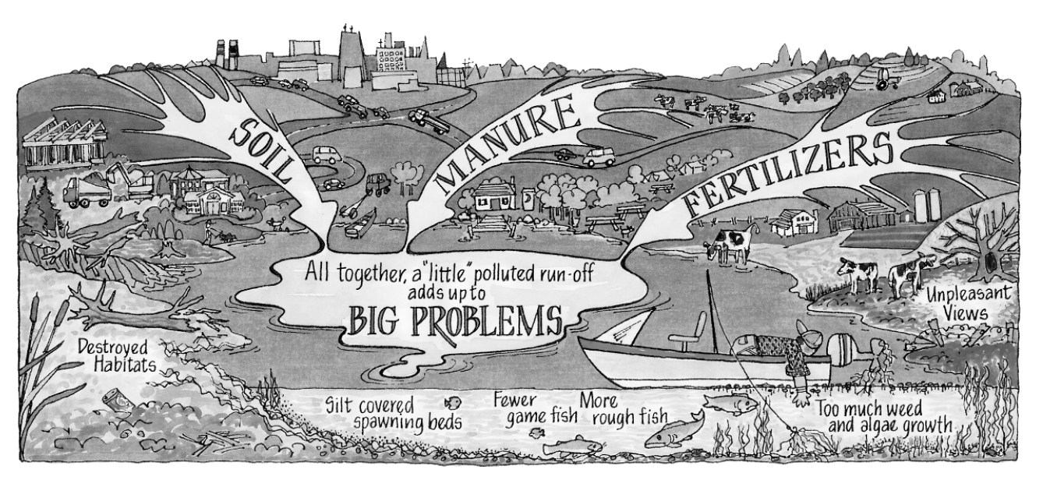
WATERSHEDS
WATERSHED
An area of land and water that drains to a central point.
p.14
Notes:
To understand how pollution impacts salt marsh-tidal creek ecosystems, it is important to understand where the water entering the system is coming from. So… what is a watershed? It is an area of land and water that drains to a central point. Everyone lives in a WATERSHED.
Watersheds can vary in size. They can be as large as the Mississippi River watershed that spans from Canada to the Gulf of Mexico or as small as your back yard. Understanding the boundaries of your chosen tidal creek and how it is affected by the larger watershed provides insights on how land use, permitting, and other occurrences in the watershed may result in change in your data and observations at your site.

Slide 14
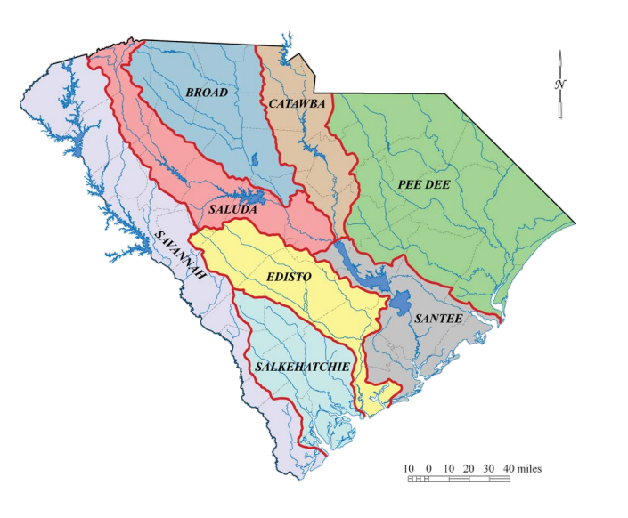
WATERSHEDS
p.14
Notes:
This map shows the 8 major watersheds in South Carolina. These watersheds can be broken up into smaller watersheds at different scales with different names. The coastal basins include the Savannah, Pee Dee, Edisto, Santee and Salkehatchie.
[Help your volunteers find their watershed.]

Slide 15
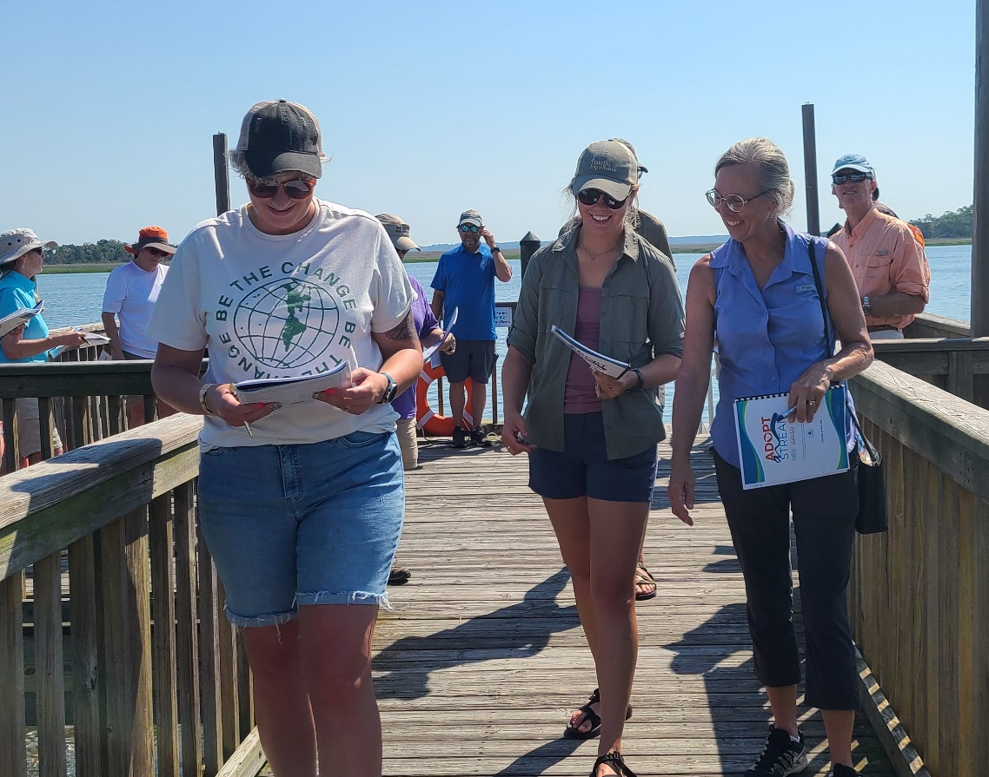
Program Overview and Goals
Page 16
Notes:
Page 16.

Slide 16

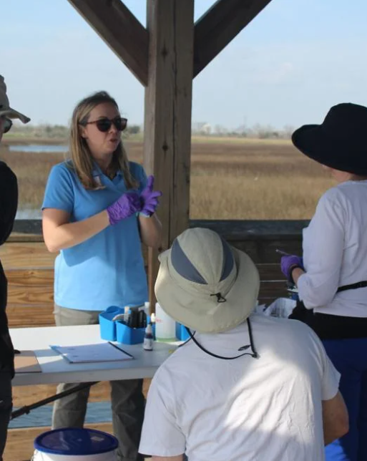


SC ADOPT-A-STREAM (SC AAS)
+ other partners statewide
p.16
Notes:
South Carolina Adopt-a-Stream is a statewide volunteer water quality monitoring program where participants learn to assess the health and water quality of their local waterways. We offer certification in four different protocols: freshwater stream, tidal saltwater, macroinvertebrate, and lake monitoring. ​Volunteer water quality monitors help our state by collecting data on waterways that may not be regularly monitored otherwise.
​
The program is led in partnership by the SC Department of Environmental Services and Clemson University with the help of many other partner organizations across the state. Your SC AAS program coordinators with SCDES keep the program running and growing, and Clemson oversees the public database and online recertification course.

Slide 17
MISSION AND VISION
Mission:
South Carolina Adopt-a-Stream empowers community members to protect and improve water quality through education and certified volunteer monitoring.
Vision:
South Carolina is known for healthy watersheds because of a collaborative statewide network of volunteers.
p.16
Notes:
The mission of SC AAS is to empower community members to protect and improve water quality through education and certified volunteer monitoring. Our vision is that one day, South Carolina is known for its healthy watersheds because of this collaborative statewide network of volunteers.

Slide 18
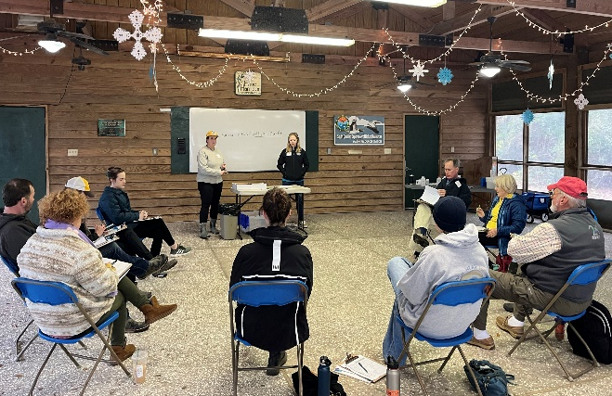
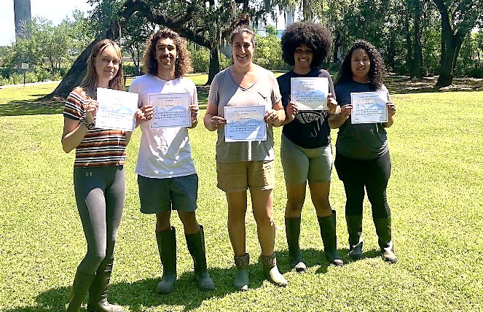

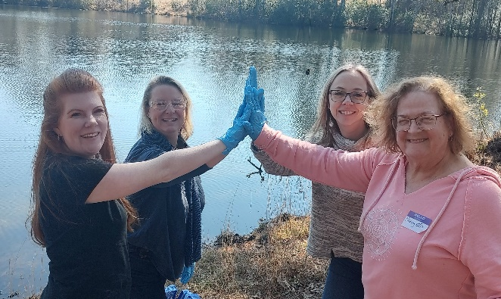
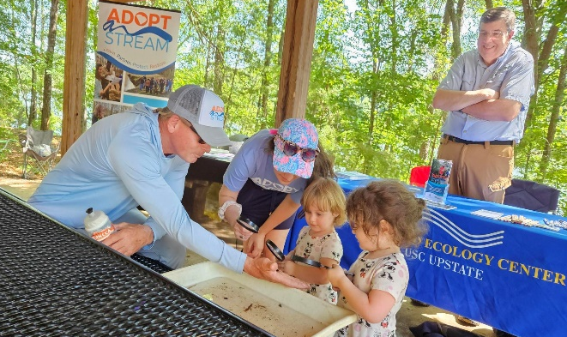
GOALS
Education
Certification
Foster environmental stewards
by educating communities about their watersheds.
Certify volunteers to collect
long-term water quality data accessible for public use.
Collaboration
Cultivation
Enable communities to address watershed needs through local partnership and collaboration.
Secure support and resources to
ensure sustainable program growth.
p.16
Notes:
There are four main goals of SC AAS that help us accomplish our mission.
Education- SC AAS seeks to foster environmental stewards by educating communities about their watersheds (like we are doing here today!)
Certification- SC AAS certifies volunteers to collect long-term water quality data that is accessible for public use. (we hope that some of you will get started with monitoring!)
Collaboration- SC AAS helps to enable communities to address watershed needs through local partnership and collaboration.
Cultivation- To keep the program running and growing we must secure support and resources.

Slide 19
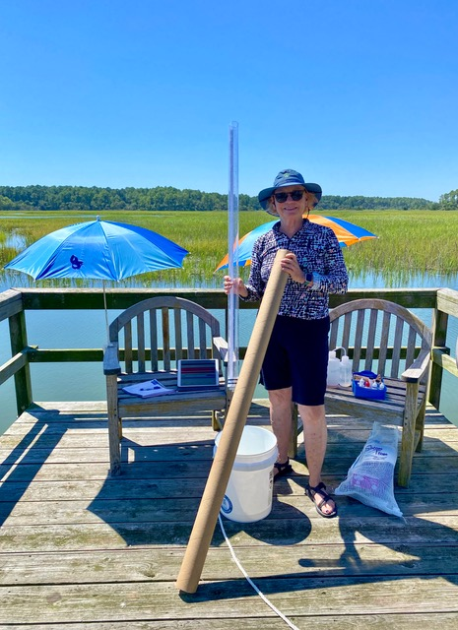
WHAT DOES IT MEAN TO ADOPT?
  A: ACTIVE
  D: DATA
  O: OUTDOORS
  P: PROTECT
  T: TOGETHER
p.17
Notes:
As volunteers, we take an ACTIVE approach to collecting DATA while enjoying the OUTDOORS to help PROTECT our waters TOGETHER.
Overall, educational participation and spreading awareness about this program leads to a positive impact in communities across South Carolina.

Slide 20
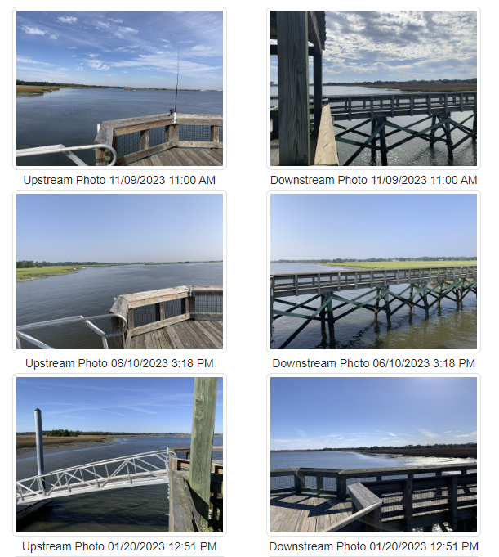
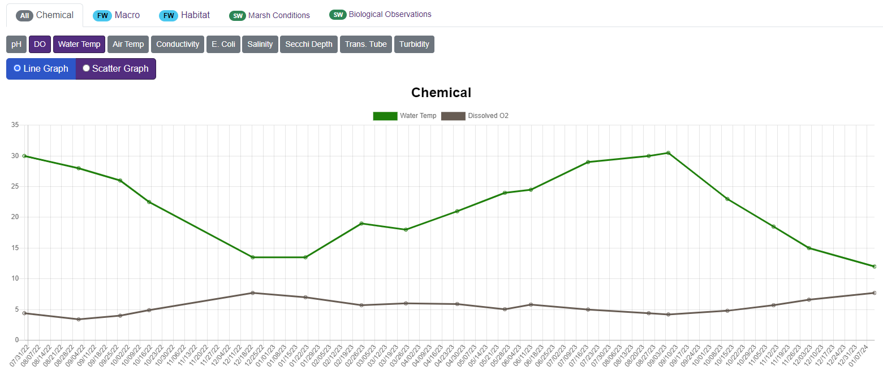
VOLUNTEER DATA USES
Education, establishing baseline conditions, and screening for issues
NOT REGULATORY
Other uses
p.16
Notes:
Volunteer data can have a lot of uses. Data collected for this program is to be used for EDUCATION, to establish BASELINE conditions, and SCREENING for issues. The data collected is not regulatory in nature and isn’t to be used for targeting neighbors or businesses.
Other data uses include research, advocacy, and watershed planning, among many others. Follow-up from collected data happens at the program coordinator level, and program coordinators can help connect volunteers with water quality professionals or local partner groups. You as the volunteer can also seek follow up from other groups!
[If you use AAS data in your job, give examples of how you use it.]

Slide 21
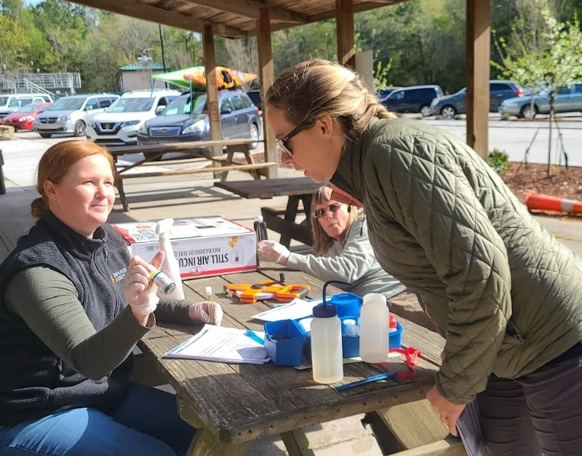
CONSISTENCY & INTEGRITY
Quality Assurance Project Plan (QAPP)
Pass certification test
Recertify annually
Follow protocol
Only certified volunteers enter data
p.17
Notes:
Although the data generated by our volunteers is not regulatory in nature, it is still extremely valuable and considered HIGH quality data thanks to our EPA-approved “Quality Assurance Project Plan,” or QAPP. This means we have a set way of collecting data and that we follow certain water sampling protocols to ensure we are collecting data in a way that is valuable for many different uses.
At the end of this workshop, volunteers must pass a certification test that is valid for one year. Only certified volunteers have access to enter data into our public database. As long as volunteers follow our protocol exactly, the data is high quality and is available for anyone to use. Volunteers must be recertified annually using the virtual recertification or attending another in person workshop.
[Volunteers must pass a written evaluation and field demonstration with a score of at least 80% to become certified. This is a test to make sure you were taught everything, NOT a test on prior knowledge or experience. ]

Slide 22
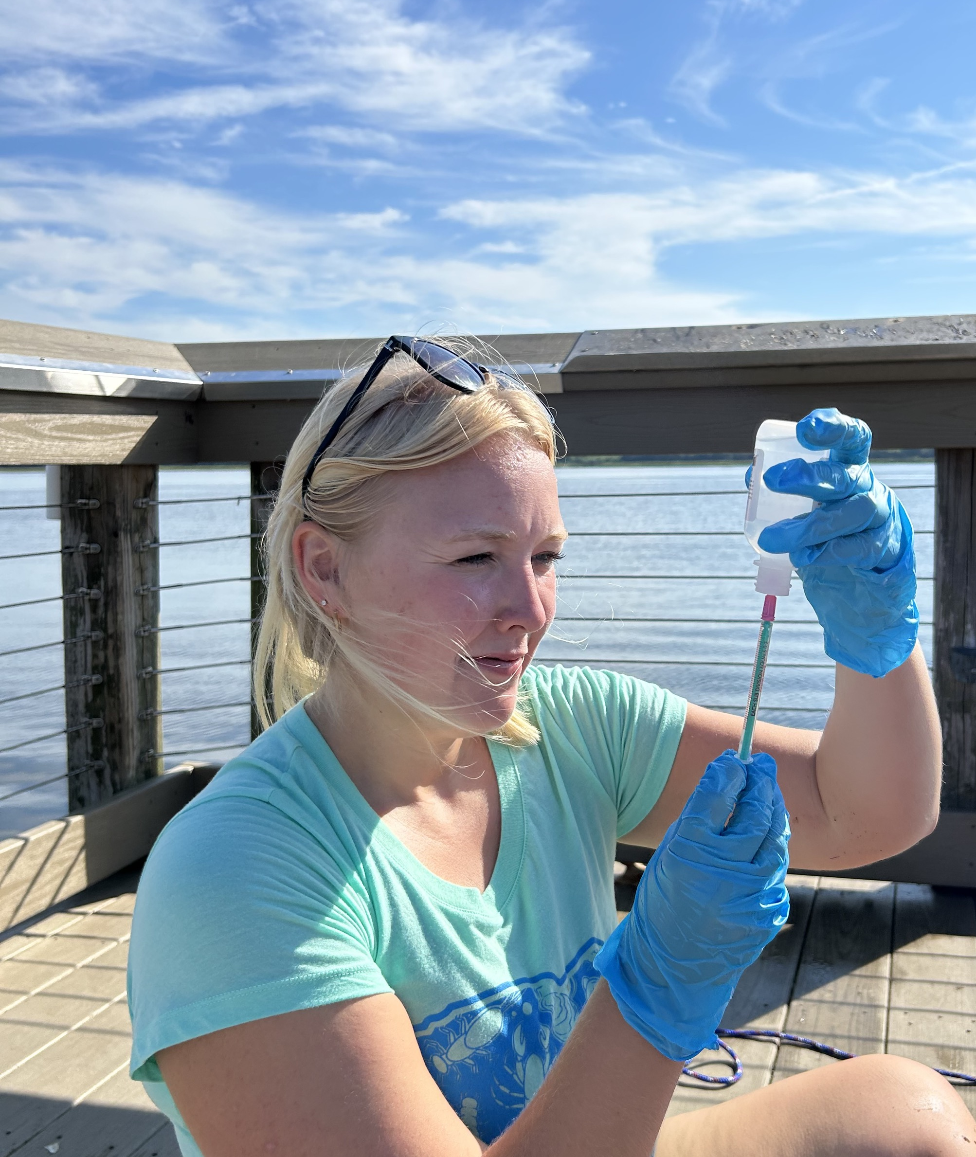
CODE OF ETHICS
Follow monitoring methods
Fully and accurately document observations
Report data in a timely manner
Respectfully discuss the program with others
p.17
Notes:
By joining SC AAS, you are agreeing to represent the program with integrity by following monitoring protocol exactly, accurately documenting observations, reporting data to the Database ASAP, and discussing the program respectfully with others.

Slide 23
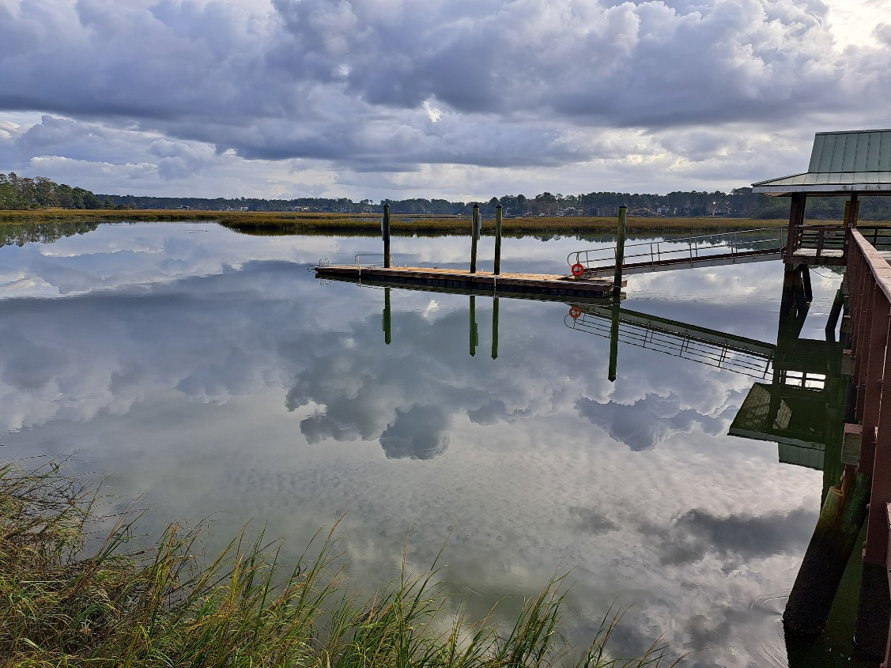
Selecting a Site
Page 18
Notes:
Page 18.

Slide 24
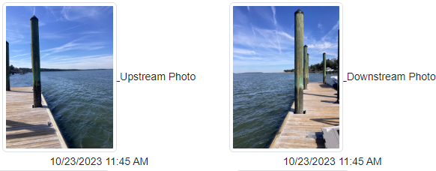
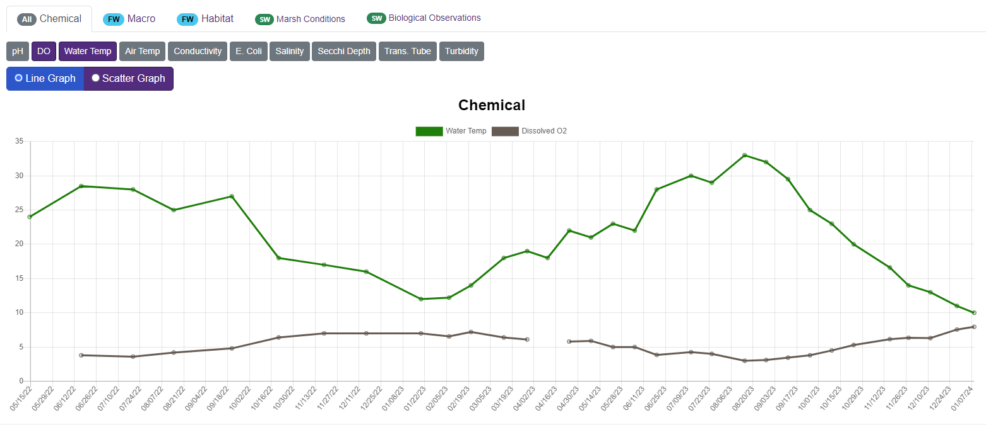
MONITORING COMMITMENT
Same location
Same time of day
Monthly
p.18
Notes:
SC AAS volunteers are asked to sample monthly at the same location, at roughly the same time of day during daylight hours. Keep in mind that measurements of certain parameters can vary at different times of the day, different tide stages, and in different parts of the tidal creek.
[For example, you do not have to sample at exactly 10:53 AM but if you normally sample around 11:00 AM, don't go out at 5:00 PM.]

Slide 25
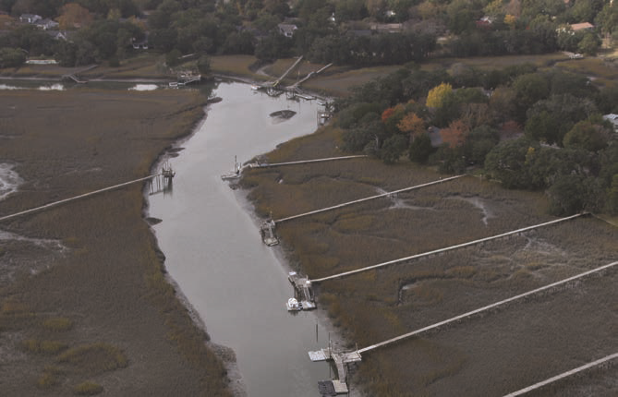
SITE SELECTION CRITERIA
Safe access from a dock, pier, landing, bank, or boat
Clear location to set supplies down
Salinity of > 0.5 ppt
Written permission to access site (if on private property)
p.18
Notes:
Volunteers can choose to adopt a site of their choice, can ask a trainer for advice on where to monitor, or can adopt a historical site that a previous volunteer is no longer monitoring.
Adopted sites must meet the following criteria:
Safe access from a dock, pier, landing, bank, or boat
Clear location to set supplies down
Salinity of > 0.5 ppt
Written permission to access site (if on private property)
If you are unsure about whether your site is tidal saltwater or freshwater, you can use the SC Watershed Atlas to check its classification or check the salinity with your refractometer.

Slide 26
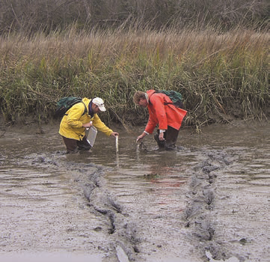
SAFETY
DO…
Wear gloves and closed toed shoes
Use the “buddy system”
Be aware of surroundings
Wash hands and gear with fresh water after sampling
DO NOT…
Sample during a storm/when conditions are dangerous
Enter the marsh
p.19
Notes:
The safety of volunteers is of the highest priority. We care more about you than your data!
Do not sample during a storm or when conditions are dangerous. Wait until it has stopped and strong water flow has subsided.
Wear proper attire including gloves and closed toed shoes.
Use the “buddy system.” Sample with someone, even if they are not a certified volunteer, or tell someone that you are going into the field and how long sampling will take.
Use caution when near a waterway and DO NOT enter the marsh! It can harm you as well as the ecosystem.
Be aware of your surroundings including traffic, wildlife, slippery surfaces, and other people.
Wash your hands after sampling as your site may be contaminated with bacteria or other pollutants.
Rinse your equipment with fresh water and dry before storing. This helps prevent invasive species transfer and keeps your equipment in top condition.

Slide 27
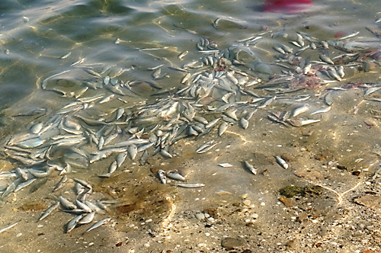
EMERGENCY HOTLINE
If there is evidence of ongoing chemical releases, oil spills, or fish kills, contact the SCDES toll-free 24-hour emergency response line at
1-888-481-0125
Learn more about reporting an environmental concern:
www.des.sc.gov/report-it
p.19
Notes:
If you find evidence of an ongoing significant or harmful pollution event at your site such as a chemical release, oil spill, or fish kill, do not sample and call the SCDES hotline at 1-888-481-0125. Make sure to take photos to document your findings.
Save this number in your phone and highlight it on Page 5 of your handbook. This page is also a great place to write down your trainers’ names and contact information.
[Give time for volunteers to record this number.]

Slide 28
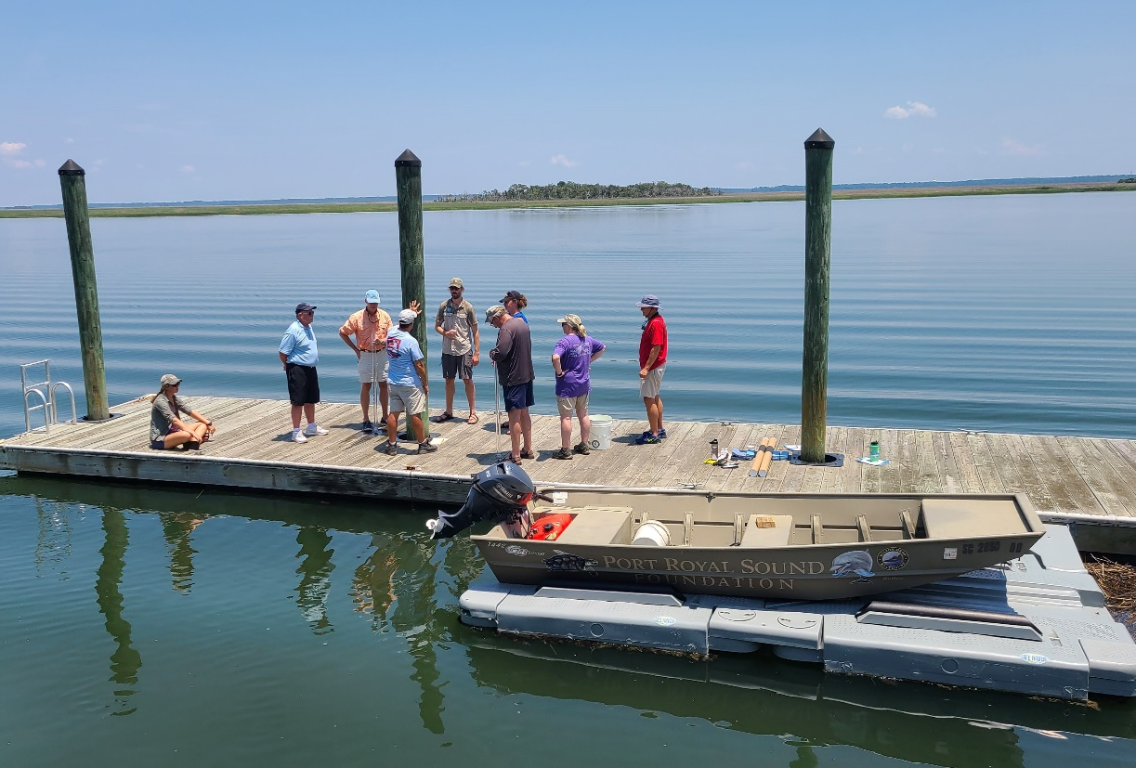
Monitoring Protocol:
Observations
Page 20
Notes:
Page 20.

Slide 29
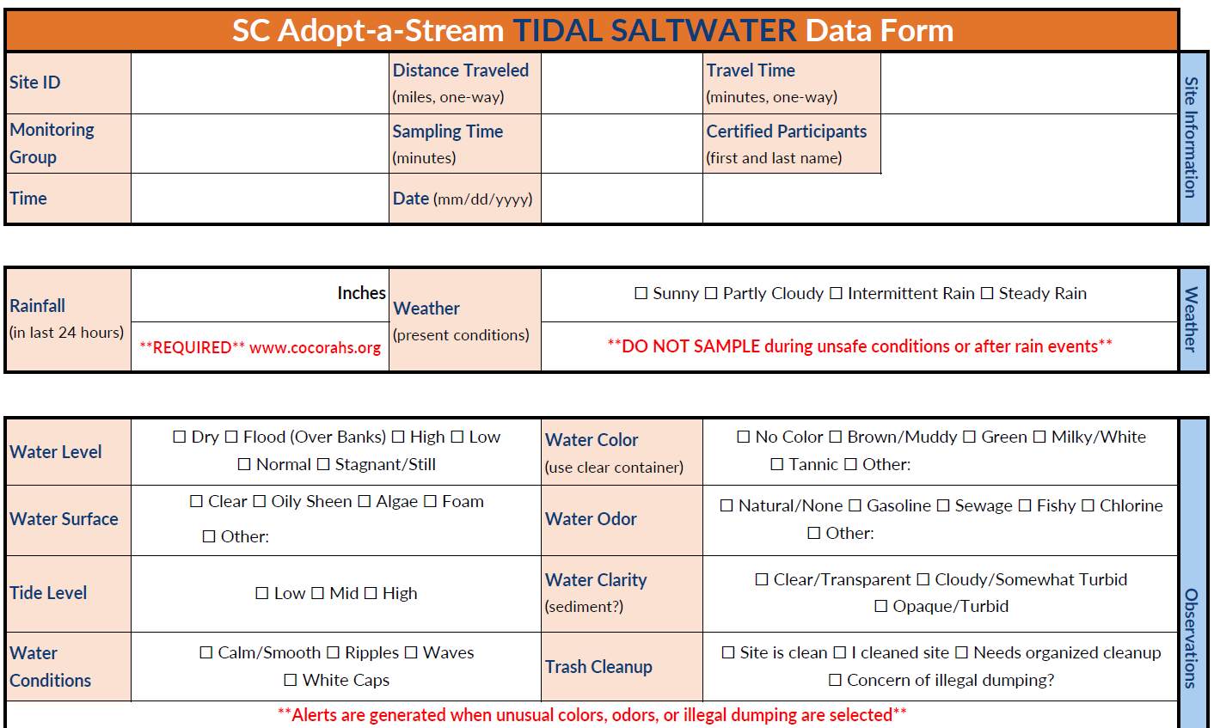
DATA FORMS
Data forms found at www.scadoptastream.org
p.20
Notes:
When monitoring, you’ll need to fill out the data form entirely or enter data directly in the SC AAS Database from your mobile device. Data forms can be found and printed from our website.
When you get to your site, the first thing you should do is make observations.

Slide 30
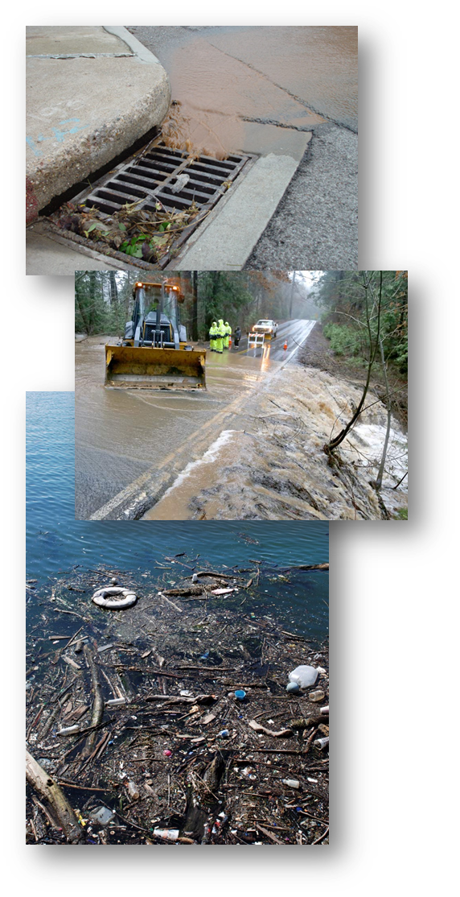
WEATHER
Present Conditions
  Sunny
  Partly cloudy
  Intermittent rain
  Steady rain
Amount of Rain
  www.cocorahs.org
**DO NOT sample during or after rain events**​
p.20-21
Notes:
Record the weather conditions at the time of your sampling event. Do NOT sample during or just after rain events. Rain runoff (and the pollution it carries) can cause spikes in your data that will lead to skewed baseline information. How long you wait to sample will depend on your watershed size. A good rule is to wait at least 24 hours or until high flow has subsided before sampling. You can simply move your sampling event by a few days to avoid rain events instead of skipping that month's data collection.
Rain should be recorded as an amount in the last 24 hours and is a REQUIRED part of data entry. You can find recent rainfall data on most weather websites; however, CoCoRaHS is the recommended resource because it gives local amounts instead of regional ones. It’s also another fun volunteer science program that you can collect data for. Explore more at https://www.cocorahs.org/

Slide 31
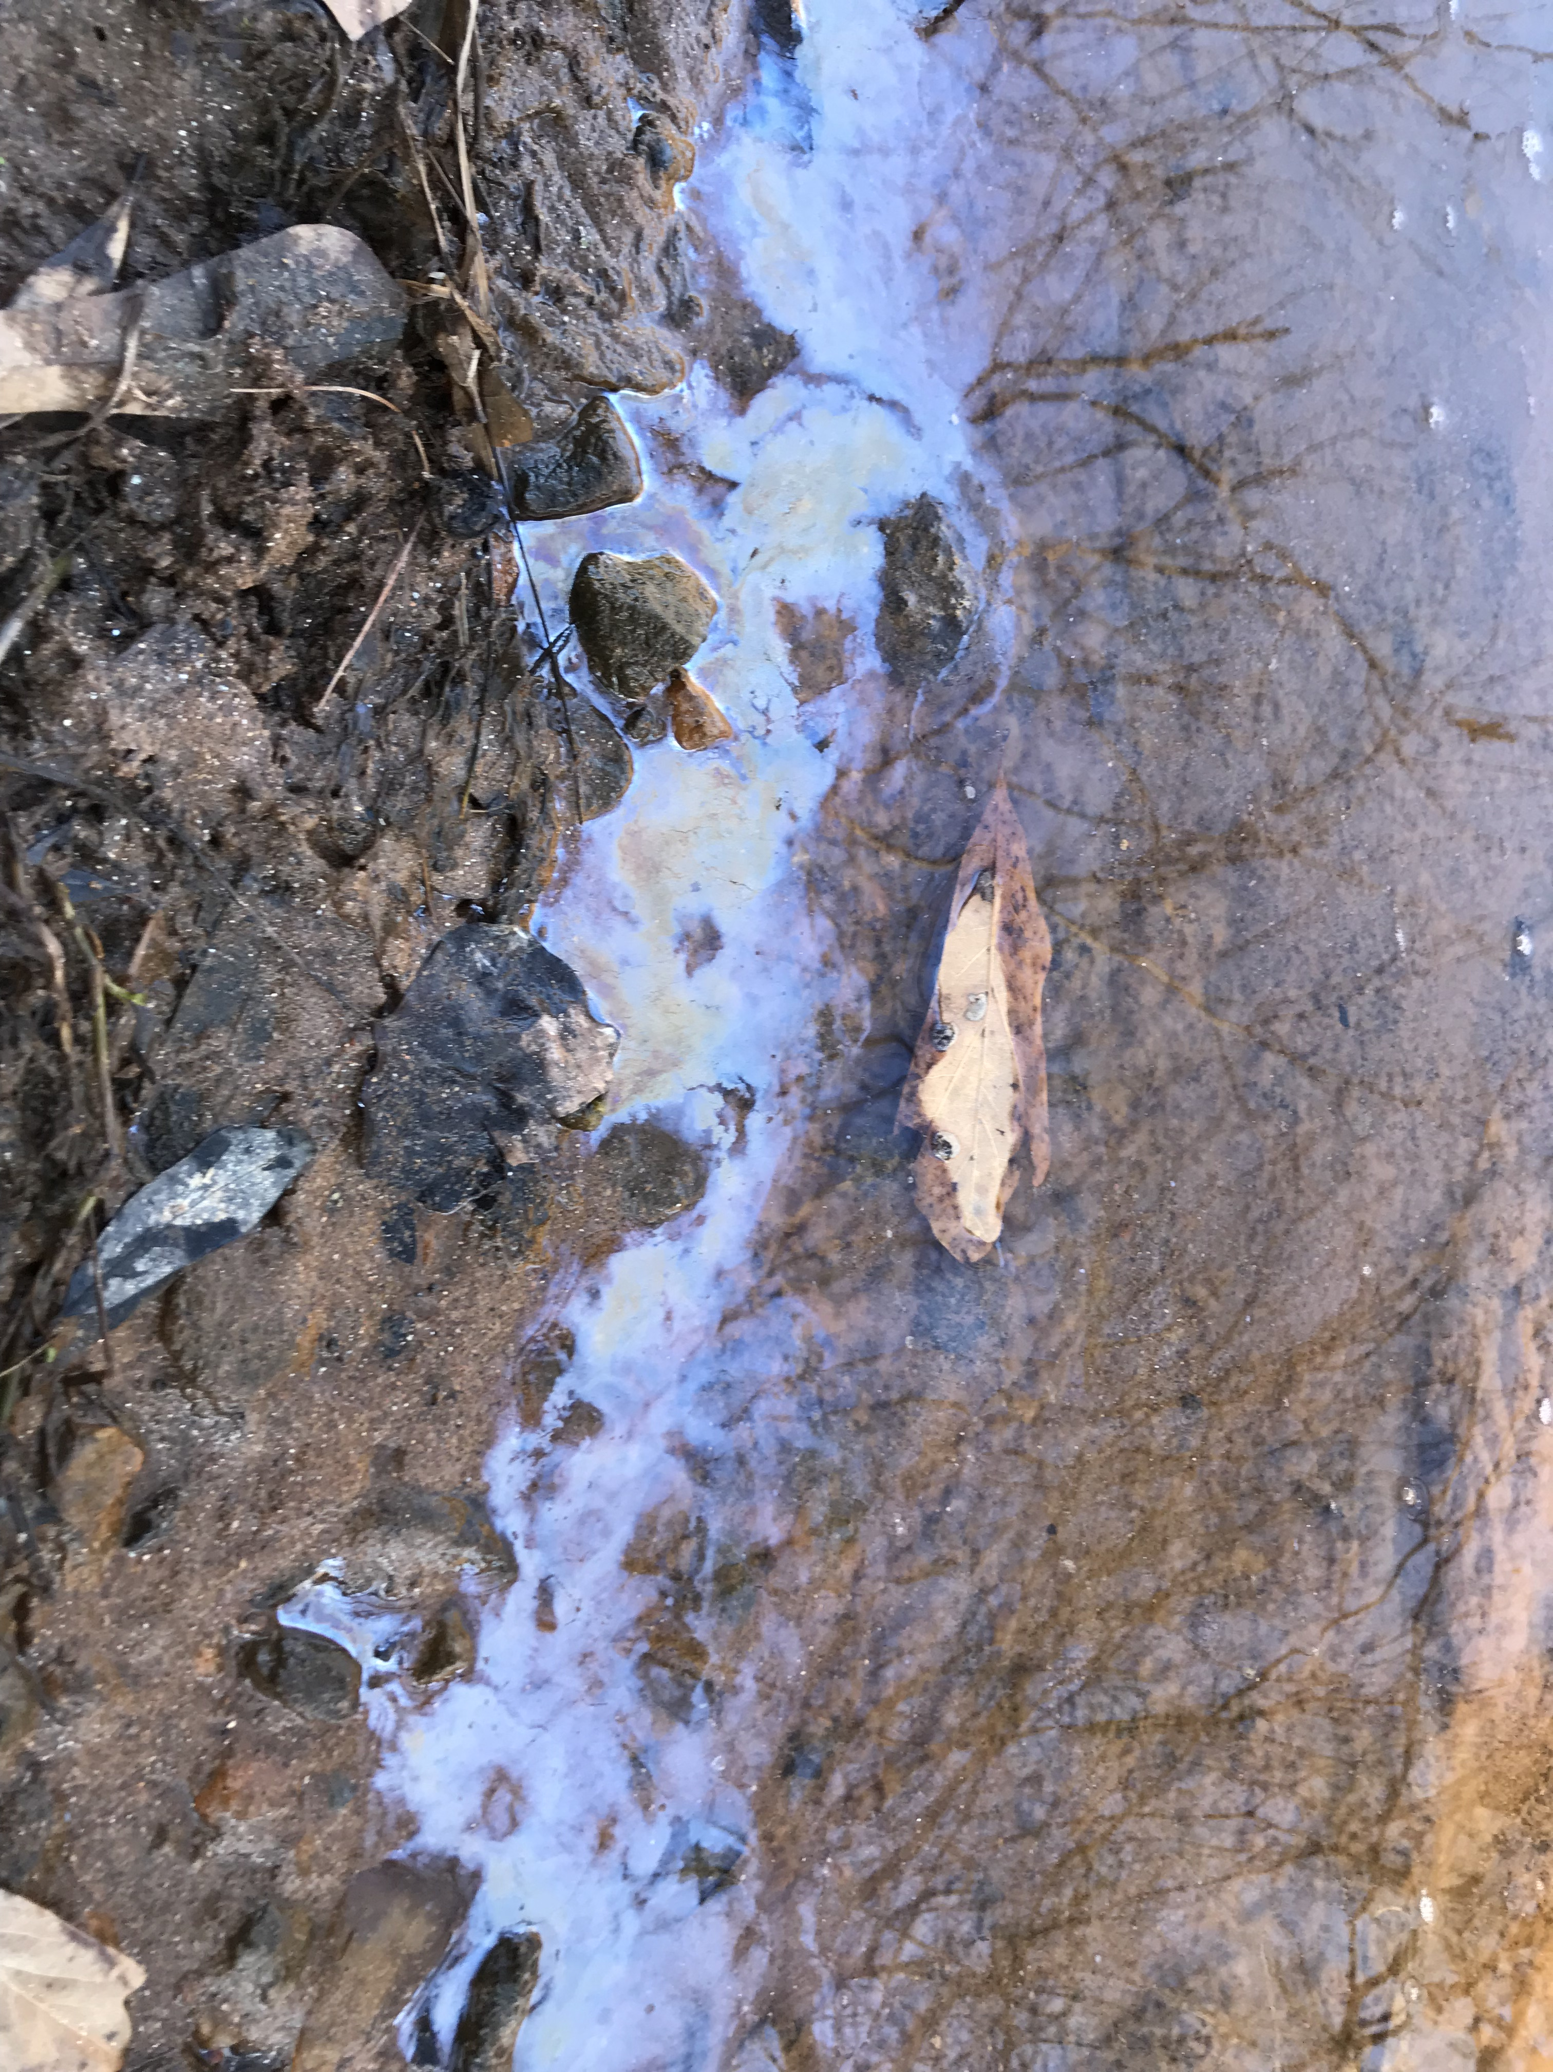
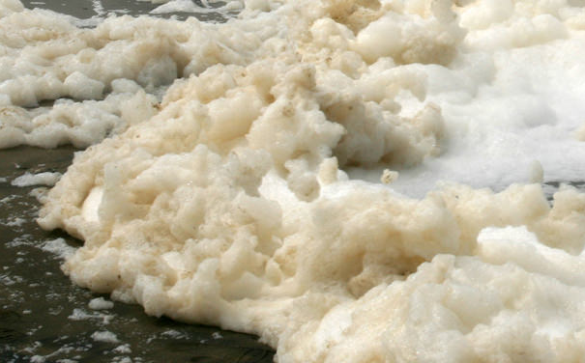
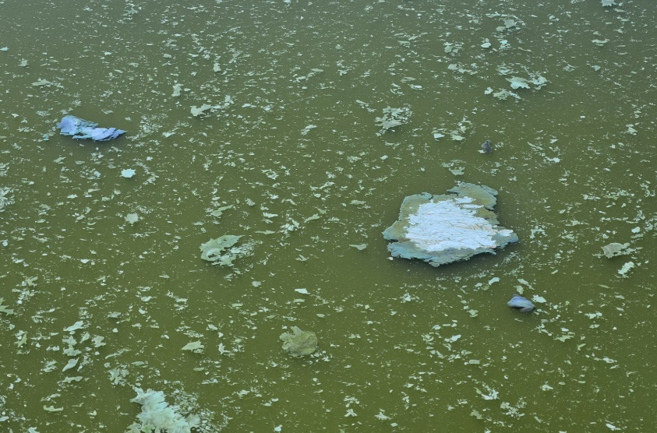
WATER SURFACE
Oily sheen
Surface foam
Algae
p.21-22
Notes:
Conditions at the water surface can alter chemical and physical measurements. Note if any of the following are present:
Oily sheens can be caused by petroleum or chemical pollution, or they may be natural by-products of decomposition. To tell the difference between petroleum spills and natural oil sheens, poke the sheen with a stick. If the sheen swirls back together immediately, it may be petroleum. If the sheen breaks apart and does not flow back together, it is likely from bacteria or decomposition of plants and animals.
Surface foam is common and can be naturally occurring. Vegetation can produce surfactants which can cause surface foam. Human-induced surface foam may be an unnatural color (red, pink, blue, yellow, or orange) and have a fragrant smell. This colorful foam is most likely generated by household detergents and may be a sign of a failing septic drain field or illegal discharge. You can also perform the stick test with foam to determine if it’s natural or manmade.
Algae are important to aquatic ecosystems, but excessive growth can occur when human activities introduce excess nutrients to the waterway. They can grow on the surface or form thick mats, impacting other organisms in the environment.

Slide 32
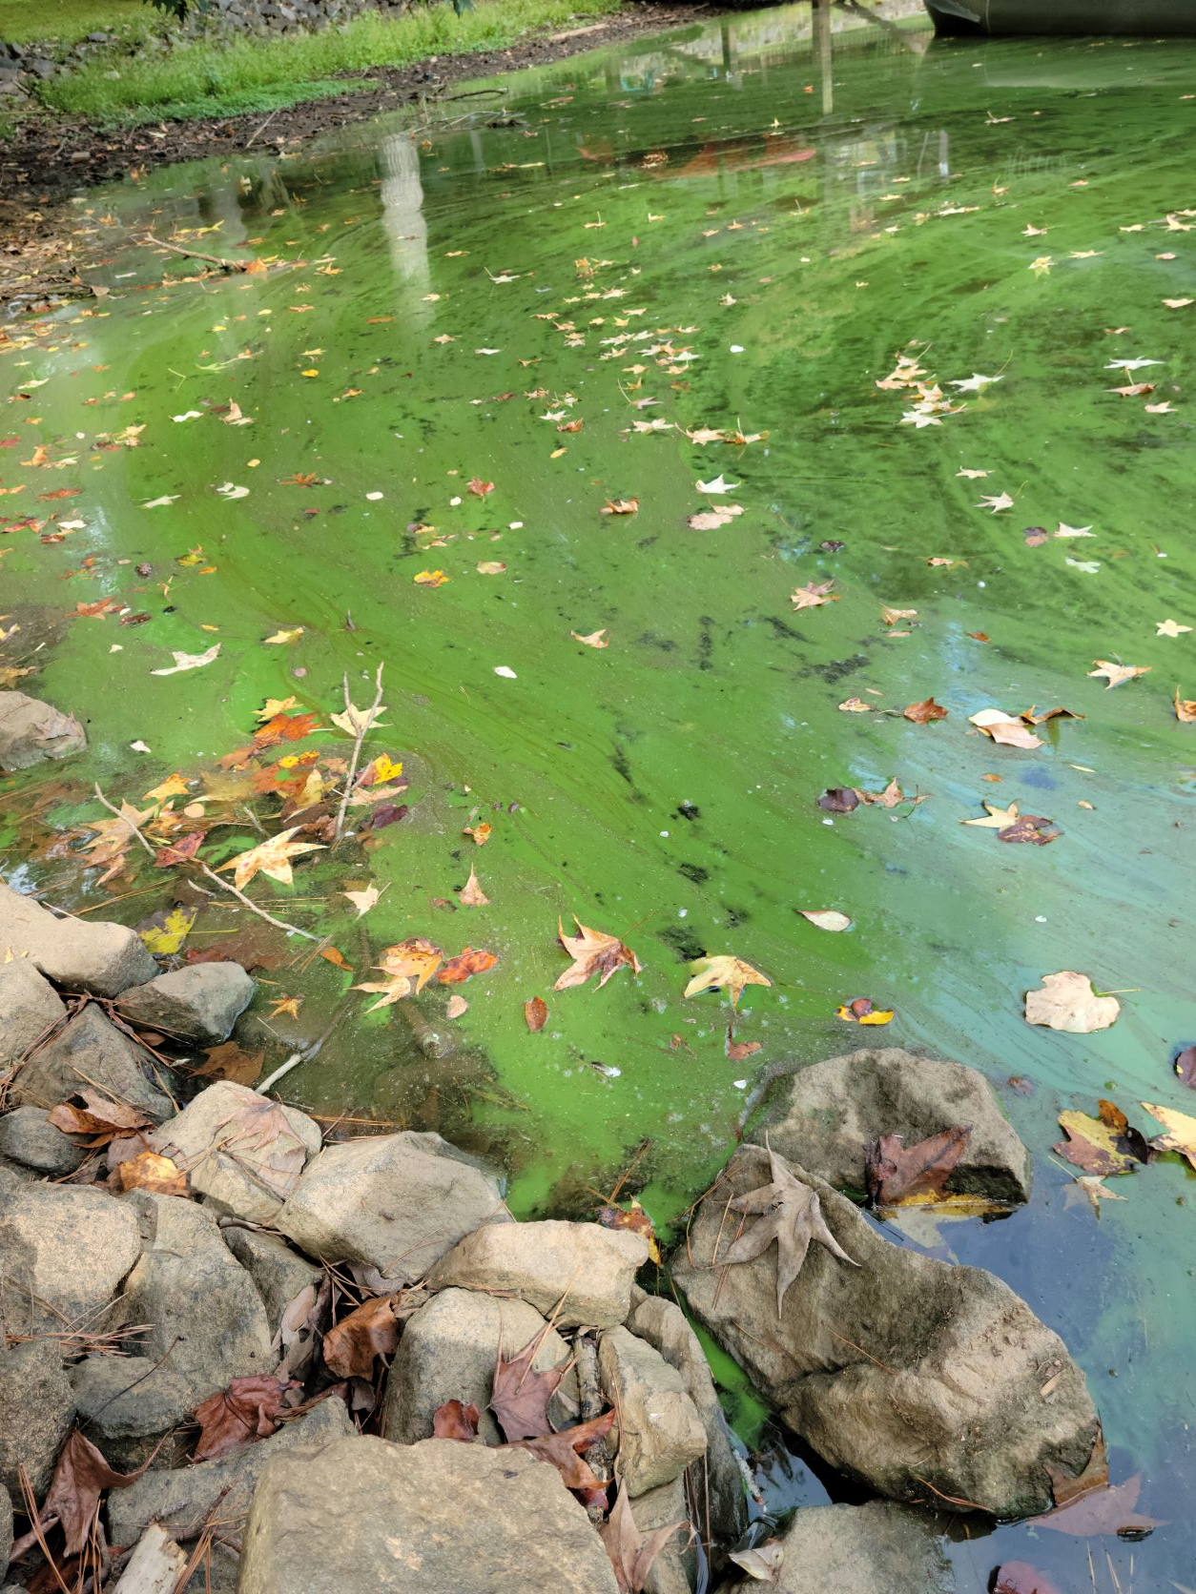
ALGAL BLOOM
Harmful Algal Blooms (HABs)
  Contain toxins that affect people, animals, and the environment
  Need sunlight, slow-moving water, nutrients, and warm water temperatures
p.23
Notes:
In a balanced ecosystem, algae provide beneficial food and oxygen for the aquatic ecosystem but can cause issues when overgrowth occurs. Rapid growth of algae is called an algal bloom and can be associated with foam, scum, or thick layers of algae on the water surface.
When blooms contain toxins that affect the health of people, animals, and the environment, they are known as Harmful Algal Blooms (HABs). For HABs to grow and form they need sunlight, slow-moving water, nutrients, and warm water temperatures. HABs are more likely to occur from late spring to early fall.
If there are algae present at your monitoring site, note how widespread they are. In the Database, algal bloom reporting language is specific to our lake monitoring protocol, but you can fill out the “Describe Algal Bloom” box if you are concerned about a potential HAB.

Slide 33
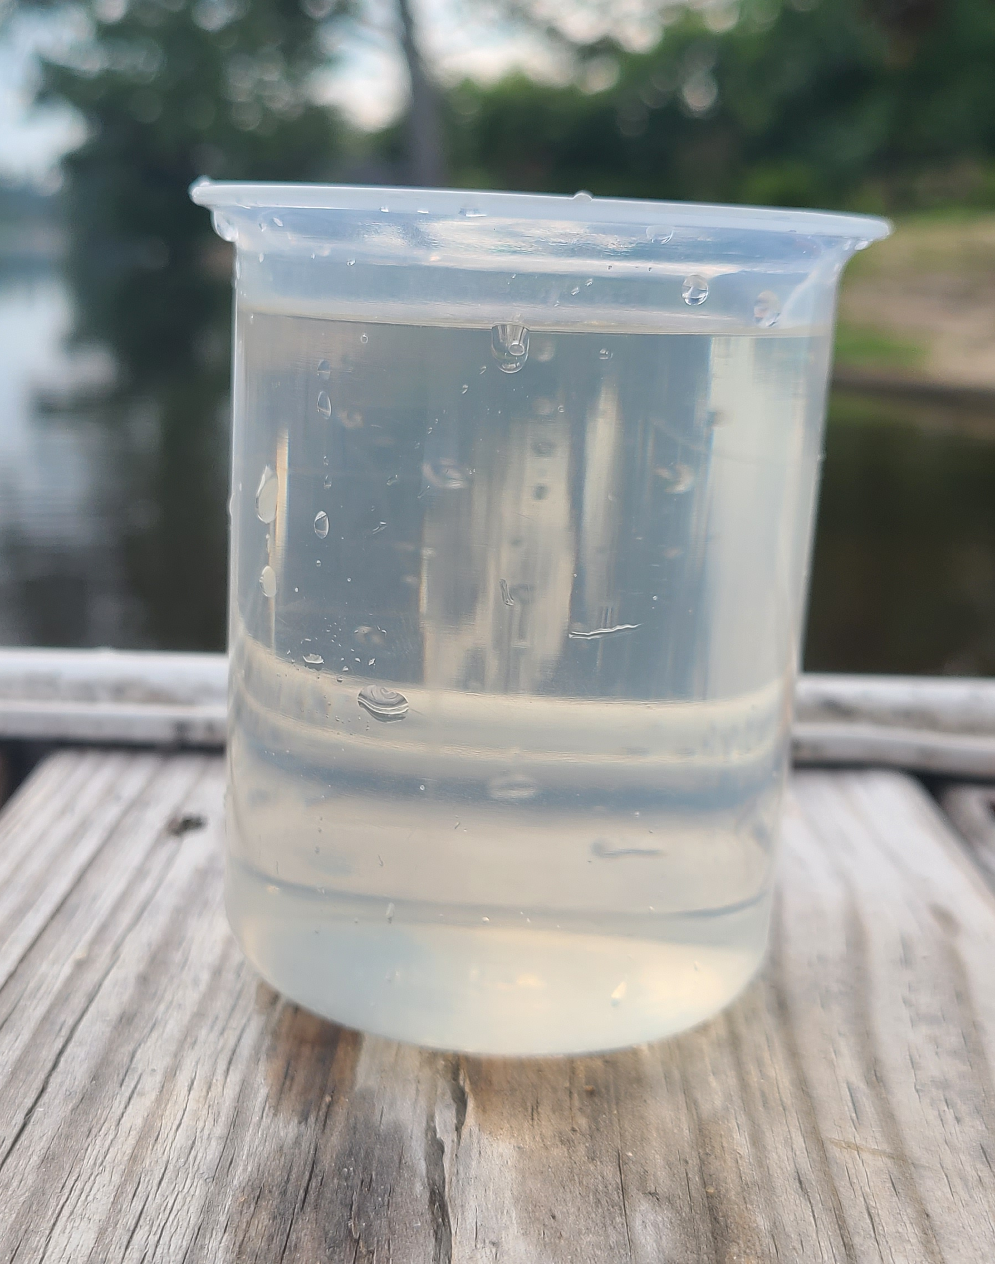
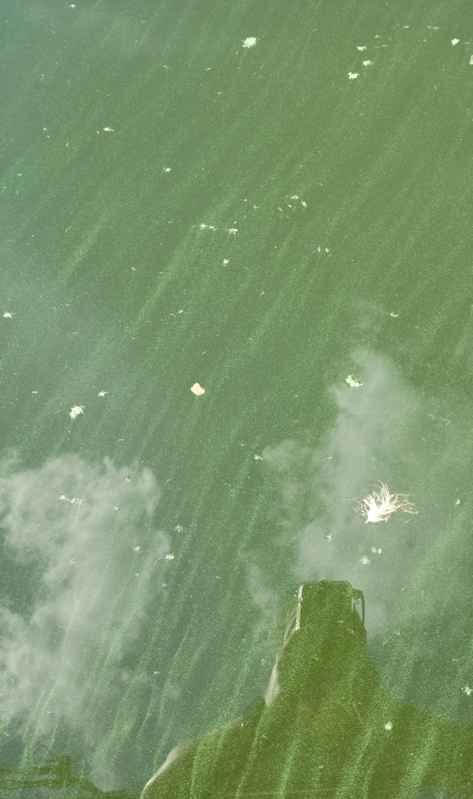
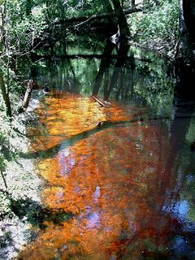
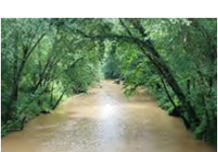
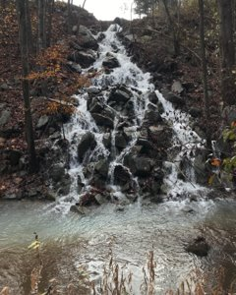
WATER COLOR
No Color/Clear
Green
Tannic
Brown/Muddy
Milky/White
p.24
Notes:
Color can provide you immediate clues to a waterway’s condition. Water color should be observed from a clear container. DO NOT look down at the water to decide its color. You may be observing the color of the creek bottom instead of the water itself.
Although clear water may or may not be of high quality, other colors may indicate certain conditions:
No Color/Clear—Normally a good thing, but clear water does not necessarily mean pollution-free water (if your stream water looks normal, mark this in the Database)
Brown/Muddy—Brown water is usually due to heavy sediment loads. Some of our South Carolina rivers more regularly run brown due to their soil types.
Green—Green water is usually the result of excessive algae growth.
Tannic—Darkly stained water is usually caused by natural processes of leaves breaking down. Pigments leached from decaying leaves can cause the water to appear brownish-red, like a glass of sweet tea.
Milky/White—A milky appearance may be caused by salts in the water. It can also be a sign of illegal disposal by contractors or dischargers.
[Emphasize the points in bold.]
Page 24

Slide 34
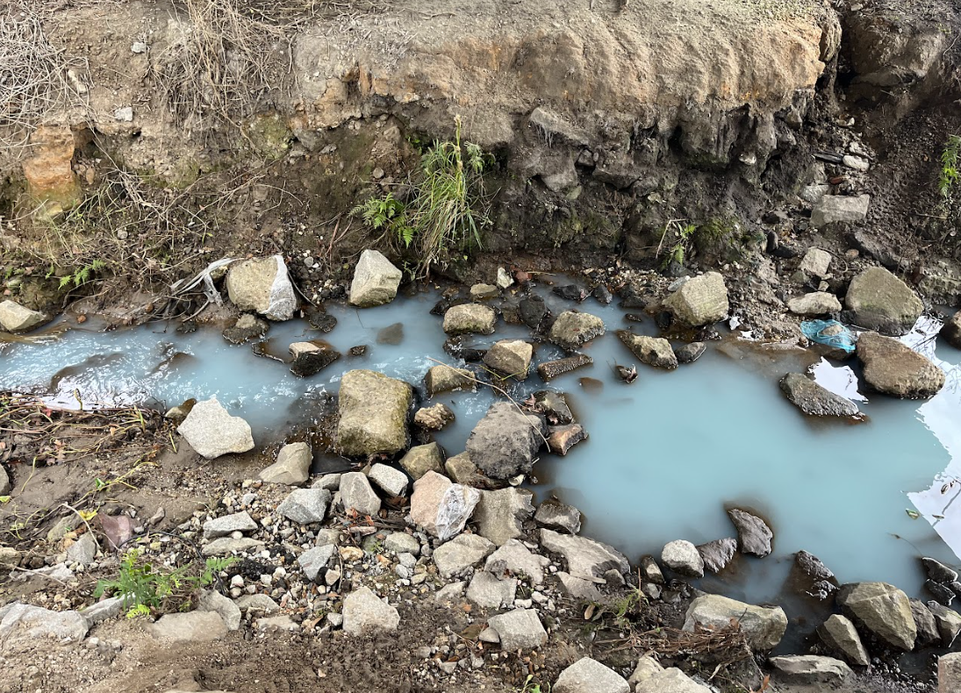
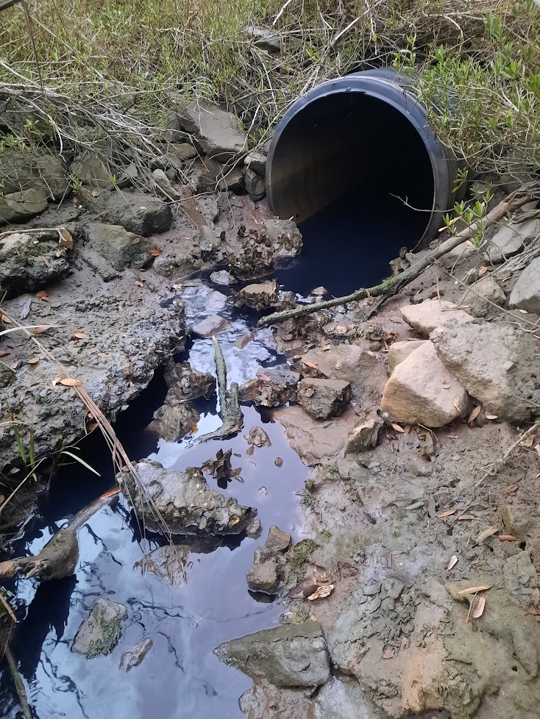

WATER COLOR - OTHER
Blue
Black
Red/Orange
p.24
Notes:
If you observe a dramatic water color other than those listed on your data form, take pictures of your site and record "Other". Call the SCDES emergency hotline (listed on page 5 of your handbook) and contact the program coordinators as the color could be the result of an ongoing pollution event.
Both the Black and Blue images were taken by volunteers when they were monitoring their sites. The Red/orange is an image of a HAB. SC AAS volunteers have been able to find and report pollution events, helping make a difference in water quality.

Slide 35



WATER ODOR
Gasoline
Sewage
Fishy
Chlorine
Other
p.25
Notes:
Water odor, like color, can provide immediate clues about potential problems in a tidal creek. Make sure you record water odor before you begin chemical testing so that you do not become acclimated to the scent. It is important to differentiate whether the odor is coming from the water or the air, so please waft the odor from your sample cup.
The rotten egg/sulfuric odor common in salt-marsh tidal creek systems is natural and should not be marked on your data form. This smell is due to hydrogen sulfide gas, a by-product of anaerobic decomposition in areas with large amounts of organic matter. This odor is heightened as the tide recedes.
Gasoline— Any petroleum or chemical smells may indicate serious pollution problems from a direct source, such as a factory, parking lot, or storm sewer runoff.
Sewage— These smells can be common in the air but should not be what our water smells like.
Fishy— This smell may be a sign of dead and decomposing fish in the stream.
Chlorine—This smell may be a sign of pollution and will smell like a swimming pool.
In the SC AAS Database, entering "Other” for color or odor will trigger an email alert to the SC AAS program coordinators, SCDES, and any local officials or organizations who have agreed to receive such alerts. If you notice a strange odor, walk around the site to see if you can identify the source. Take photos of anything unusual.

Slide 36


WATER CLARITY
  Clear
  Cloudy
  Opaque
p.25
Notes:
Water clarity can also give us insight into how much sediment is present in the water. Transparency will be precisely measured later in the monitoring process — water clarity is a more general observation.
Use the water in the container to check for clarity. Give it a good stir. Is it perfectly clear? Is there murkiness, or is it hard to see through?

Slide 37


WATER CONDITIONS
  Calm
  Ripples
  Waves
  White caps
p.26
Notes:
Typical salt marsh water conditions will appear calm, with the surface looking smooth or flat. With some wind or tide pull you may see ripples appear on the surface. White caps will probably only appear during poor weather conditions, in which you should not be monitoring!

Slide 38
TIDE LEVEL
  Low
  Mid
  High
p.26
Notes:
Check your local high and low tide schedule to determine which stage your site is at. NOAA’s Tides and Currents website is a great resource. [https://tidesandcurrents.noaa.gov/]
[You can recommend best website/app to use locally.]
SCDES also offers yearly tide change tables in collaboration with NOAA data. You can download or print a copy for your reference.
[Optional: 2024 Tide Chart here: https://des.sc.gov/programs/office-ocean-coastal-resource-management/2024-tide-tables ]

Slide 39


OTHER DATA FORM OBSERVATIONS
Trash cleanup
Illegal dumping
Outfall flow
Security and hazards
p.26-27
Notes:
Other data form observations include trash cleanup, outfall flow, security, and hazards.
It’s a good idea to bring a garbage bag when sampling. Please clean the site if litter that you can discard is present. If there are tires or other large, potentially hazardous materials present, please take photos and record “concern of illegal dumping”. Illegal dumping is defined as more than 15 pounds of solid waste, litter, dead animals, or other hazardous materials. Careless littering of smaller items is not considered illegal dumping.
Pay special attention if pipes are flowing during dry spells. This could be an illegal discharge or pollution event.
Be alert for any security issues or hazards at your site, such as drug abuse, vagrancy, and dangerous animals. If you ever feel unsafe while sampling, please consider adopting a new site.

Slide 40

PHOTOS = PRICELESS
Take 3 photos:
  Upstream (inland)
  Downstream (toward ocean)
  Water height
Pick a location to stand every time
  View should include a fixed object
Other photos: wildlife, pollution, smiling volunteers
Send more to scaas@des.sc.gov!
p.27
Notes:
Photos are VERY important to collect and upload. Take photos in the upstream (inland) and downstream (oceanward) direction, as well as a picture of the water height. Please be consistent about getting the same view each time. It is helpful to have a stationary landmark in your photos. You don’t want to use a buoy or anything that would float up and down with the tides. If you use an iPhone, change the photo file type to a .jpeg to get it to upload to the database.
In the additional photo field, please include images of anything of concern or fun group pictures.

Slide 41

Monitoring Protocol:
Habitat Assessment
Page 28
Notes:
Page 28.

Slide 42


WETLAND CONDITION/APPEARANCE
p.28
Notes:
Marsh grass naturally goes through seasonal changes. Generally, marsh grass is green with new growth in the warmer months and turns brown in the colder months. If you notice a sudden, unseasonable change of color, this could indicate a problem and should be monitored. Record the marsh grass color and note whether the marsh area is increasing, decreasing, or is the same as the last sampling event.

Slide 43


REPORTING INVASIVE SPECIES
Phragmites
(common reed)
  Invasive
SCDNR
Non-native Species Reporting Tool
p.28-29
Notes:
It is also important to check for the presence of invasive Phragmites. Phragmites australis subsp. australis, the invasive subspecies of the common reed, has been identified along the coast of South Carolina. This aggressive plant outcompetes native species, dominates ecosystems with thick growth, alters wetland hydrology, and increases the potential for fire as it dries out. Phragmites typically establishes in areas of high nutrient inputs and disturbed soils.
Volunteers should indicate if they find Phragmites on their data form and report it to SCDNR using the Non-native Species Reporting Tool [www.non-native-species-scdnr.hub.arcgis.com].

Slide 44

MARSH SURROUNDINGS & IMPACTS
Located within 100 feet of the waterway
  Industrial
  Commercial
  Residential
  Agricultural
  Docks
Observed impacts on marsh
  Erosion
  Dredging
  Large vegetative debris
  Algae
p.30
Notes:
Human activities can impact and change habitats, so make note of what land is being used for around the site and any potential impacts on the marsh. Look for signs of active erosion and bank loss, as well as mud in the marsh that accumulates as mud flats or fresh deposition of wet mud.
Page 30

Slide 45









WILDLIFE SURVEY
www.saltmarshguide.org
p.31
Notes:
The last thing to note on the Habitat Assessment section of the data form is the wildlife survey, which can be useful in determining the long-term baseline conditions of your site. Many species require specific conditions to thrive, and their presence or absence can provide insight into habitat quality. DNR’s Guide to the Salt Marshes and Tidal Creeks of the Southeastern United States can help you identify plants and animals that you may be unfamiliar with.
[https://www.saltmarshguide.org/]

Slide 46




Monitoring Protocol:
Measurements
Page 32
Notes:
Page 32.

Slide 47


MEASUREMENTS
6 Parameters:
  Air temperature
  Water temperature
  Transparency
  Salinity
  pH
  Dissolved oxygen
p.32
Notes:
The 6 parameters that you will be sampling MONTHLY are: air temperature, water temperature, transparency, salinity, pH, and dissolved oxygen. We’ll practice measuring these parameters in the field later.

Slide 48

DATA COMPARISON
  Factors that influence water chemistry:
    Time of day
    Weather
    Physical influences (tides, wind, storms)
  Baseline data may be different for high and low tide
p.33
Notes:
Regular monitoring enables your data to be compared over time. Be aware that tide stage will significantly impact the parameters you are monitoring, and that baseline data may be different for high tide and low tide. Sampling at the same time of day ensures you will collect data at different tide stages throughout the course of the year.
Water chemistry is very complex and natural variation in some parameters is the norm. Time of day, weather, and physical influences like tides, wind, and storms can affect all the parameters that we measure.

Slide 49

STRATIFICATION
Salt water is denser than fresh water
Depth can lead to different values of:
  Water temperature, salinity, dissolved oxygen
Seasons, tides and rain events mix the water
Sample 1 foot below the water surface
p.33-34
Notes:
Fresh water and salt water have different physical properties. Salt water is denser than fresh water, which can lead to periods of time where the fresh water sits on top of the saltwater. This layering is called stratification.
Stratification varies based on the tide cycle and the shape of the waterway.
When water is stratified, sampling at different depths can lead to variable results of temperature, salinity and dissolved oxygen. Changing seasons, tides, rain events, and wind can lead to a mixing of fresh and salt water. It is best to sample 1 foot below the water surface for a more evenly mixed sample. Use a bucket or a sampling pole to collect your sample. Avoid overfilling your bucket, as it may be difficult to pull it back up.

Slide 50

TEMPERATURE
Affects feeding, reproduction, metabolism
p.35
Notes:
Water temperature is one factor in determining which species may or may not be present in the salt marsh-tidal creek ecosystem. Temperature affects feeding, reproduction, and the metabolism of aquatic animals. A week or two of relatively high temperatures may make a tidal creek unsuitable for sensitive aquatic organisms, even though temperatures are within tolerable levels throughout the rest of the year.
Not only do different species have different requirements, but optimum habitat temperatures may change for each stage of life. Fish larvae and eggs usually have narrower temperature requirements than adult fish.

Slide 51

TEMPERATURE TRENDS
Temperature and oxygen are opposite!
Cooler winter waters (lower temperature) will have higher oxygen levels
p.35-36
Notes:
Temperature is also closely linked with how much oxygen a stream can hold. The higher the water temperature, the less oxygen water can hold. Cooler winter waters will have higher dissolved oxygen levels, and hotter summer waters will have lower levels. This is why you may see stories about fish kills in the heat of summer and why temperature and oxygen-sensitive fish species, like trout, can only thrive in cold streams.
[Data pulled from AAS site 239]

Slide 52


MEASURING TEMPERATURE
Measure:
In the shade
Take air temperature FIRST
Measured in degrees Celsius (˚C)
p.36-37
Notes:
To measure temperature, we use an armored case thermometer.
ALWAYS take air temperature before water temperature. Make sure the thermometer is hanging or suspended in the shade. Do NOT wrap your hand around the bottom of the thermometer while reading the result, as this increases the temperature.
Let the thermometer stabilize before recording air temperature. In other words, give it a few minutes to adjust.
Measure water temperature second by submerging the thermometer in the water for at least 60 seconds. Try to read the thermometer in the water or immediately after removing it from the water.
Record temperatures in degrees Celsius. There is a temperature conversion chart in the appendix that lists Celsius and Fahrenheit side by side for easy comparison.

Slide 53



TRANSPARENCY
  Clarity or light penetration of water
  Affected by color &
  suspended materials
  Measured with metric system
p.37
Notes:
Transparency, or the clearness of water, is a measure of light penetration into a waterbody. It is affected by color and suspended materials in the water. Transparency is measured using the metric system (meters and centimeters). The terms clarity and transparency can be used interchangeably. This measurement can help monitor erosion or land use changes in your watershed.
[play the video of the transparency tube by clicking the image on the left]

Slide 54

TURBIDITY
  "Cloudiness" or measure of suspended particles of water
  NOT the same as transparency
  Measured in NTUs
State Standard:
Not to exceed 25 NTUs
p.37-38
Notes:
Turbidity, or the cloudiness of water, is a measure of how light is scattered and blocked by suspended materials in the water. Suspended materials may be soil, algae, or phytoplankton. Turbidity is measured in Nephelometric Turbidity Units (NTUs).
Transparency and turbidity are not the same and are measured in different units. They are inversely related: the higher the turbidity, the less transparent the water. There are no state standards in South Carolina for transparency, only turbidity. The tools used in SC AAS sampling measure transparency. The SC AAS Database automatically converts transparency tube values to turbidity values so that data can be related to state standards.
Transparency and turbidity can indicate erosion or land use changes in your watershed and may influence a waterway’s suitability as habitat for aquatic organisms.
[Optional video on measuring transparency: https://www.youtube.com/watch?v=56KxMeLKfG4]
[The state standard is not on the test but is included for awareness and reference.]
[As of the last update on this presentation (February 2025), the Database is not capable of converting Secchi disk values to turbidity, only transparency.]

Slide 55



SECCHI DISK
Disappearance depth and reappearance depth
Measure from the disk to the top of the water, NOT to where you hold the rope
Measured in meters
p.38
Notes:
It is recommended to to use a Secchi disk when sampling from a dock or boat. However, the water must be deep enough for the disk to disappear, and the rope must remain vertical.
When using a Secchi disk, two measurements are taken. The first is the disappearance depth, which is the measurement from the disk to the top of the water, taken when the disk first starts to disappear from sight. The next is the reappearance depth, which is the measurement from the disk to the top of the water, taken when you can just start to see the disk again as it is pulled upwards. These two measurements are averaged in the database to yield one transparency value.
Ropes made by AAS Trainers will have 10 cm, 50 cm, and 100 cm markings. Record your measurement in meters.

Slide 56

TRANSPARENCY TUBE
  Collect a new sample using a bucket/sampling pole
  Measure in shade
    Remove hats and sunglasses
  > 120 cm
  Remix if water sample has settled
When quadrants are barely visible.
p.39
Notes:
Transparency tubes can be used at any site as you can collect water directly from the tidal creek or fill the tube with water from your sample bucket.
Fill the tube completely with water. Move the filled tube to the shade and remove anything that could alter your field of view like sunglasses or hats. Look straight down into the tube, slowly letting water out until you can begin to differentiate the black and white of the Secchi disk at the bottom of the tube. Read the scale on the outside of the tube and record measurement in centimeters.
If your tube is full but you can see the Secchi disk from the top, mark that your transparency is greater than 120 cm in the Database.
If you leave the water sample in the tube too long, remix it to suspend everything again.

Slide 57

SALINITY
Measure of dissolved salts
  ppt (parts per thousand)
> 0.5 ppt = tidal saltwater
  Fresh water: 0.0 ppt
  Tidal creeks: 5.0-35.0 ppt
  Ocean: 36.0 ppt
Salt excretion on leaf of Spartina
↑ Salinity = ↓ DO
p.40-41
Notes:
Salinity is the amount of dissolved salts in the water, typically measured in parts per thousand (ppt). Salinity is a major factor in determining which plant and animal species can inhabit the salt marsh-tidal creek ecosystem.
Salinity exists as a gradient with the Atlantic Ocean measuring 36.0 ppt and fresh water measuring 0 ppt. Closer to the ocean it is typical to see salinities of 20.0-35.0 ppt, and tidal creeks further inland can have salinities of around 5.0-10.0 ppt. For SC AAS purposes, any tidal creek with a salinity greater than 0.5 ppt is considered saltwater.
Salinity is naturally altered by tides, rainfall, and extreme weather events. Salinity tends to be higher at high tide and lower at low tide. During rain events when the waterway is inundated with fresh water, the salts in the water will become more diluted and salinity will decrease.
Salinity also influences the saturation level of dissolved oxygen. As salinity increases (for example, as a river moves towards the ocean), the amount of DO that the river can hold decreases.

Slide 58


MEASURING SALINITY
Measure:
  Calibrate refractometer
  Remove hats and sunglasses
  Measure in bright area
  Read scale through eyepiece
p.41-42
Notes:
Salinity is measured using a refractometer, which reads the change in the way light bends/refracts through salt water.
The refractometer must be calibrated with distilled water prior to every sampling event. Place a few drops of distilled water on the angled prism and seal the clear plate on top of it. Ensure that the liquid spreads evenly without air bubbles or dry spots. Hold the instrument in a bright area (no hats or sunglasses) and look through the eyepiece. Adjust until the reading is zero. Wipe the prism clean and repeat the process with your sample. Read the scale on the right-hand side and record your results in ppt.
If your screen is all blue, two conditions may be at play. There may be too small an amount of sample water on the prism, or, you may be seeing results of freshwater dilution, perhaps from a large storm.
[Optional video: https://www.youtube.com/watch?v=kay3tsU-u4M&t=7s]

Slide 59

pH
Acid/base scale
Ranges from 0-14
7 is neutral (pure water)
p.43
Notes:
pH is a measure of how acidic or basic a substance is and has a scale of 0 to 14. A pH of 7 is considered neutral, a pH greater than 7 is basic/alkaline, and a pH less than 7 is acidic. The pH scale is logarithmic, so every unit of change in pH represents a tenfold change in acidity. Rainwater is slightly acidic, and sea water is slightly basic. The pH of salt water is influenced by the concentration of acids in rain and the types of soils or bedrock in the watershed.
Low pH levels (acidic water) can have a harmful impact on the health of aquatic communities. Very acidic water or acid rain can allow toxic substances such as ammonia and heavy metals to leach from our soils and possibly negatively affect aquatic plants and animals. Extremely high or low pH values are quite rare in South Carolina.

Slide 60

LOWER pH STREAMS
Naturally lower pH
Slow-moving streams in forested swamps and wetlands
Rivers of the southeastern and coastal plain
Tannic water
p.44
Notes:
Certain waters in South Carolina’s coastal plain naturally have a lower pH. These rivers and swamps are known as blackwater systems. In these slow-moving streams, vegetation decays and adds tannins to the water. These tannins cause the water to become acidic and colored reddish brown to black. An example of this is the Edisto River.

Slide 61


MEASURING pH
Measure:
Rinse sampling bottles twice before collecting sample
Two samples must be within +/-0.25
White paper helps
State Standard:
6.5-8.5 (SW)
p.45
Notes:
The pH of water is measured by adding an indicator to a water sample and using a tool called a color comparator. Simply fill a test tube up with sample water, add the color changing chemical, and compare the color of the test tube to the color-coded scale.
There are three important things about testing for pH:
The test tubes must be rinsed with stream water two times prior to taking your measurement.
You must do this test twice for duplicate precision. The two samples must be within 0.25 of each other to be valid according to SC AAS protocol.
Do not estimate between the marked increments of 0.5.
In saltwater habitats in South Carolina, pH levels should fall between 6.5 and 8.5 to meet state standards.
[Demonstrate how to check both scales. There are different shades of green on BOTH scales. Always remove sunglasses to take reading.]

Slide 62

DISSOLVED OXYGEN
p.46
Notes:
Like land organisms, aquatic animals need oxygen to live. Dissolved oxygen (DO) is the oxygen available in water for aquatic species and is measured in milligrams per liter (mg/L) or parts per million (ppm). Tidal creeks naturally have low and fluctuating DO levels that change daily and seasonally. You may see a wide range during your sampling events.
Fish, invertebrates, plants, and aerobic bacteria all require oxygen for respiration. Just like pH and water temperature, there are levels of dissolved oxygen that determine which species may or may not be present in the system. Many species in the salt marsh-tidal creek ecosystem have adapted to withstand its lower DO levels. When DO levels drop too low, species who can relocate will move to areas with higher DO. Smaller and stationary organisms benefit from the low DO levels because they keep out larger predators, making creeks and marshes good nursery habitat.

Slide 63


ALTERING DISSOLVED OXYGEN
Increases DO:
  Cooler temperatures
  Atmospheric diffusion
  Turbulent mixing (waves)
  Photosynthesis
Decreased DO:
  Warmer temperatures
  Higher salinity
  Slow moving, deep water
  Decaying organic matter
p.47
Notes:
DO to changes daily and seasonally within your stream because there are multiple ways it can be increased or decreased in water.
DO levels can increase through oxygen entering from the atmosphere, turbulent mixing from wind and water flow, and photosynthesis by living aquatic plants, algae, and phytoplankton.
DO levels can decrease due to warmer temperatures, decaying organic matter increasing oxygen-consuming bacteria, and slow-moving, deep water. That is why critically low oxygen levels often occur during the warmer summer months when dissolved oxygen capacity decreases and oxygen demand increases. Living organisms increase their activity in warm water, which requires more oxygen to support their metabolism.

Slide 64


MEASURING DISSOLVED OXYGEN
  Measure:
  Rinse sampling bottles twice before collecting sample
  Take two samples for duplicate precision (+/- 0.6 )
  Retest if not within duplicate precision
  Measured in ppm or mg/L (1 mg/L ≈ 1 ppm)
State Standard:
Daily average above 5.0 mg/L and not less than 4.0 mg/L
Note: Tidal creeks can naturally have very low DO levels, especially in the summer.
p.47-51
Notes:
[Demonstrate the different pieces of the kit. Go over terminology like reagents, syringe/titrator, sample bottle, etc.]
Dissolved oxygen is measured using the Winkler Titration Method and involves adding a series of chemicals to the sample. Remember to rinse both stream sample bottles twice before taking the sample. Like the pH sampling, you will do this test two times. Once you have completed the chemical reactions, your final measurements between the two sample MUST be within 0.6 mg/L of each other. Redo the test until you have both samples within duplicate precision of one another.
The most common mistakes happen when there are air bubbles accidently left in the sample bottles or the syringe. You’ll get to practice using this kit later in the field. Remember, your handbook has instructions and tips from pages 48-51 and in the appendix.
DO levels must have a daily average not less than 5 mg/L and must be never be less than 4 mg/L to meet standards. Your saltwater site may also experience frequent DO levels below state standards in the heat of the summer.
[Optional Video: https://www.youtube.com/watch?v=Nmu7r32gE-g&t=3s ]

Slide 65


CHEMICAL KIT MAINTENANCE
Always check expiration dates!
  Replace when expired or contaminated
    Contact trainer, kit loan location, or program coordinators
Store in a cool, dark place
Sampling waste:
    Flush down drain with excess water
    EXCEPT if you have a septic system
p.51
Notes:
Store your kit in a cool, dry place (NOT in a hot car or garage). Check that the chemicals used for pH and DO testing are not expired before sampling. Expiration dates can be found on the labels of each chemical bottle. After your sampling event, rinse your equipment with fresh water and let dry.
Sampling waste can be poured down your sink at home with extra water or flushed down the toilet UNLESS you are on a SEPTIC system. If you are on septic, return your waste to your kit loan location or dispose of it in a location connected to the public sewer system. (DO NOT POUR expired chemicals down the drain).
To replenish the chemicals in your SC AAS monitoring kit, consider purchasing kit refills online. Visit our website to view a list of suppliers. Please contact your trainer(s), kit loan location, or the program coordinators at scaas@des.sc.gov for guidance and to return any expired chemicals.

Slide 66

Next Steps
Page 52
Notes:
Page 52.

Slide 67

IDENTIFYING WATERSHEDS
Hydrologic Unit Codes (HUCs) identify watersheds
Smaller watersheds have larger HUC numbers
p.52
Notes:
Instead of using various names for the millions of watersheds, scientists use numbered codes to identify them. These codes are called hydrologic unit codes or HUCs. HUCs are useful for identifying which watershed you want to monitor, as watersheds are not always exclusively contained by a single city, county, or state. The HUC system divides and subdivides areas into successively smaller watersheds. The smaller the watershed, the longer the code. SC AAS uses 8-digit HUCs in the Database and Atlas.

Slide 68

SC AAS ATLAS
Access the SC AAS Atlas from our website:
www.scadopastream.org
p.52-53
Notes:
The SC AAS Atlas is designed to assist certified volunteers in identifying watershed information (such as watershed name and HUC-8) needed to adopt new sites. The Atlas also allows fast look-up of existing monitoring sites and kit loan locations. Please be aware that there may be a lag time in displaying new information.
You can find instructions for using the Atlas by clicking the “Info” icon in the upper right-hand corner of the webpage.
Green pins represent adopted sites. Black and white icons are kit loan locations.
Click any pin on the map to view details for that location. A pop-up will display the Waterbody Name, Watershed Name, and Watershed Number (8-digit HUC). Latitude and Longitude will be displayed in the lower left-hand corner of the screen.
Popups may have more than one page of information. Use the arrow to toggle through pages.
[Demonstrate the SC AAS Atlas and/or explain where the local kits are.]

Slide 69

SC AAS DATABASE
Step 1: Register and log into the
SC AAS Database
p.54-56
Notes:
Once you become a certified volunteer, you will be added to the SC AAS Database as a certified user. The link to the Database can be found on our website, www.scadoptastream.org.
[You can show the volunteers the database or go through these slides.]
Following your certification, a registration link will be emailed to you (be sure to check your spam folder). Follow the link to create your account in the Database. The email address you provided for the workshop will become your username.
Click the “Login” button in the top right and choose the option on the righthand side of the screen (unless you are Clemson faculty, staff, or student).

Slide 70

SC AAS DATABASE
Step 2: Create or join a group
p.54-56
Notes:
All volunteers must be a part of a group to enter data. You can create a new group using the “Add Group” button or search for an existing group to join. Detailed instructions are available in the handbook.

Slide 71

SC AAS DATABASE
Step 3: Register your sampling site(s)
p.54-56
Notes:
Under the “Sites” tab, select “Add Site”. Fill in the information using the SC AAS Atlas and the map on the righthand side of the screen. Detailed instructions are available in the handbook.

Slide 72

SC AAS DATABASE
Step 4: Enter sampling data
p.54-56
Notes:
When you have completed a sampling event and are ready to enter data, go to the “Sampling Events” tab and click the “Add Sampling Event” button. The tabs in the Database are the same as the tabs on your data form. If you have any Database issues, email the program coordinators at scaas@des.sc.gov.

Slide 73

SUBMIT DATA
As soon as possible after monitoring
Submit data online OR on mobile device
Share your data with partners, local governments, and your local communities
p.54-56
Notes:
Data should be submitted to the Database as soon as possible to be shared with your community. You can do this from your phone directly or from a computer. Anyone with internet access can view sampling events, groups, or sites. On those pages, you can use the export buttons to download data, or you can copy and paste the data into a new file.

Slide 74

INTERESTED IN MORE?
www.scadoptastream.org
Additional programs
  Freshwater Stream Monitoring
  Macroinvertebrate Monitoring
  Lake Monitoring
Other volunteer opportunities
Appendix resources
p.57-71
Notes:
If you would like to explore different volunteer monitoring opportunities or share the program with friends and family in other areas, check out our other SC AAS monitoring programs! Workshops and more information can be found on our website.
Other ways to get involved in protecting water quality include sharing data, reaching out to community members, and leading initiatives like litter pick-ups and riparian buffer repairs. Page 58 of your handbook describes other volunteer monitoring programs including CoCoRaHS, NOAA’s Phytoplankton Monitoring Network, SCDES MyCoast, and SCDNR SCORE.
The appendix includes helpful resource and app links, a field checklist, temperature conversion chart, dissolved oxygen instructions, and notes pages.

Slide 75

KEEP IN TOUCH
Facebook
facebook.com/scadoptastream
Instagram
@scadoptastream
Notes:
There are many ways to stay connected with the program. After you register in the Database, you will be added to the monthly SC Adopt-a-Stream e-newsletter. We also recommend you follow us on Facebook and Instagram so you can keep up with the latest Adopt-a-Stream happenings! SC Adopt-a-Stream is an ever-growing and evolving program.

Slide 76


CONTACTS
If you have any questions, please don’t hesitate to ask!
Reach the program coordinators: scaas@des.sc.gov
Lexi Toole
Columbia Office
alexandra.thomason@des.sc.gov
(803) 898-9564
Erin Rosebrock
Charleston Office
erin.rosebrock@des.sc.gov
(843) 953-0149
Notes:
If you have any questions, please don’t hesitate to ask! You can reach out to your trainer or program coordinators anytime. Thank you and welcome to South Carolina Adopt-a-Stream!
Lexi Toole: Alexandra.Thomason@des.sc.gov (Columbia)
Erin Rosebrock: Erin.Rosebrock@des.sc.gov (Charleston)
[You can add your contact information to this slide or add another slide.]

Slide 77
Now to the field!
What to Bring?
Handbook
Notes
Data form
Pencil
Water bottle
Notes:
[If travelling to the stream, give volunteers directions.]
[You can modify this slide with field directions, map, and any special instructions.]

