Slide 1
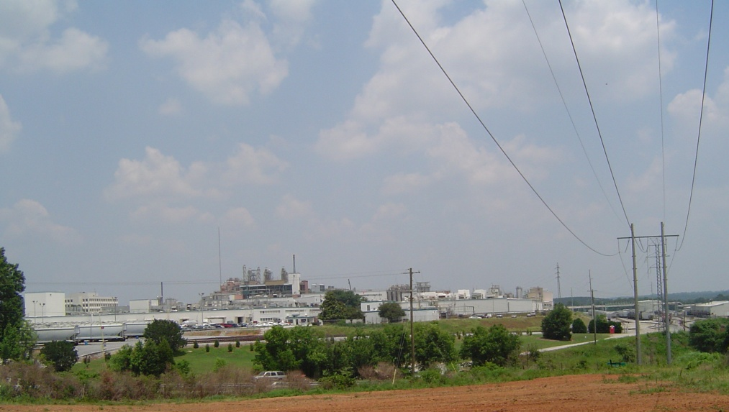
Auriga Site (Former Hoechst Celanese) DHEC Community Meeting Update Spartanburg, SC 11/28/11
1

Slide 2
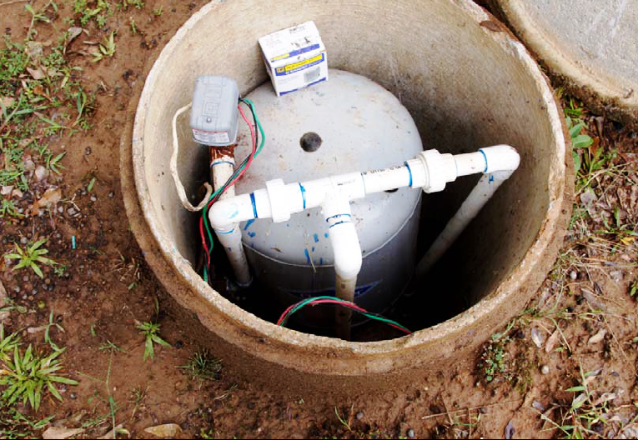
Actions Since August 4, 2011
Pacolet River Macroinvertibrate Assessment
Cherokee Creek Stream Sediment Results
Offsite Chloroform Assessment
Private Well Sampling
2

Slide 3
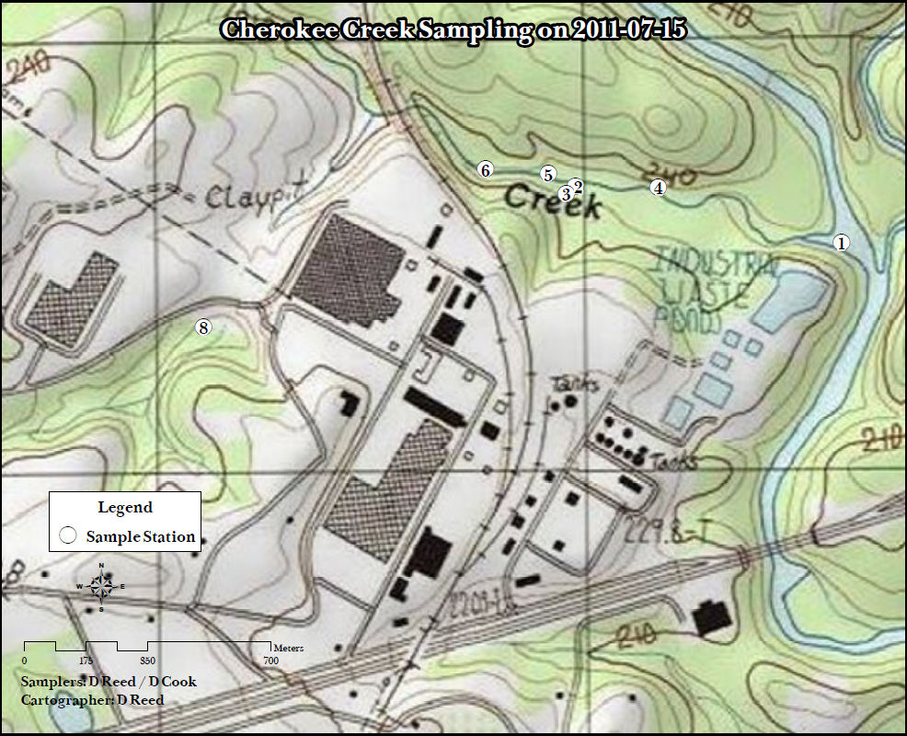
Stream Sediments
3
Notes:
Causes need to be determined.

Slide 4
Several Detections
Dowtherm (1,1 Biphenyl & Diphenyl Ether).
Polychlorinated Biphenyls.
Other compounds known to be in groundwater plumes.
Other compounds associated with past agricultural practices.

Slide 5
Historical Groundwater Plumes
Notes:
Chemicals in GW & Direction Moving.

Slide 6
Offsite Chloroform Plume
Notes:
Chemicals in GW & Direction Moving.

Slide 7
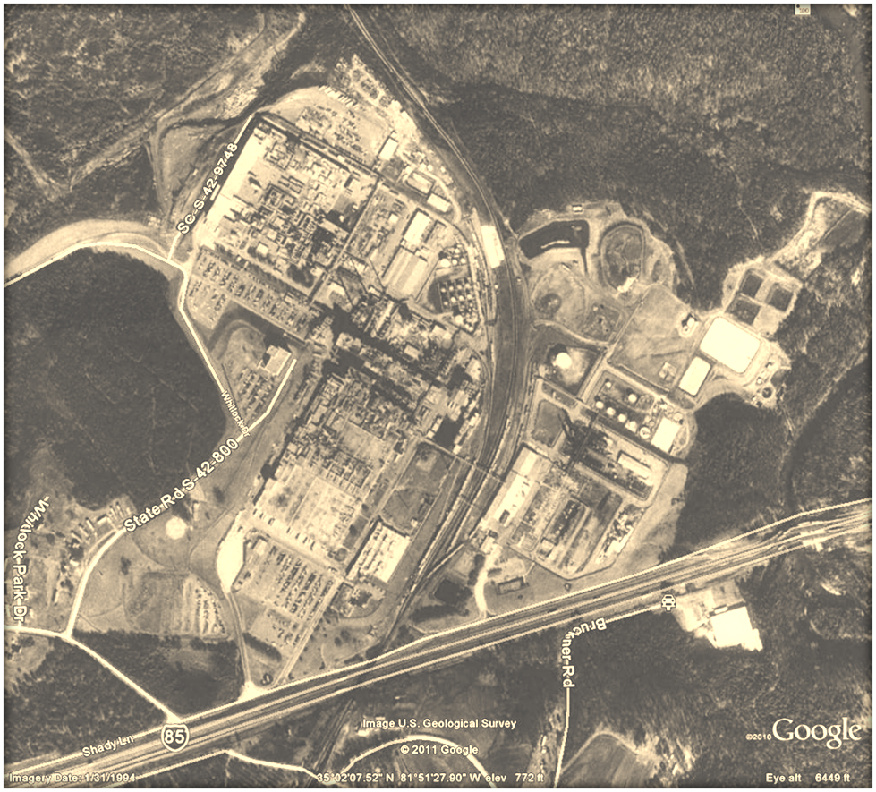
Offsite Chloroform Assessment

Slide 9
Questions?

Slide 10
Private Well Sample Results Ken Taylor, P.G.

Slide 15
Spartanburg Area Assessment Initiative
Use existing assessment resources to examine watershed-level issues
Two geographic areas:
Pacolet River, including Cherokee Creek, Pole Bridge Branch, Lawsons Fork Creek, and other tributaries
Kelsey Creek from headwaters to Lake Craig

Slide 16
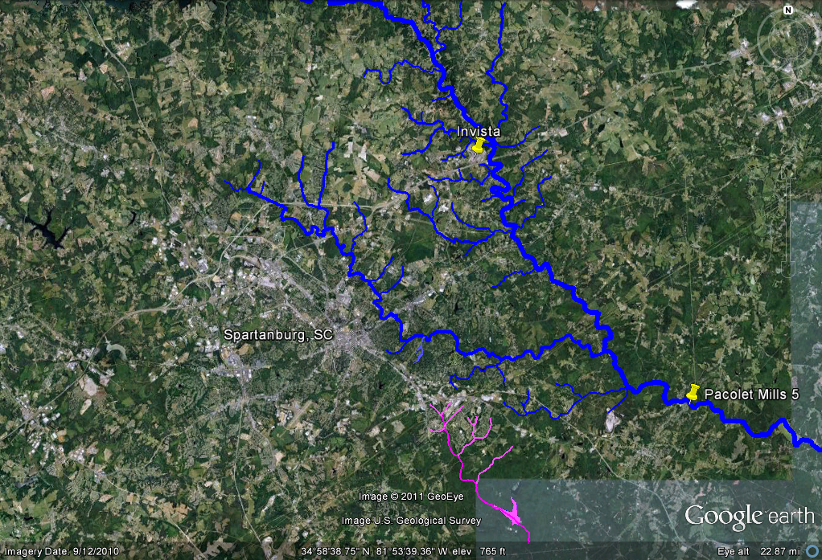
Pacolet River
Kelsey Creek

Slide 17
Pacolet River Study Area

Slide 18
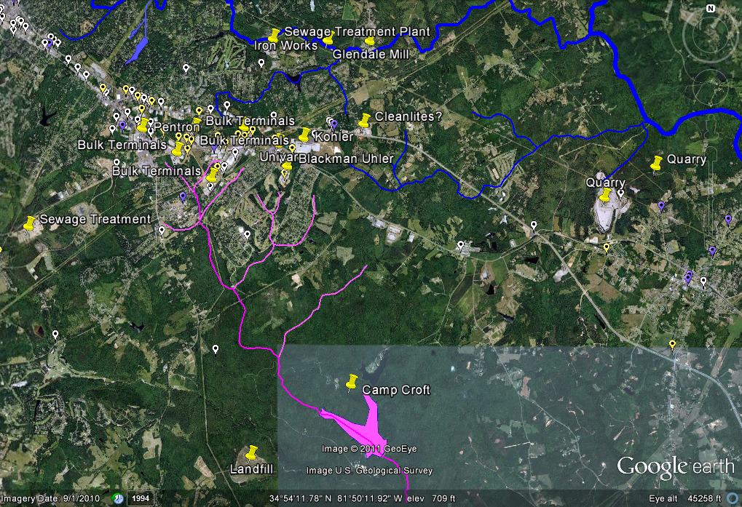
Kelsey Creek Study Area

Slide 19
Spartanburg Area Assessment Initiative
Public Participation – Focus Groups for each study area
Timeline
December 2011 – March 2012 Environmental Sampling
February 2012 – May 2012 Receive analytical data
March 2012 – June 2012 Prepare reports on individual “sites”
June/July 2012 – Present comprehensive results to community
July 2012 forward – additional assessment/followup as needed

