Slide 1
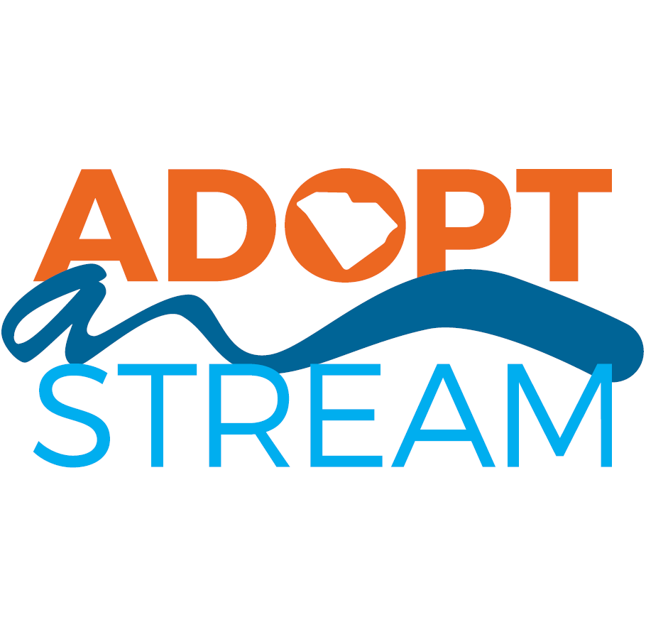
Welcome!
The presentation will begin shortly. Here are some tips for a great online training experience.
You are muted and your microphone should remain off unless instructed otherwise.
We do encourage the use of video for this workshop.
Close out of all other programs on your computer to improve your connection.
If you are having technical difficulties, leave the training and rejoin.
The control panel will be on the bottom of the screen.
To ask questions, use the chat box or click the raise hand option.
Notes:
Ignore this slide unless you are doing a virtual classroom portion. Start on slide 2.

Slide 2
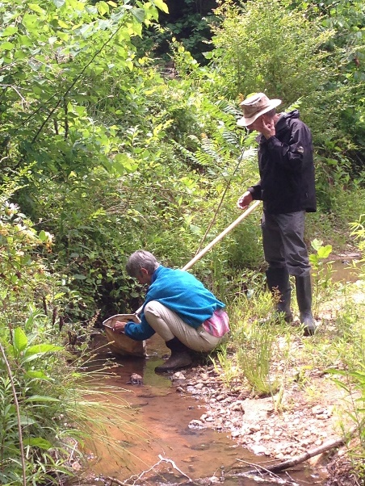
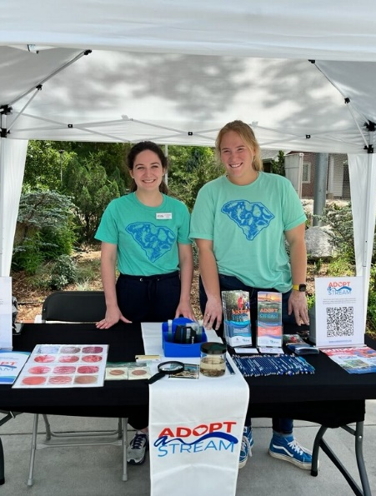
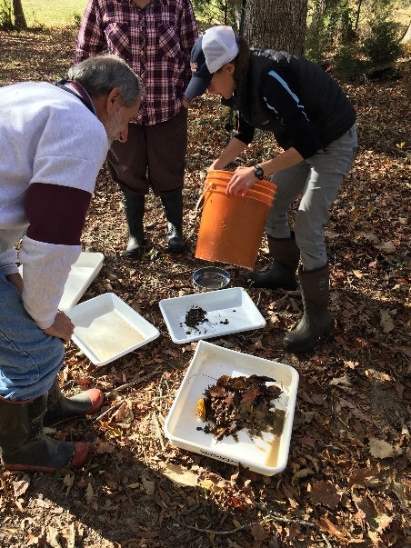
South Carolina Adopt-a-Stream Macroinvertebrate Monitoring

Slide 3
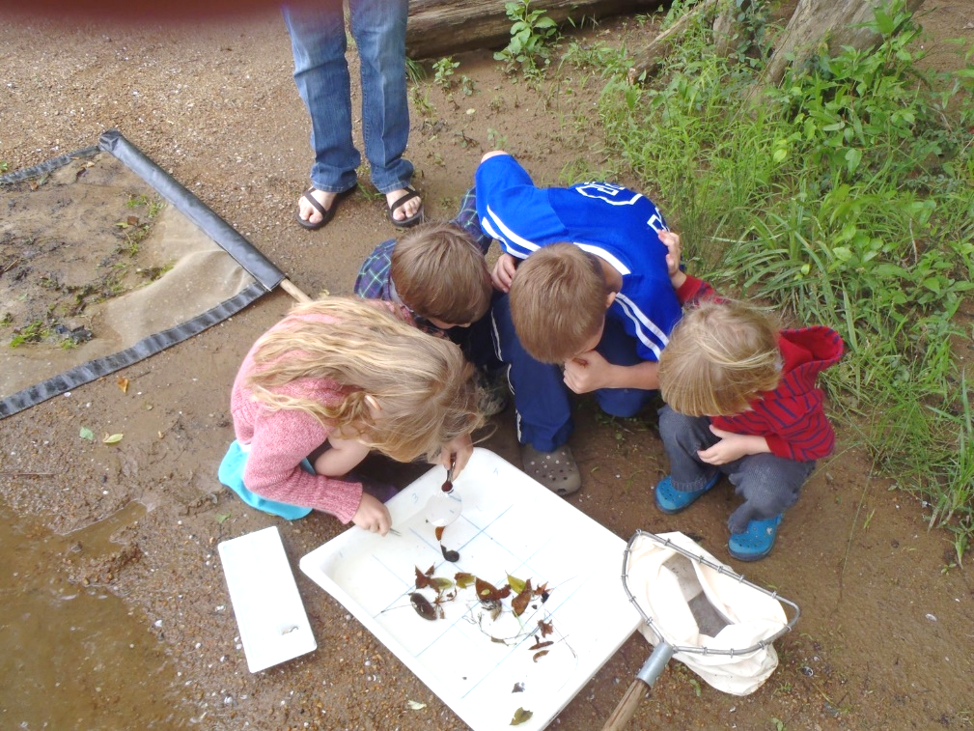
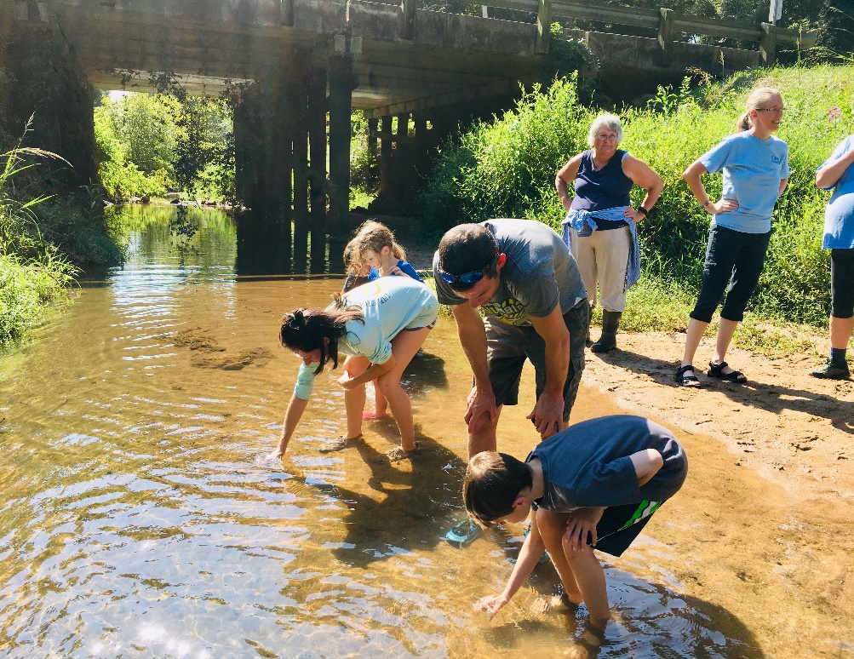
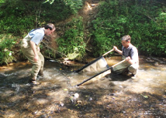
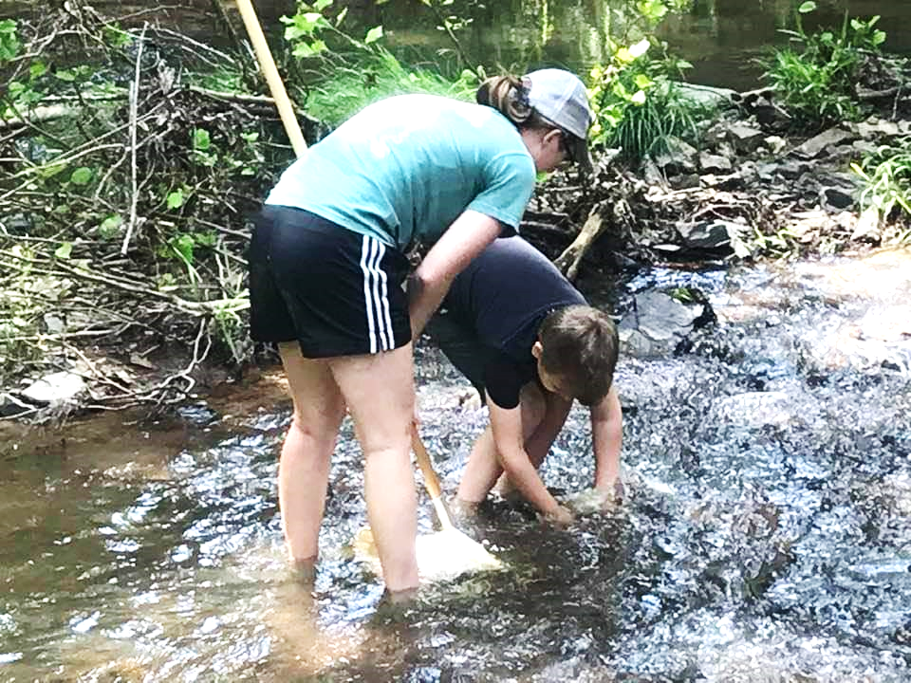
SC AAS INTRODUCTION
Notes:
SC Adopt-a-Stream (SC AAS) is a community of individuals, agencies, businesses and friends that partner together to learn about our waters by collecting data that can be used to protect and restore them. SC AAS trained volunteers are taught how to increase water quality awareness within their own community by sharing their data and knowledge gained at free certification workshops.
****Introduce yourself as a trainer. Give instruction on how day will go, bathrooms, lunch, traveling to field etc.

Slide 4
THE SC AAS PROGRAM
Co-lead by SC Department of Health and Environmental Control (SC DHEC) and Clemson University’s Center for Watershed Excellence (CU CWE)
~150 active volunteer samplers
Trainer Directory: https://www.clemson.edu/public/water/watershed/scaas/trainers_and_staff.html
Trainers
University Professors, Clemson Extension, SCDHEC/
You (citizen scientist)
Notes:
South Carolina Adopt-a-Stream was launched in 2017 as a freshwater quality monitoring program for citizen scientists. It is co-led by South Carolina Dept. of Health and Environmental Control (also known as DHEC) and Clemson University's Center for Watershed Excellence. Together these two groups form the State Team. The State Team helps keep the program running and oversees the public database.Trainers are AAS volunteer water quality monitors that have been in the program for more than a year and have completed a trainer certification workshop. Last but not least, YOU. After this workshop, YOU will be a certified citizen scientist. You have the chance to impact water quality in your community by providing VALUABLE data about tidal saltwater sites that you care about.

Slide 5
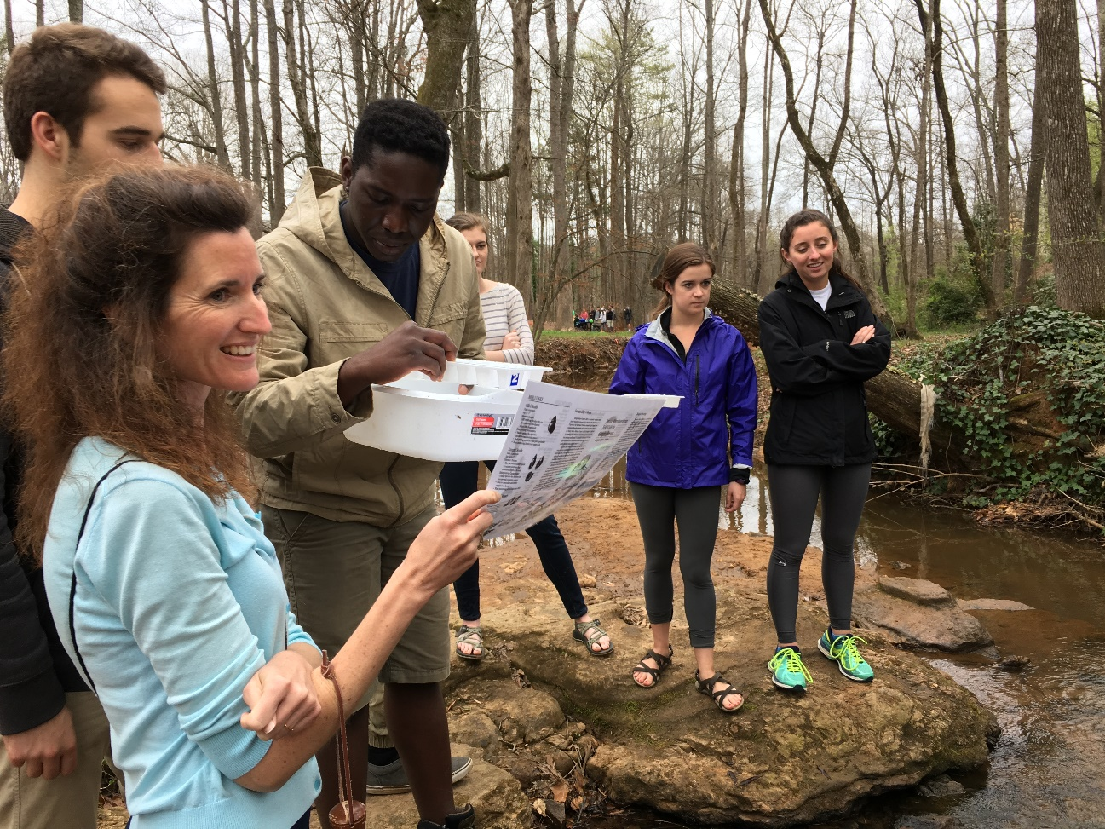
INTRODUCTIONS
Who are you?
Why are you here?
Where will you monitor?
Notes:
Take some time to get to know the volunteers. Ask them:
Who they are
What they do
Why they have come to the training
MESSAGE: GET READY TO GET INVOLVED! We will have as much hands-on as possible in this training, but the best thing to do, is get out and sample.

Slide 6
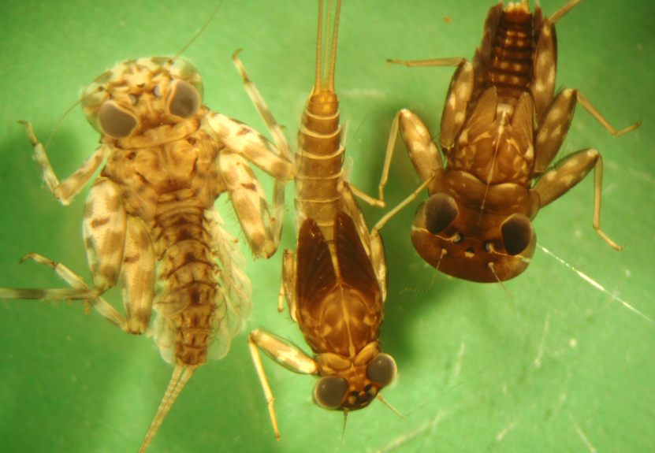
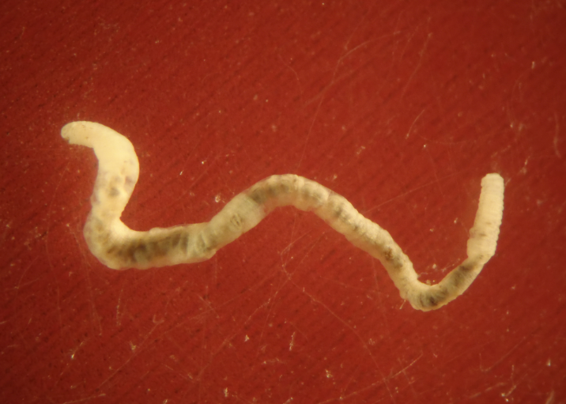
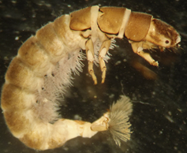
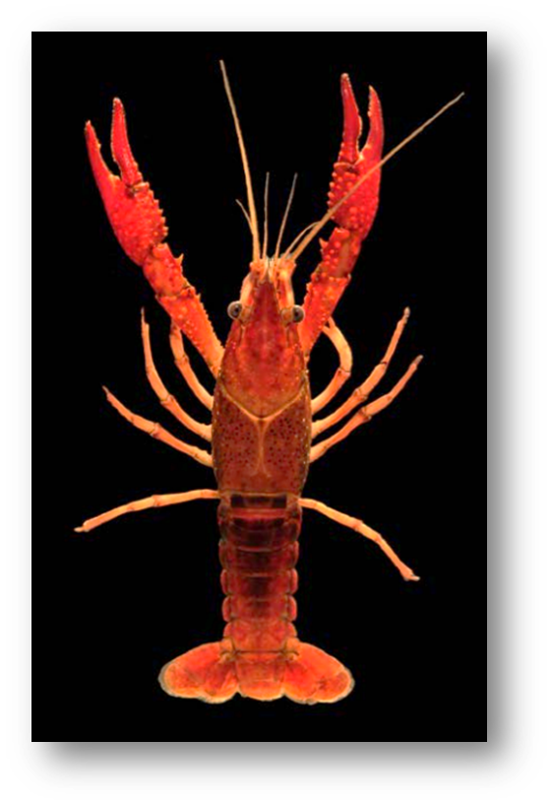
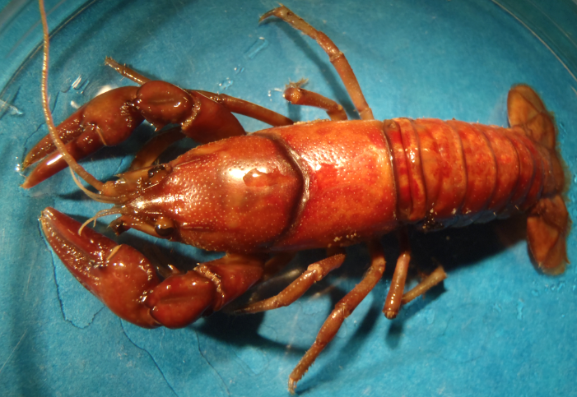
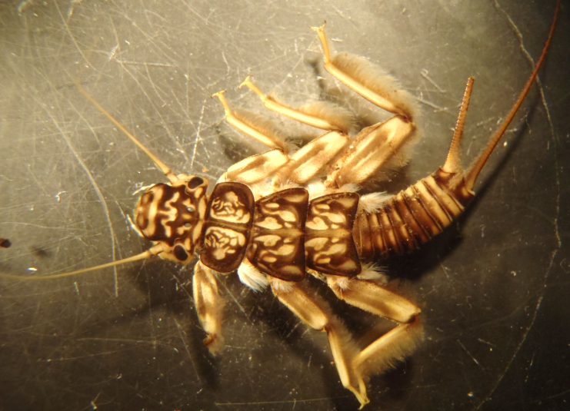
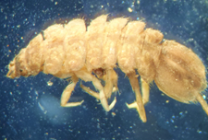
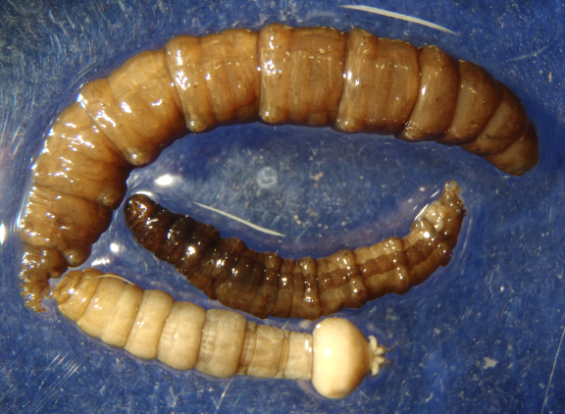
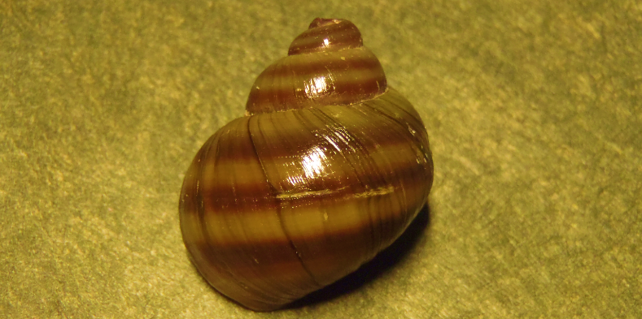
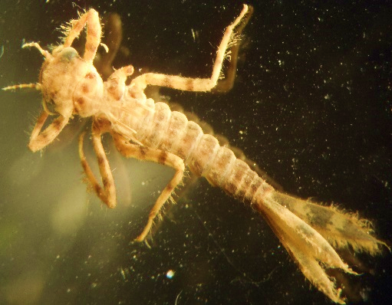
MACROINVERTEBRATES?
Notes:
The organisms that we sample for are called benthic macroinvertebrates – or in other words aquatic bugs that live in the stream bottom. Macroinvertebrates have the following characteristics. They:
Lack backbone
Visible to the naked eye
Live in many different habitats
Derive oxygen from water
Impacted by all stresses that occur in a stream environment, both man-made and naturally occurring

Slide 7
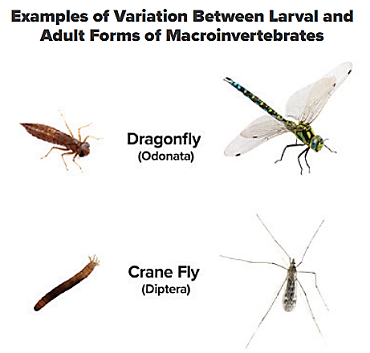
CAN YOU NAME ANY?
Notes:
Aquatic macroinvertebrates can be found in many different aquatic habitats. Although many people are unfamiliar with the aquatic form of macroinvertebrates…many people may know a few of their adult forms such as the dragon fly or the large “mosquito-like” bugs that bounce around porch lights during the summer that are called Crane Flies. Many of the macroinvertebrates we’ll learn today will spend much of their life (1-3 years) if not all underwater before becoming adults.

Slide 8
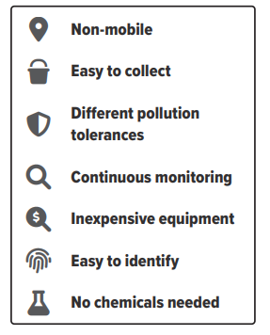
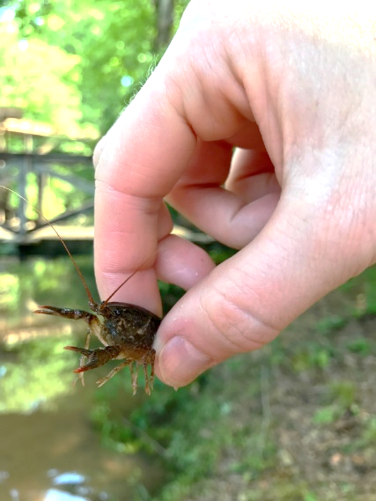
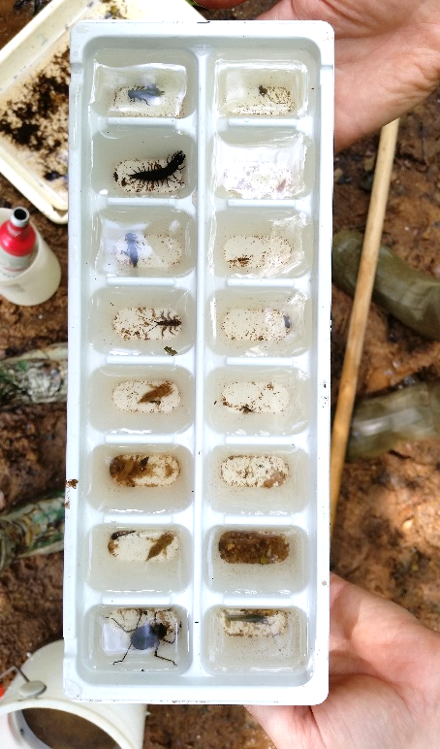
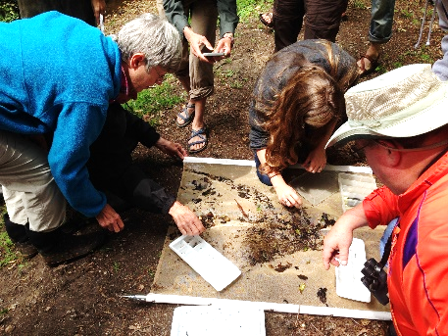
WHY MONITOR MACROS?
Notes:
Macroinvertebrates are indicators of water quality because different types of them tolerate different levels of pollution and stream conditions. In addition to being excellent water quality indicators they are also: not very mobile, easy collect, can be continually monitored, inexpensive to find, easy to learn and there is no waste or chemicals that are needed to sample.
Page 8

Slide 9
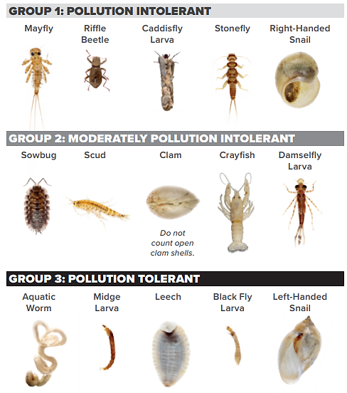
INDICATORS OF WATER QUALITY
Notes:
Here is an example of some macroinvertebrates separated by their pollution tolerance categories: Pollution Intolerant (needs clean water and great habitat to thrive), moderately pollution intolerant (may be reduced or absent in some pollution types) and lastly, pollution tolerant (able to withstand more pollution than other types). In other words, some bugs are more sensitive to changes in water quality or habitat than others.

Slide 10
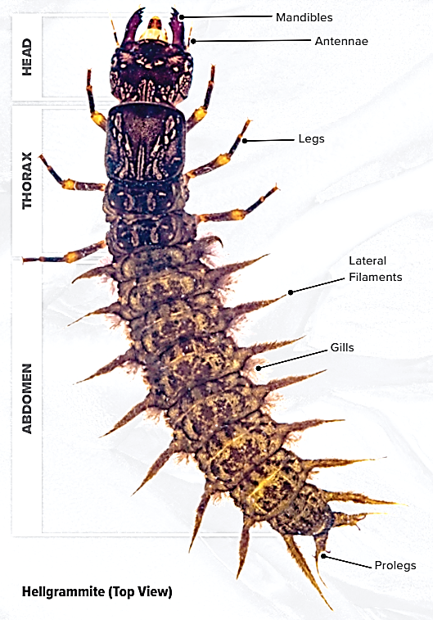
MACRO ANATOMY
Notes:
Most macroinvertebrates that we look for in the SC Adopt-a-Stream program have 3 main body segments (Head, Thorax, Abdomen). Other features that are important to learn include (Mandibles, Antennae, Legs, Lateral Filaments, Gills and prolegs). Not all parts are present on all groups of macros and they can be in different spots on different species.
Page 10

Slide 11
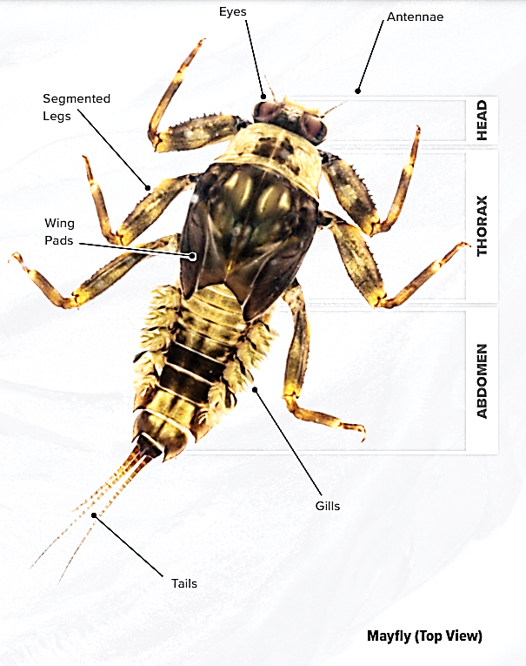
MACRO ANATOMY
Notes:
Here is another example. This macro also has a head, thorax and abdomen but has no mandibles, lateral filaments or prolegs. Instead, it has wing pads and 3 tails.

Slide 12
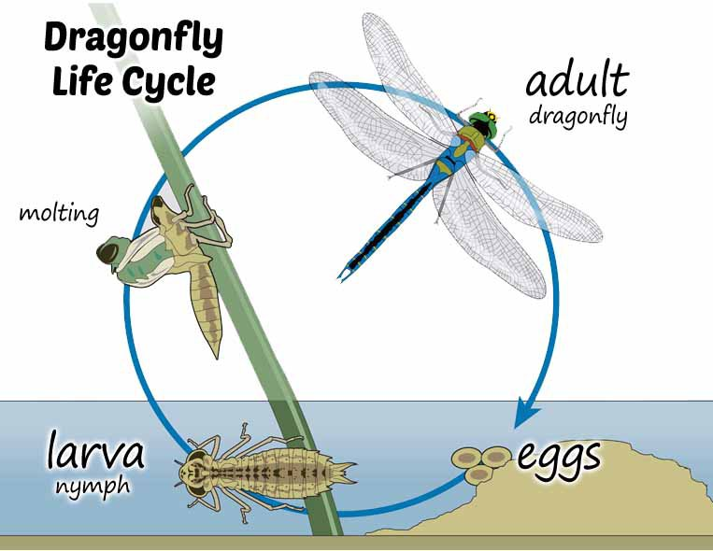
LIFE CYCLES
Shredders
Scrapers
Collectors
Predators
Notes:
Life cycles of macroinvertebrates can vary depending on temperatures, levels of dissolved oxygen, day length, pesticide use, water quantity and climate changes. Aquatic insects can feed by shredding, scraping, collecting or predation. Predators will only be found if they have prey present; which is similar to scrapers needing algae or other nutrients to survive. Most are harmless to humans!
Page 12

Slide 13
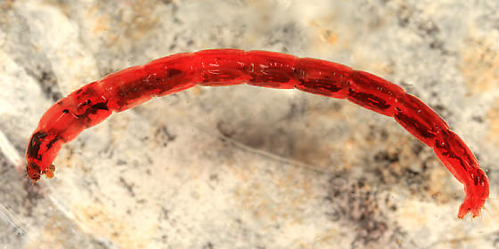
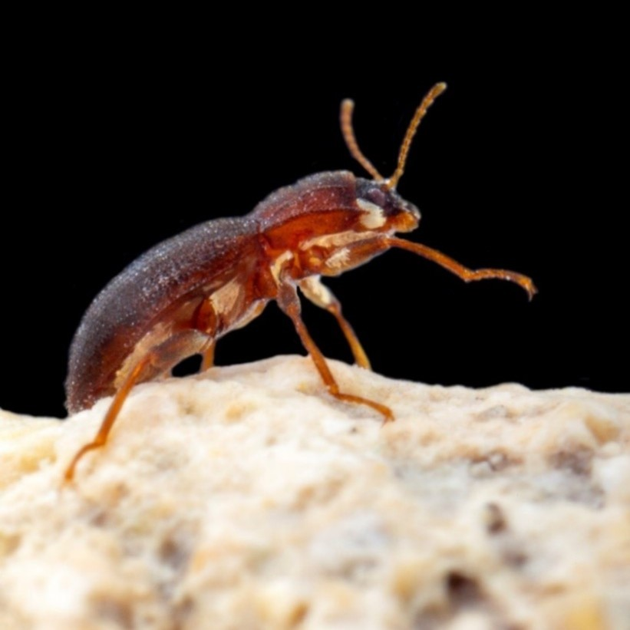
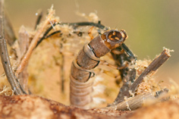
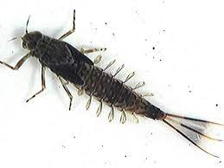
MOVEMENT
Burrowers
Climbers
Crawlers
Clingers
Swimmers
Notes:
Different macroinvertebrates move in different ways. This movement can help you identify or rule out certain types when identifying them. Note: Only sample submerged habitats…don’t look at dry leaves, under living bark or around vegetation that is above the water line. Although “where” you find the macroinvertebrates is a clue to their identity, so is the way they move. There are many different habitats that macroinvertebrates live in.

Slide 14
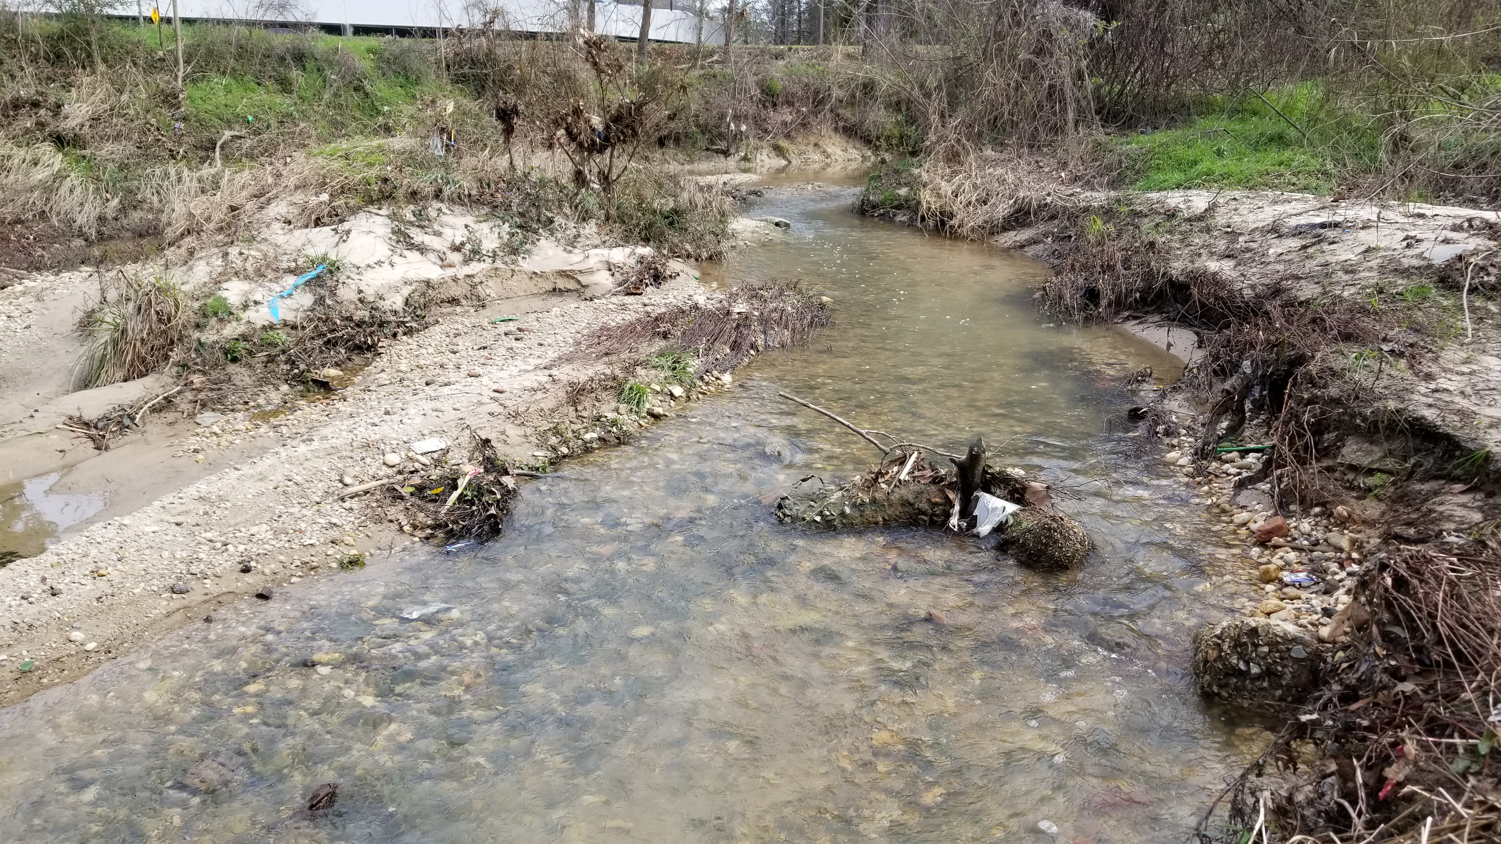
STREAM HABITATS
Vegetation
POOL
Leaf Pack
Riffle
Snags, Root Wads & Woody Debris
Notes:
Macroinvertebrates can be found in different types of habitat based on their mobility and food sources. In order to find them, you must sample from a variety of habitats. Some habitat is easier to sample than others or may harbor a more diverse sample.

Slide 15
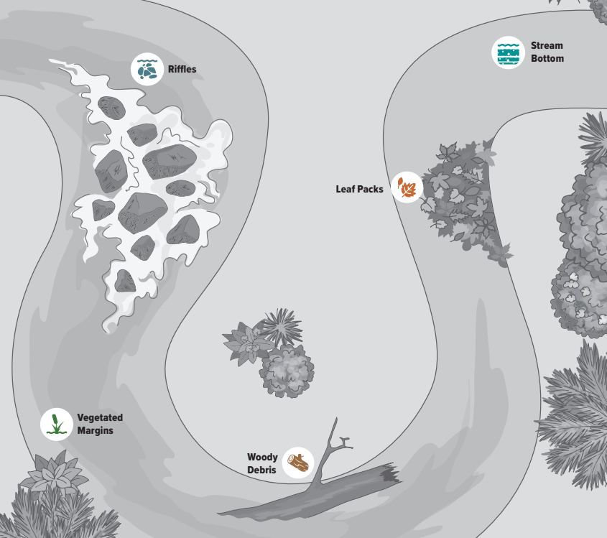
STREAM SAMPLING
Upstream Direction
Return all collected items to stream
“Riffles” and “Leaf Packs” usually most diverse
Notes:
When sampling, always work in an upstream direction. You do not want to walk through areas that you plan to sample. Be mindful of where you return the macroinvertebrates to. Never dump them in an area that you plan to sample next or leave them to dry out on shore. Always return water, leave, sticks and rocks back to the stream. Only sample submerged items (no dry leaves, don’t look under bark or around vegetation that is above the water line).
For our sampling protocol, we want volunteers to look at 5 types of habitat to sample from. Note: some streams may only have a few types of habitats but each different type should be sampled.
Page 14

Slide 16
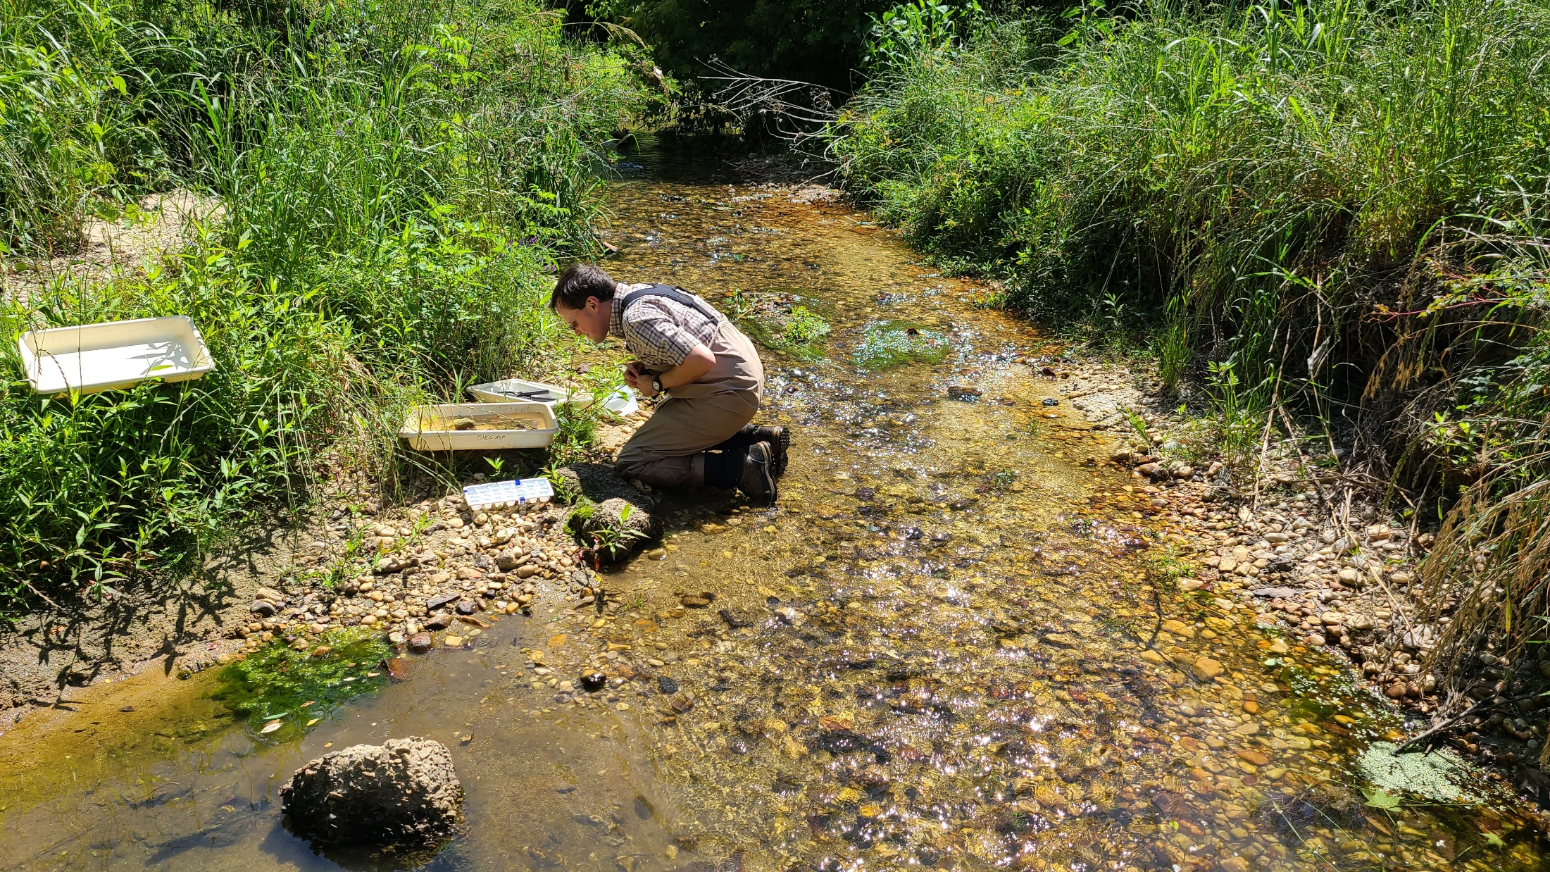
SAMPLING – RIFFLES
Notes:
The first and often most diverse place to sample is in riffles. Riffles are shallow areas where water flows over rocks. Many macroinvertebrates like hiding or hunting in between the various sized rocks in the fast moving, oxygen rich, flow.

Slide 17
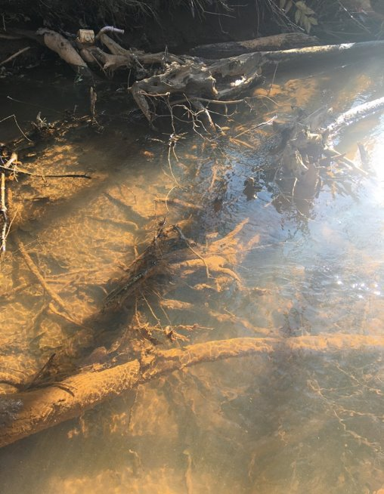
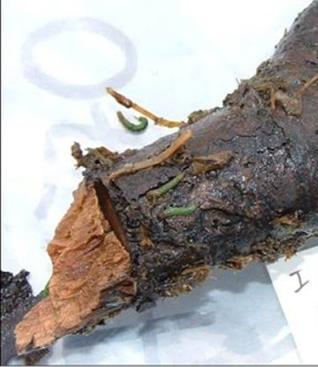
SAMPLING – WOODY DEBRIS
Notes:
Another great place to sample is any SUBMERGED woody debris. This can be twigs, logs, submerged trees. You may have to peel the bark back or collect small pieces to rinse into your bucket or sorting pan. Watch out for fish hooks and wear gloves or use a brush if you choose to sample individual pieces of wood.

Slide 18
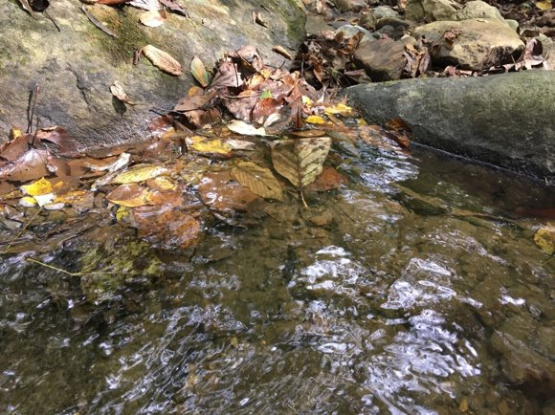
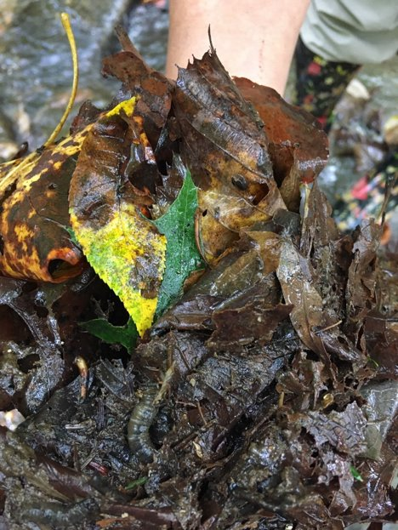
SAMPLING – LEAF PACKS
Notes:
Submerged leaf packs are important to sample when they are available. Look at each leaf individually and return all of them to the water when finished collecting.

Slide 19
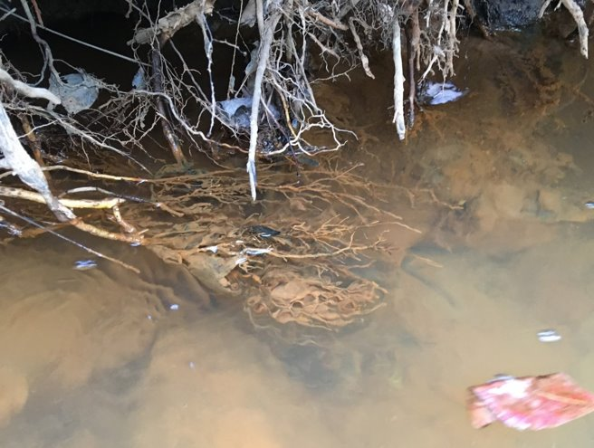
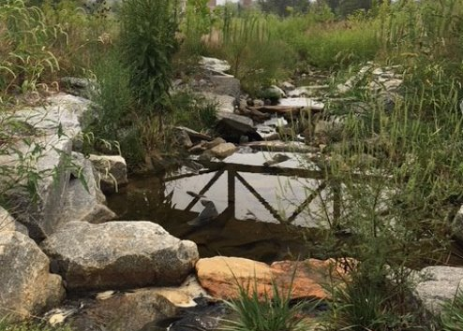
SAMPLING – VEGETATED MARGINS
Notes:
Vegetative margins includes plants and submerged roots. Watch out for poison ivy. Do not pull the vegetation from the bank however, it’s good to collect any parts of the plants that break free with your sample.

Slide 20
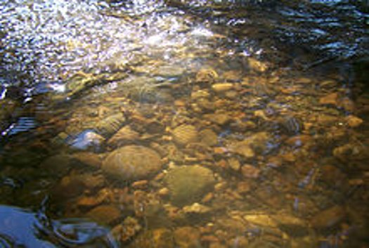
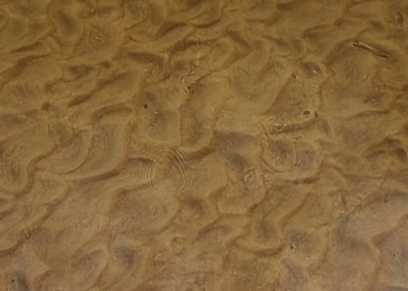
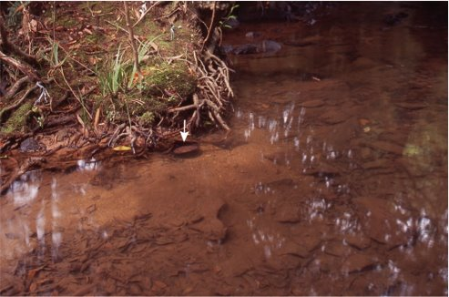
SAMPLING – STREAM BOTTOM
Notes:
The streambed is often sampled last because it can make your sorting pan hard to find macros in. Try to rinse or let flowing water run through your net several times before rinsing it into the sorting pan. Always choose the coarsest spot of the stream bottom to sample.

Slide 21
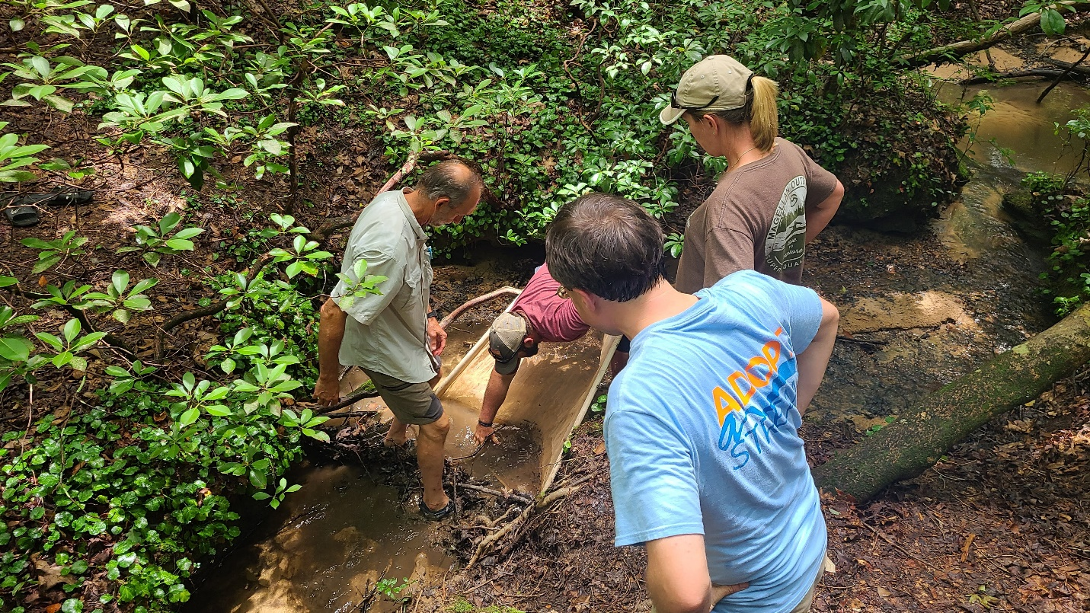
SAMPLING PROTOCOL
1 Hour Total to Collect
As much time as needed to identify
Sampling in groups encouraged
Sites can be 100 ft – 300 ft
Learn to ID 20 Macro Groups
Notes:
Emphasize each point on slide. Two people can collect for 30 mins each to count for the 1 hour total.

Slide 22
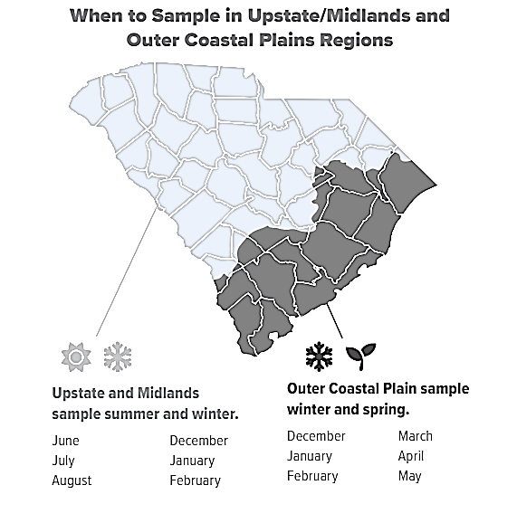
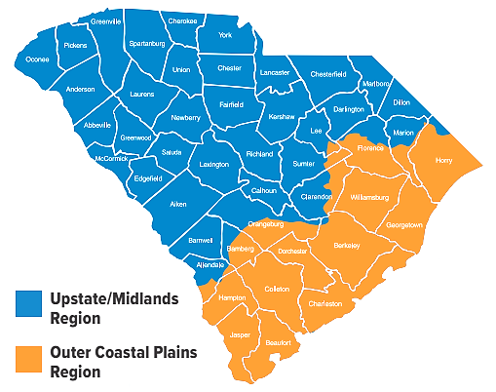
FREQUENCY
“When?” Depends on Location
2x per year
Notes:
Page 17 and inside front cover.
Encourage volunteers to select their months on the inside cover for when to sample.

Slide 23
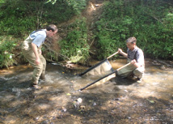
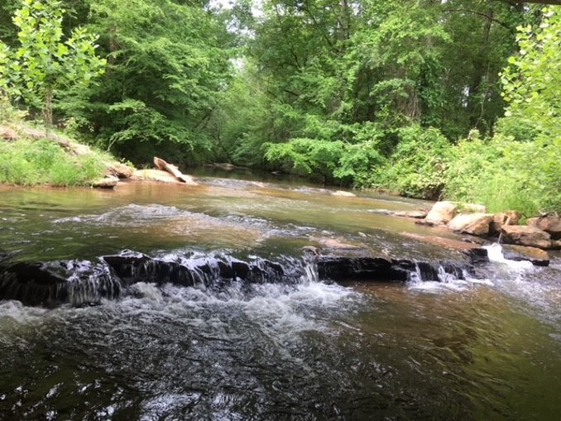
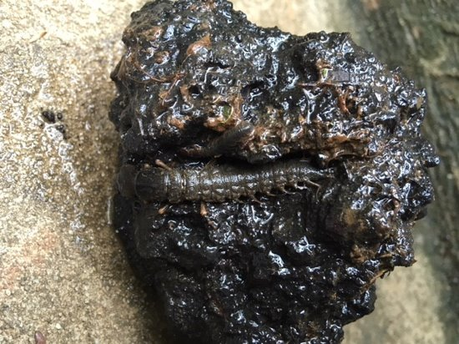
SAMPLING - KICK NET
Stream and Sampling Types
Notes:
Different sampling tools can be used for different stream types. Kick nets are used in shallow areas with good flow, such as riffle habitat. Most nets are 3x3 feet and need two people to properly operate. Use rocks to secure the bottom of the net. Make sure to examine any rocks in that area for macros hiding in the cracks. You’ll need to rinse the net into a bucket or tray to find most of the insects. Always check the net for movement, especially around the seams.

Slide 24
SAMPLING - DIP NET
Stream and Sampling Types
Notes:
“D-Frame” nets can be used in slower moving streams, to collect leaf packs or under vegetated margins. Sweep the net back in forth if current isn’t strong enough to push the macros into the net once the area is disturbed.

Slide 25
SAMPLING – SIEVE BUCKET
Notes:
As a last resort, a bucket with a sieve (fine mesh) can be used to sample fine sediment along the stream bottom.

Slide 26
DATA FORM
Notes:
Data Forms can be found on our website www.scadoptastream.org or by scanning the QR code on page 18 of the guidebook. You can also enter data directly from your phone to our database once you become a certified volunteer.
Link to Data Form (QR Code) Page 18

Slide 27
R C D – TALLIES - SCORING
Rare (1-9), Common (10-99), or Dominant (100+).
www.scadoptastream.org
Notes:
Keep a tally of the macroinvertebrates you find as you begin to identify them. Once finished, total them to determine which category they fit in: Rare (1-9), Common (10-99), or Dominant (100+). Check R, C, D for each type of tax that you find. Circle the number in the right hand column for any taxa that you find whether you find 1 or 100. Total that column to find your water quality index score which tells you if your rating is Excellent, Good, Fair or Poor.

Slide 28
Notes:
In addition to following the protocol exactly, there are some important tips to remember:

Slide 29
STREAM SCORE
Stream score represents long-term water quality and habitat health
Poor score?
Email Trainer/Staff
Keep Sampling
Add Comments to Database
Adopt Additional Sites
VS
Notes:
Now that you know how to score a stream itself, what does the score mean? Here are two examples of what you may find: high macro diversity often means good water quality (especially if you find mayflies, stoneflies and caddisflies) while low diversity, even if the water is clear, could mean a pollution event is occurring or has recently occurred. There are other examples listed in the SC Adopt-a-Stream handbook or you can reach out to your local trainer to help interpret what you are finding. They can also help with ID if you send them photos.

Slide 30
BREAK

Slide 31
GOALS
Educate Citizens
Increase Statewide Data
Encourage positive water quality habits
Support watershed stewardship
NOT for targeting
NOT used for regulatory action
Notes:
Now that you know how to sample lets take a deeper dive in to why you may want to become a long-term volunteer monitor. Our program goal is to educate citizens on how to collect usable data that can be used in a positive way to support watershed stewardship. SC Adopt-a-Stream monitoring is NOT to be used to target any individual or group and is not to be used for regulatory action.
Page 24

Slide 32
MISSION
A: ACTIVE
D: DATA
O: OUTDOORS
P: PROTECT
T: TOGETHER
Notes:
Through this program, it is our MISSION to help citizen scientists take an “A”ctive approach to collecting “D”ata while enjoying the “O”utdoors in order to “P”rotect and restore our streams together.

Slide 33
INTEGRITY
Quality Assurance Project Plan (QAPP)
Quality Control
Only individual certifications
Certification valid for one year
Annual recertification
Only certified volunteers enter data
EPA approved
Notes:
Because of our QAPP and the integrity of our volunteers this data is highly valuable and can be used in many different ways. In the field, volunteers must be able to come close to the results obtained by the trainer ID (18 out of 20 on the test). Overall, volunteers must pass a written evaluation today, with a score of at least 80%. All volunteers, including trainers, get recertified each year to keep up to date on the program protocol and updates.

Slide 34
ETHICS
Following the SC AAS monitoring methods EXACTLY
Fully and accurately document observations…ask trainers or staff for help with ID
Report data directly to the SC AAS database from SC AAS website
Represent SC AAS with integrity …and by wearing our shirt (purchase on website marketplace)
Notes:
SC AAS Volunteer Monitors and Trainers represent this program with integrity, by doing the following:
Following the SC AAS monitoring methods.
Fully and accurately documenting observations.
Reporting data directly to the SC AAS database.
Representing SC AAS with integrity when performing monitoring and discussing the program with others.
It is also expected that certified volunteer monitors foster positive relationships with landowners, inviting all audiences to be stewards of our shared water resources.
To ensure the quality and portrayal of this program volunteers should commit to these code of ethics

Slide 35
WATER QUALITY IN SC
Notes:
South Carolina is divided into 8 very large watersheds or river basins. These river basins are than further broken up into smaller “watersheds.” Each watershed is vulnerable to pollution based on the land use and water use in that area.
Page 27

Slide 36
POINT SOURCE POLLUTION
Can point to the source of the pollution
Regulated by DHEC
Notes:
There are two main types of water pollution: point source and nonpoint source. Point source is where you can actually see the source and or point to the source. Some examples of this is industrial discharges and municipal sewage treatment plants. This type of pollution is regulated by DHEC. Industries, business, cities, and counties have to go through a lengthy permitting process.

Slide 37
NONPOINT SOURCE POLLUTION
Source not easily identified
Runoff carries materials into streams
Notes:
Nonpoint source pollution is where an individual source cannot be identified. Examples of nonpoint source pollution comes from Erosion/Sediment runoff, Fertilizers, pesticides Animal wastes, Runoff from roads and parking lots, Illicit spills and illegal dumping, Leaking septic systems. This type of pollution #1 cause of water quality problems in SC.

Slide 38
WHY MONITOR?
Notes:
We use water for all sorts of activities from recreation to hydration. Water is important to all of us. The quality of water can be indicative of the quality of life.
Monitoring provides specific information about the health of our waterbodies because all the water we have now is all the water we’ll ever have.
So to ensure the health of our waterbodies long-term monitoring can be used to make sure the water is healthy now and for future generations.

Slide 39
SITE SELECTION
Same location (100-300ft)
Same time of day
Flows Year-Round
Away from pipes/structures
Sample in upstream direction
Notes:
To sample macroinvertebrates in the AAS program, you must be prepared to sample the same location, at the same time of day, twice per year. It is best to select a site that has a well mixed area of flowing water. This means a stream that is wrist deep to hip deep that flows year-round. Remember to only sample during NORMAL flow conditions….never during or after rain storm events.

Slide 40
EXPLORE BEFORE ADOPTING
Access/Permission
Existing Data
No drought/flood
No lakes/swamps/large rivers
Seasons alter results
Notes:
There are several things to consider before selecting a site to monitor. First, you need appropriate permission and safe access. It’s also important to learn if the site has ongoing monitoring efforts or not. This could be monitoring at the state level or local monitoring, if so try to pick an area where no data currently exists. Do not sample during extreme weather events as that could alter your stream score. Do not adopt sites on lakes, in swampy areas or on large rivers. Keep in mind that data should only be compared from similar seasons.

Slide 41
EXPLORE AFTER ADOPTING
Watershed Tour
Stream Walk
Mapping Data
https://gis.dhec.sc.gov/scaas/
Notes:
After you adopt your site and begin monitoring it’s good to become familiar with what’s going on in your watershed. You can do this by doing a driving tour, walking the stream if permission is granted or by mapping your data using online tools like the SC AAS Atlas. This tool lets you see where other data currently exists and can make simple maps that allow you to share your data easily. This tool can also be used to help you find your watershed name and number for adding your adopted site to our online database.

Slide 42
SAFETY
DON”T SAMPLE if conditions are dangerous!
Sample together
NEVER sample during a storm or after a rain event
Wear boots and gloves
Get permission from private land owners
Notes:
The safety of volunteers is the highest priority in this program. Never sample if conditions are too dangerous!
It is always best to sample with someone, even if they are not a certified volunteer. However, if you have to sample without someone, let a friend know where you’ll be and what time you plan on leaving and returning. Never sample during a storm. Wait until a storm has stopped AND high water flow has subsided. Keep in mind, your site may be contaminated even if the water is clear or has no odor. Always wear boots and gloves and wash hands after sampling.
Lastly, if there is evidence of criminal activity, leave the area immediately and call local law enforcement. Make sure you have permission to sample on private lands each time you sample at that site.

Slide 43
HABITAT ASSESSMENT
Once per year
Can be completed prior to borrowing kit
Notes:
In addition to macroinvertebrate monitoring, knowing your stream habitat score can help you understand or document changing conditions at your adopted site. Watch the “Stream Habitat Assessment” video on the Resources & Materials page of our website, www.scadoptastream.org to learn more. This visual assessment should be completed once per year (during leaf-on conditions) and can be done whether you have access to a kit or not. It’s fun to do as a group!
https://www.youtube.com/watch?v=7HDB4IJQlb0
Page 36

Slide 44
HOW TO IDENTIFY
Use the size, color, shape
Consider the movement/habitat
Double check distribution
Rule out look-alikes using “similar to” section
Measure macro using rulers
Notes:
Page 38

Slide 45
Notes:
Page 40

Slide 46
Pollution Sensitive Organisms
Require High Levels of Dissolved Oxygen
Found in Good Quality Water
Notes:
Now its time to go over some macroinvertebrates. First we’ll cover which macroinvertebrates fall in the pollution sensitive organisms category. These organisms are found in good quality water and require high levels of dissolved oxygen

Slide 47
Stonefly Nymph
1/2 -1 1/2 inch in length (excluding tails)
2 sets of wing pads, 2 tails, 2 prominent antennae, 2 claws at end of each leg
Branched gills between legs on underside of body, “hairy armpits”
Yellow to dark brown
POLLUTION
SENSITIVE
Similar to Mayfly
Notes:
Stoneflies do not tolerate low levels of dissolved oxygen and therefore prefer cold, swift-moving streams. The streamlined, flattened bodies of stonefly nymphs enable them to move about the rocky streambed in rapid currents.
stonefly nymphs always have two tails, prominent antennae, and two claws at the end of each leg. They will never have gills on their abdomen.
Other good indicators can be the 2 sets of wing pads or gills that look like ”hairy armpits”. These macros can be easily confused with mayflies.

Slide 48
Notes:
https://www.youtube.com/watch?v=wYbeaCRFdeQ

Slide 49
Mayfly Nymph
Up to 3/4 inch
Slender antennae, one claw on each leg
Usually three tails
Gills on abdomen
POLLUTION
SENSITIVE
Similar to Stonefly
Notes:
Mayfly nymphs look similar to a stonefly, but with noticeable gills on abdomen and three tails instead of two in most cases. They can be shaped like a small minnow or can be flattened top to bottom.

Slide 50
Notes:
https://youtu.be/-Psfo9Sk5xk

Slide 51
Stonefly vs Mayfly
POLLUTION
SENSITIVE
Notes:
Here is a side by side comparison of the Stonefly and Mayfly
Speaking Points
Make sure to point out the Gills on the mayfly (abdomen)
Most mayflies have 3 tails, but some have 2 and gills are more reliable for telling them apart
2 tarsal claws (stonefly) vs. 1 on mayfly

Slide 52
Caddisfly Larva (Non-Net Spinning)
Up to 1 inch
“C” shaped
Some have cases
Claw-bearing prolegs at the end of the abdomen
3 pairs of legs
Case-building/Free-swimming
Similar to Riffle Beetle Larva, Net-spinning Caddisfly, Midge Fly
POLLUTION
SENSITIVE
Notes:
Caddisfly larva are unique because some build distinctive cases made of sticks, rocks, sand, plant material and/or other debris. There is also a common net-spinning caddisfly that spins a net instead of building a case around itself. Common net-spinning caddisflies should be be counted separately. In general, caddisfly larvae are c shaped, have 3 pairs of legs and have 2 claws at the end of their abdomen. Some caddisflies are free swimming.

Slide 53
Notes:
https://youtu.be/W7LOhbjCzeU

Slide 54
Aquatic Snipe Fly Larva
¼ to 1 inch
Pale brown-green color
Caterpillar-like
Two stout tails
Pointed head
POLLUTION
SENSITIVE
Similar to Crane Fly, Midge Fly, Horse Fly
Notes:
Aquatic snipe fly larva are mostly cylindrical, with the front tapered to a cone-shaped point. The can be pale brown to green in color and are catipillar-like. They also have two stout tails.
Look similar to crane flies (which have no prolegs) and midges (which are much smaller), and another kind of Dipteran in the Family Empididae (dance flies)

Slide 55
Notes:
https://youtu.be/fh0OQP4t6rc

Slide 56
Water Penny
¼ inch
Flat disk-like body
6 legs and gills
POLLUTION
SENSITIVE
Notes:
Water pennies are very small. Water pennies prefer cold, fast-moving streams. Their smooth, flattened bodies enable them to resist the pull of the current. Water pennies are usually found on smooth rocks where they graze on attached algae
They have a Flat body, looking very similar to a horseshoe crab. They are almost always found stuck (suction cup-like) to the sides and tops of rocks.

Slide 57
Gilled Snail
Shell opens to the right
Shell opening has a cover
DO NOT count empty shells
Similar to Lunged Snail
POLLUTION
SENSITIVE
Notes:
The gilled snails have a hard flat plate attached on the rear of the foot, kind of like a trap door. If needed, snails withdraw the head and foot into the shell and seal the opening. To ID the gilled snail, orient the shell to where the point is upwards. If the “door’ opens to to the right you have found a gilled snail.

Slide 58
Gilled Snail vs. Lunged Snail
Notes:
Here is an example of a right handed vs left handed snail.

Slide 59
Riffle Beetle
Larva
1/16 to 1/4 inch
“C” shaped
Dark and “crunchy”
3 pairs of legs
Adults
Long legs
No gills
Slender Antennae
Walk underwater (not found on surface)
Mdc photo
POLLUTION
SENSITIVE
Larvae Similar to Caddisfly, Midge Fly
Notes:
Riffle beetle larvae are elongate, up to 16 mm long (most less than 8), with the head and all 3 pairs of legs visible from above. They are “c” shaped and “crunchy.”
Adult riffle beetles are small, dark, elongate, hard-bodied beetles, with relatively long legs and tarsal claws. The antennae are at most slightly clubbed,

Slide 60
Notes:
https://youtu.be/O0uNbzsceZE

Slide 61
Riffle Beetles vs. Caddisflies
Body “creamy”
Body “crunchy”
Covering over gills and pair of claws
Exposed pair of claws
Notes:
Riffle beetle larva are ‘crunchy’ (hard bodies) vs caddisflies and other beetles which are ‘creamy’ (or soft-bodied)
Note how riffle beetles don’t have tufts on abdomen like Common net spinners (not pictured)
Note how riffle beetles have a dark, armored appearance along their entire body, whereas caddis flies do not.

Slide 62
Somewhat Pollution Tolerant Organisms
Require Moderate Levels of Dissolved Oxygen
Found in Good or Fair Quality Water
Notes:
Somewhat pollution tolerant organisms are macroinvertebrates that require moderate levels of dissolved oxygen and most often found in good to fair quality water

Slide 63
Common Net Spinning Caddisfly
“C” shape
Dark plates near head
Gills on abdomen
Tuffs at end of abdomen
Similar to Riffle Beetle Larva, Case-making Caddisfly
SOMEWHAT
SENSITIVE
Notes:
Net spinning caddisfly are common among much of the world's streams. As their name implies they construct nets at the open ends of their dwelling. There body is strongly curved and caterpillar-like with three pairs of legs. Net Spinning caddisflies have gills on their abdomen, dark plates behind their head and are “c” shaped.

Slide 64
Notes:
https://youtu.be/NcK7xtCiZR0

Slide 65
Dobsonfly / Fishfly Larva
¾ to 4 inches
Flattened body
Short antennae
Two prolegs at end of abdomen, 2 claws on each
8 pairs of lateral filaments
Pinchers
May have gills under lateral filaments
SOMEWHAT
SENSITIVE
Notes:
Dobsonflies and fishflys are very similar. They can be large compared to other macros. Both have pinchers, 8 pairs of lateral filaments on the abdomen and have a flattened body. Handle dobsonflies (hellgrammites) carefully - larger individuals may deliver a painful pinch!

Slide 66
Dobsonfly / Fishfly Breathing

Slide 67
Dragonfly Nymph
½-2 inches
Two pairs of wing pads
Large round abdomen
Large eyes and jaw
No tails, no gills
SOMEWHAT
SENSITIVE
Similar to Mayfly, Stonefly, Damselfly
Notes:
Dragonfly nymphs have 6 legs, large eyes, and two pairs of wing pads on the back of the thorax. They do not have tails or gills. Their body shape can vary between different species of dragonflies.

Slide 68
Notes:
https://youtu.be/nqX-oKsHLCY

Slide 69
Damselfly Nymphs
½-1 Inch
Very narrow abdomen
3 oar-like tails (gills)
Large eyes
Similar to Mayfly, Stonefly, Dragonfly
SOMEWHAT
SENSITIVE
Notes:
Damselfly nymphs, slender, with 6 thin legs, and large eyes,. The 3 gills are oar like and positioned in a tripod configuration at the tip of the abdomen

Slide 70
Dragonfly vs Damselfly Nymph
Notes:
Speaking Points
Paddle shaped tails on damsel (gills)
Dragonflies tend to be stout looking, while damsels are usually more delicate looking (just like adult forms)
These two macros are counted in the same category on your data sheet similar to the Dobsonfly and Fishfly category

Slide 71
Crane Fly Larva
1/3 – 2 inches
Plump, caterpillar-like
Segmented body
Milky green to brown color
Finger-like gills
Similar to Midge Fly, Black Fly, Snipe Fly, Worms
SOMEWHAT
SENSITIVE
Notes:
Crane fly larvae can be tan, gray, or greenish grubs: plump, segmented caterpillars with a definite head and with tiny, fleshy projections at the hind end. They lack legs. Their head is withdrawn and not visible.

Slide 72
Notes:
https://youtu.be/c-lPN5iDuJw

Slide 73
Crayfish
INVASIVE
Up to 6 inches
Lobster-like
Large pinchers
5 pairs of legs
SOMEWHAT
SENSITIVE
Similar to Scud, Sowbug
Notes:
Crayfish are freshwater crustaceans resembling small lobsters (to which they are related). They can pinch. Return them to the water if they are crawling out of your sample or attempting to eat your other macroinvertebrates.
The Red swamp crayfish picture is INVASIVE. Remember, you can email photos to the trainiers or state team members to help you ID anything you find at your site.

Slide 74
Aquatic Sowbug
<1/4 – ¾ inch
Clear to pink in color
Flattened top to bottom
7 pairs of legs
Similar to pill bugs or roly-polies
SOMEWHAT
SENSITIVE
Similar to Scud
Notes:
Aquatic sowbugs are usually dark brown or gray, flattened top-to-bottom, with many-segments, 2 pairs of antennae and 7 pairs of walking leg. Some of the aquatic species look almost exactly like the terrestrial isopods known as sowbugs, pillbugs, or roly-polies.

Slide 75
Notes:
https://youtu.be/D2EkT-4Pq6s

Slide 76
Scud
<1/4 – ¾ inch
Clear to pink in color
Flattened side to side
SOMEWHAT
SENSITIVE
Similar to Sowbug
Notes:
Scuds are segmented and their body is flattened from side to side.

Slide 77
Clams & Mussels
Fleshy body between shells
When alive, shells are shut
DO NOT count empty shells
Mussel
Clam
SOMEWHAT
SENSITIVE
Notes:
Clams and mussels have a fleshy body enclosed between two clamped shells. When monitoring do not count empty shells.
Difference between two:
Clams typically more oval; 1 external hinge
Mussels typically more elongate; 2 external hinges
Asian Clam Corbicula fluminea- found in high oxygen areas, INVASIVE

Slide 78
Pollution Tolerant Organisms
Require Low Levels of Dissolved Oxygen
Found in Any Quality Water
Notes:
Pollution tolerant organisms can be found in any quality of water and require low levels of dissolved oxygen

Slide 79
Midge Fly Larva
Up to ½ inch
Body small, cylindrical and curved
Variety of colors
Two small prolegs under head and at end of abdomen
Similar to Riffle Beetle Larva, Caddisfly Larva, Crane Fly, Worm, Leech
POLLUTION
TOLERANT
Notes:
Midge fly larvae are thin, with cylindrical (not flattened), slightly curved, segmented bodies. These wormlike larvae of flies have a distinctly separate head, which is typically darker than the rest of the body. Overall coloration can be light olive green, tan, or clear, but some are bright red. Midges have two fleshy prolegs beneath the head and 2 at the end of the body (though these posterior prolegs may be very tiny).

Slide 80
Blackfly Larva
Up to ½ inch
Bowling pin shape
Sticks to surfaces
Similar to Riffle Beetle Larva, Caddisfly Larva, Crane Fly, Worm
POLLUTION
TOLERANT
Notes:
Blackfly larva are usually found attached by the end of their abdomens to rocks, woody debris, or vegetation in the currents of rivers and streams. Their heads contain fan like mouth brushes and body is larger at the rear end, similar to a bowling pin
Generally, this group is considered tolerant to pollution, however, they can be found only in clean water as well, depending on the species.

Slide 81
Leech
Up to 2 inches
Flattened top to bottom
Some parasitic but many are not
POLLUTION
TOLERANT
https://youtu.be/eogMqmus6Qw?list=PLrmuh958ChiYW8rl8-i6jmuYncr7LHb7j
Notes:
Leeches are segmented worms with flattened bodies. They are usually black or brown, although some species are brightly colored. Many leeches have attractive speckled or striped patterns. They are amazingly flexible, able to expand and contract to the point where it’s difficult to measure them. Some are parasitic but many are not.

Slide 82
Aquatic Worm
Up 1.5 inches generally or max of 4 inches
White or pink color
Segmented body
No eyes
POLLUTION
TOLERANT
Notes:
Aquatic worms live in lakes, ponds, streams, and wetlands. Body is soft, cylindrical, and long. The body is divided into many segments (usually 40-200). No suckers or eye spots are present.

Slide 83
Lunged Snails
Shell usually opens left
No “trap door”
DO NOT count empty shells
Breathes air
POLLUTION
TOLERANT
Notes:
instead of breathing underwater through gills, lunged snails breathe via a lunglike cavity located within the shell. Many lunged snails crawl to the water surface to take in air, but others can stay underwater all the time. Another, more obvious characteristic of pulmonate snails is that they lack a “trapdoor” that other types of aquatic snails have that closes when the animal retracts into the shell. Lunged snails open to the left.

Slide 84
“OTHER” NOT SCORED
Notes:
Page 82

Slide 85
BREAK

Slide 88
MONITORING KITS
Borrow Trainers
Check Hub Map on www.scadoptastream.org
Purchase $200
Make your own!
Notes:
Page 83/85

Slide 89
DATABASE
Data collected by certified volunteers
Used to establish baseline conditions for determining stream health
Useful in screening waterbodies for water quality problems and assessing the overall health of a watershed
WWW.SCADOPTASTREAM.ORG
Notes:
Go through the steps of signing up, creating a group, site, and entering data.
Just close when finished, don’t save.

Slide 90
RESOURCES
SC ADOPT A STREAM
@CLEMSON_WATERSHED_CENTER
#SCAAS #SCADOPTASTREAM
Phone ID Apps
Other workshops
eNews
Social media
Videos
www.scadoptastream.org
Notes:
Stay informed by following us on social media, reading our e-newletters, practicing your macro ID on phone apps or online quizzes and by watching our videos from our website or youtube page. SC Adopt-a-Stream is an ever growing and evolving program. We always enjoy hearing from you and seeing your data be submitted for your site. Please stay in touch!

Slide 91
Notes:
Optional video if you didn’t play the short movement videos.

Slide 92
EMERGENCY HOTLINE
If there is evidence of ongoing chemical releases, oil spills, or fish kills, contact the DHEC toll-free 24-hour emergency response line at
1-888-481-0125
For more information visit:
https://www.scdhec.gov/report-it/reporting-chemical-spills-pollution
Notes:
Remember South Carolina Adopt-a-Stream is not used for regulatory or targeting purposes. If you do find evidence of ongoing chemical releases, oil spills, or fish kills, call the SC DHEC hotline at 1-888-481-0125.
For more information please visit SC DHEC webpage on reporting chemical spills and pollution
*active link to each that opens a new tab

Slide 94
THANK YOU!
We hope you have enjoyed the presentation.
Good luck adopting your first site!
Don’t forget about field training
You will not receive database log in information until AFTER you have attended a field training AND passed a test
Write down your trainer’s contact information in the front of your handbook
Follow us on social media and sign up for the e-newsletter
Stay tuned for other workshops and events

